Slide 1
NARCISSITIC LEADERSHIP
How to recognize and deal with
the Good, the Bad and the Ugly
9-20-24 Rev. 42

Slide 2

Narcissist :
refers to someone intensely concerned with only his or her own self or interests and who seems to forget that others exist.
Source: Greek Reporter, The Myth of Narcissus, Being Vain, Aug, 2024
Narcissus, entranced
by his reflection
Notes:
The noun narcissist refers to someone intensely concerned with only his or her own self or interests and who seems to forget that others exist
.its origin is from Greek mythology. Narcissus was a hunter who was exceptionally beautiful and also just as proud of his looks, ignoring other people around him. He was punished by the gods by falling in love with his own reflection in a pool of water. Not realizing it was himself he loved, he eventually died from unrequited love.

Slide 3
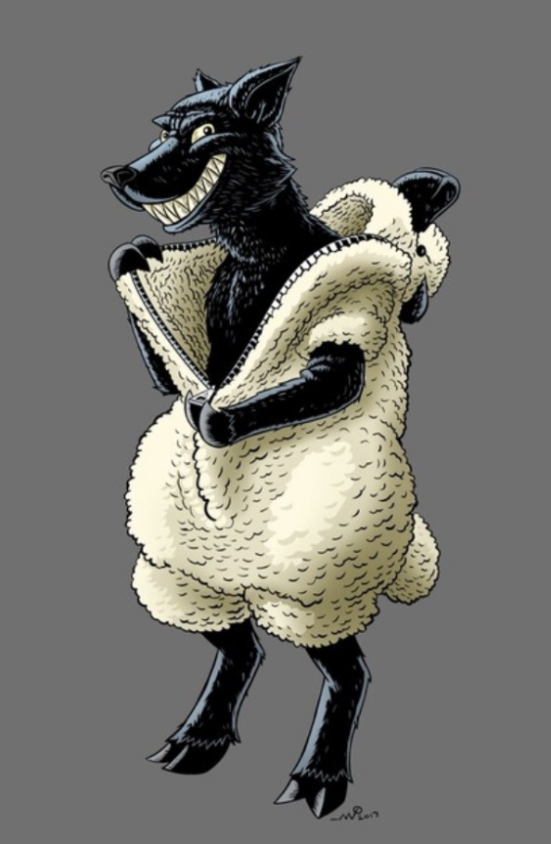
10 Question
Narcissistic Boss
Test

Slide 4
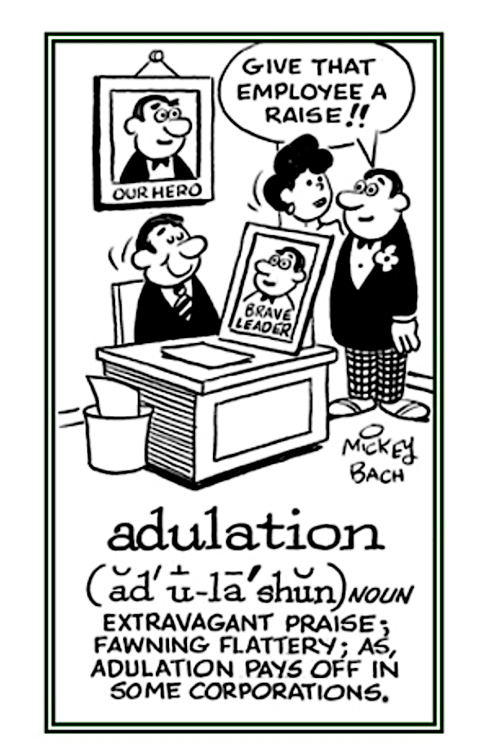
Overstate your experience and accomplishments?
Fantasize about power and fame?
Belief you are superior & deserving of special privileges?
Think that others rightly admire you?
Rarely consider other's perspectives to round-out thinking?
Source: Inc., Are you a Narcistic Leader, EGO in Check, Sept 2019
TM
Audeo Leadership Workshop

Slide 5

Take advantage of people through exaggeration & self-aggrandizement?
Are indifferent to what other's need or want?
Focus on maintaining power and control?
Think you’re can manipulate others because of superior intelligence?
Generally, feel superior to others?
Source: Inc., Are you a Narcistic Leader, EGO in Check, Sept 2019
TM
Audeo Leadership Workshop

Slide 6
Test scoring
> 2
Work on items for improvement
4 – 5
Seriously consider ego check
6 or >
Likely Narcissist
Source: Inc., Are you a Narcistic Leader, EGO in Check, Sept 2019
TM
Audeo Leadership Workshop

Slide 7
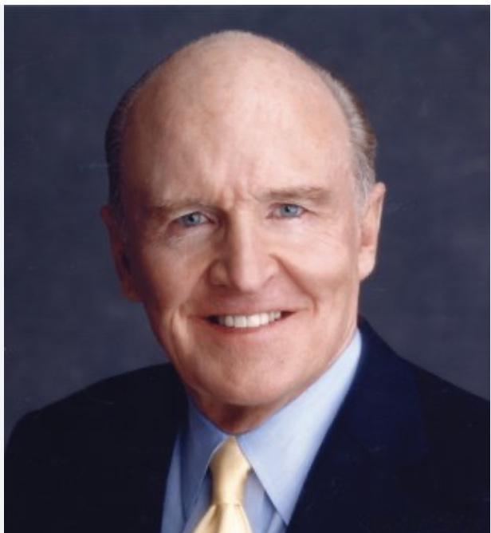
The good narcissist exec
Productive
Extremely useful
Audacity to push through
Transformational
Great Vision
Attempt to create future
Source: Inc., Are you a Narcistic Leader, EGO in Check, Sept 2019
Jack Welch
6 Sigma, SBU Management, #1 or #2 or out
TM
Audeo Leadership Workshop

Slide 8
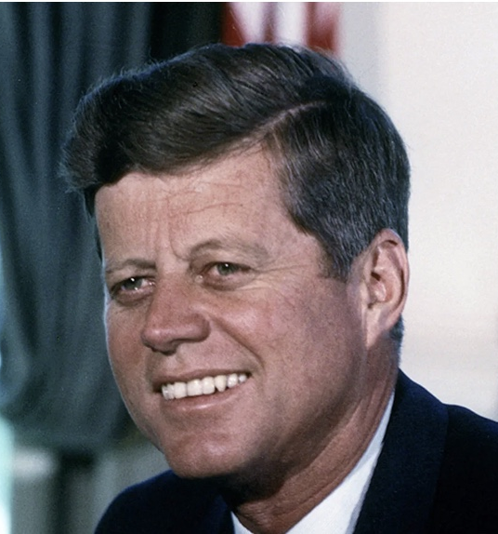

The good narcissist exec
Productive
Attract followers
Risk takers
Innovators
Skillful orators
Courage to act
Source: Harvard Business Review, Narcistic Leaders, Incredible Pro’s, Jan. 2004
JFK
We will go to the moon…
TM
Audeo Leadership Workshop

Slide 9

The good narcissist exec
Weaknesses
Selective listeners
Don’t teach
Dominate meetings
Dominate subordinates
Create pressure
Steve Jobs
Source: Harvard Business Review, Narcistic Leaders, Incredible Pro’s, Jan. 2004
TM
Audeo Leadership Workshop

Slide 10

The good narcissist exec
Weaknesses
Sensitive
to criticism
Intolerant of dissent
Street smarts
Vs.
empathy
Don’t learn from others
Narcissism increases with
success
Bill Gates
Source: Harvard Business Review, Narcistic Leaders, Incredible Pro’s, Jan. 2004
TM
Audeo Leadership Workshop

Slide 11
Best of times or Worst of times
More companies seeking narcistic leaders
No substitute for innovators
Anticipate future
Best of Times
Can Self
Destruct
Lead Company
Astray
Out of place in tranquil times
Worst of Times
Source: Harvard Business Review, Narcistic Leaders, Incredible Pro’s, Jan. 2004
TM
Audeo Leadership Workshop

Slide 12

Constantly talk about themselves
Fantasies of greatness
Require constant praise
Show sense of entitlement
Take advantage of others
Envious of others
Signs of narcissistic leader
Lack of empathy
Insecurities
Extremely
competitive
Hold long
grudges
Intolerant
of criticism
Can’t relax
On-the-go
Source: Choosing Therapy, 15 Signs you are dealing w/ Narcissistic Boss, May 2024

Slide 13

Shaming &
belittling
Disregard for
others
Manipulation
Gaslighting
Hidden
grandiose
superiority
Signs of covert
narcissistic leader
Self-depreciating
superiority
Emotional
inaccessible
Hyper-sensitivity
Low performance
reviews
Withholding
info
Source: Leaders, 8 Subtle Clues of a Covert Narcissist, May 2023

Slide 14

How to deal with narcissistic leaders
Be reminded of your value
Network yourself
Keep a paper trail
Remember who you are dealing with
Don’t share negatives
Source: Choosing Therapy, 15 Signs you are dealing w/ Narcissistic Boss, May 2024

Slide 15

How to deal with narcissistic leaders
Avoid questions on Mgt. approach
Set clear boundaries
Do not engage
Know when to escalate
Source: Choosing Therapy, 15 Signs you are dealing w/ Narcissistic Boss, May 2024

Slide 16

Impacts of narcissistic leaders
Employee disengagement
Micromanagement
Lack of trust
Undermine employee gain
Emotion or psychological damage
Impaired
decision-making
Low organizational performance
TM
Audeo Leadership Workshop
Source: LinkedIn

Slide 17
Avoid hiring the narcissist leader
“Too often, when boards select Executives, especially outside CEOs, through interviews.
But interviews play to the strength of a narcissist.
And you can’t just look at performance, because they can fake performance” — taking credit for others’ work and even falsifying results.
“What would really be far more illuminating would be to go talk to the people who’ve worked for them and with them in the past.
You have to get data from people who have seen that person operating.
But that typically isn’t what happens.”
Source: Standard Business, How Narcissistic Leaders Destroy From Within, April 2020
TM
Audeo Leadership Workshop

Slide 18
Spot a narcissist in job interview
Tendency
Left last job, Not appreciated for work
Disparaging talk about colleagues/ manager
Disrespect authority, dislike of policies
Ask about jealous coworkers / others promotions
Excessive self-praise, unrealistic boasting
Make unrealistic promises / can’t provide plan
Not actively listening/ redirects back to them
How to Spot
Need to be admired
Arrogance
Entitlement
Envy / Jealousy
Exploitation/ Manipulation
Grandiose Fantasies
Domineering Conversation
Source: Standard Business, How Narcissistic Leaders Destroy From Within, April 2020

Slide 19
How to deal with narcissist employee
Arguing with narcissists
Instead, validate any of their strong points, and move on.
Feeling you need to defend your approach
Keep your comments short & sweet. Less is more with narcissists. They’d rather hear themselves than you, anyway.
Trying to get them to accept responsibility
Point out possible negative consequences their approach may bring them, then let them choose.
Taking what they say personally
Recognize they are like this with everybody. This is simply how narcissists seek to get their needs met.

Slide 20
How to deal with narcissist employee
Responding to dramatics or ultimatums
Sidestep theatrics and return focus to the task at hand.
Taking the bait when they blame or criticize
Reassure them you are not against them, then go about your business.
Overlooking vagueness, failed agreements, or claim credit for your work.
Protect yourself document agreements & your work.
Recruit allies -don't face a narcissist alone.
Consider if working with a narcissist is best in the long run.
Source: Psychology Today, 4 Ways to Manage Work with Narcissist, June ‘22

Slide 21

Difficulty sleeping
Malaise of low moods
Self-doubt & low self-esteem
Episodes of work anxiety
When to seek professional help
Need
self
assurance
Source: Choosing Therapy, 15 Signs you are dealing w/ Narcissistic Boss, May 2024

Slide 22

Altruistic Leadership
Altruism, is synonymous with selflessness to a degree.
About putting the needs of others above your own without expectation of reward or gratitude.
In terms of servant leadership & organizational culture, altruism is the concern for the growth & development of the company
And without the added agenda of self-interest.
Source: Contact Center Pipeline, Impact of Altruism on Servant Leadership, Feb 2020
Altruism is about selflessness, but not always self-sacrifice
Notes:
Servant Leadership is not only about management style, but it is also an ideology dedicated to the development of an altruistic culture with a focus on organizational success. The idea is that, as employees experience managers who are compassionate and involved in employee development and corporate growth and excellence, those principles will rub off and develop future leaders and further success.
Altruism is about selflessness, but not always self-sacrifice

Slide 23

Altruistic leaders
Desire to serve a greater goal
Drive to help others succeed
Compassion and empathy
Not motivated by external or intrinsic reward
Source: The Predictive Index, Everything You Need to Know About an Altruist
TM
Audeo Leadership Workshop

Slide 24
Altruistic leaders
Leading cautions
Leading strengths
May struggle with delegating
Struggle going against existing processes
Slow to make decisions that impact team
Proactive
Collaborative
Organized
Development of others
TM
Audeo Leadership Workshop

Slide 25

Are you an altruistic leader
Passionate about helping others achieve fulfillment in life?
Do I delight in the success of others?
Do I measure my value in life by those I help along the way?
Have I made someone’s life better today?
Source: Forbes, A Company That Demonstrates Power of Altruistic leadership, July 2016

Slide 26
Servant Leadership is a form of
Altruism
Many leaders practice Servant Leadership
Servant Leadership & Altruistic leadership differ
Altruism would suggest everything is for others
Business have goals that often cannot align fully with altruism
That’s not bad, just not pure altruism
Business Leaders - Truly Altruistic?
Source: Penn State Leadership, Is Altruistic Leadership Possible?, May 2019
Servant Leadership is centered around Altruism

Slide 27
Are any leaders - truly altruistic?
Catholic ethics reconciles self-love and benevolence by subordinating both to the supreme purpose of creation and the providential ends of the Creator.
It teaches that acts of self-love may have a moral quality; that sacrifice of self for the good of others, may sometimes be a duty, and when not a duty, may oftentimes be an act of virtue.
Source: Catholic Answers, Altruism Defined
Notes:
So what is the “happy medium.” ? I think its to understand that altruism is not possible in most of our environments of work. We have to remember that our followers are essential for reaching our goals and objectives. Our followers deserve a leader that is in tune with their feelings, growth and professional/personal wellbeing with the understanding that there are goals in place that need to be addressed and the organizational well being depends on those goals.
Northouse (2016) makes a good point when talking about the strengths of servant leadership when he said that servant leadership is centralized around altruism. I agree that it is “centered” around altruism, putting followers needs first, is altruistic in nature and I think it is essential but, we have to ask ourselves why are catering to our followers? Because we want them to complete a goal. The personal aspect of altruism as it relates to the follower is essential, but we cannot say that its overall goal is altruism.
To conclude, altruism, in my opinion, is not feasible in most contexts of life including work and leadership but, if there were one style that was closest to the ideal of altruism it would be the servant leadership style.

Slide 28
Any Leaders - Truly Altruistic?
Love, therefore, whether of oneself or of others is in its last analysis love of GOD, by partaking of Whose perfections we become lovable.
The Catholic teaching on love of others is summed up in the precept of Christ: Love thy neighbor as thyself. The love due to oneself is the exemplar of the love due to others, though not the measure of it.
Source: Catholic Answers, Altruism Defined
Notes:
So what is the “happy medium.” ? I think its to understand that altruism is not possible in most of our environments of work. We have to remember that our followers are essential for reaching our goals and objectives. Our followers deserve a leader that is in tune with their feelings, growth and professional/personal wellbeing with the understanding that there are goals in place that need to be addressed and the organizational well being depends on those goals.
a good point when talking about the strengths of servant leadership is that servant leadership is centralized around altruism. I agree that it is “centered” around altruism, putting followers needs first, is altruistic in nature and I think it is essential but, we have to ask ourselves why are catering to our followers? Because we want them to complete a goal. The personal aspect of altruism as it relates to the follower is essential, but we cannot say that its overall goal is altruism.
To conclude, altruism, in my opinion, is not feasible in most contexts of life including work and leadership but, if there were one style that was closest to the ideal of altruism it would be the servant leadership style.

Slide 29
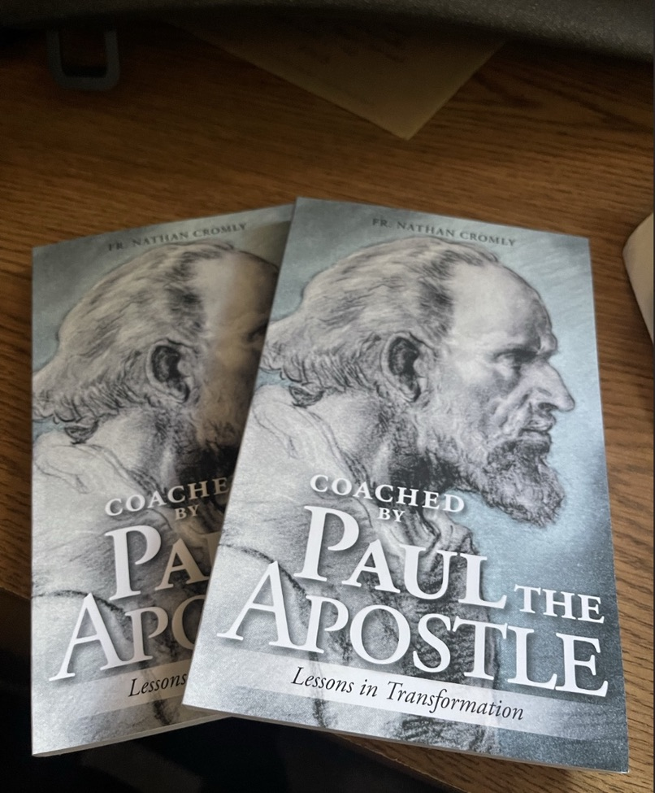

August Release:
Father Nathan Cromly
Coached by Paul the Apostle
Lessons in Transformation
Notes:
SO I will end where we started… and that is that coaches and mentors are invaluable in the lessons they can teach….I was planning on saving this to the end of the discussion today, but I think it is worth noting early here that Coaching is important to all parts of our lives. Father Nathan as many of you know just published his first book… and the title is appropriate to todays discussion on Coaching and mentoring.. The book is Coached by Saint Paul, lessons ion transformation and in general follows Fathers audeo methodology of leadership…..with St Paul as the Coach…. We can learn many great coaching lessons from historically great coaches and in this case saints…. But in todays business world we generally think of a coach as a supervisor a manager, an executive, owner or sometimes someone external to our business but that has great experience and insight…. Someone that we can activelyy connect with to guide us to greater success and productivity.

