Slide 1
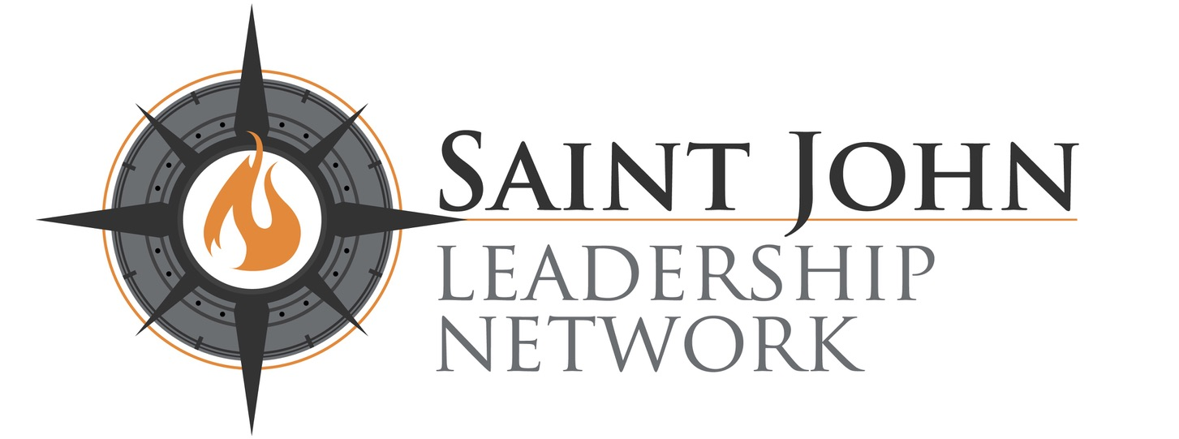
Friday May 24, 2024
Our MS TEAMS Meeting will start shortly … 9:00 AM CENTRAL

Slide 2
The Rise of Statism Statism, business regulation and democratic freedom
May. ‘24 v. 037
Notes:
Good morning and welcome. ….Today we are going to discuss a topic that has been in the news and a concern for many in both their personal and professional business life. ……And that is statism or the growth in government …and government control of many things in our lives. ….This is a business discussion… discussing the rise of regulation of almost all things especially our businesses…..but also has many implications to our freedoms and the path of democracy…. It will feel like a political discussion, ….but is a discussion founded in the reality of our times…. The business impact of Growing big government and increasing state control. ….. Let me say up front that I will not present a solution necessarily for the growth of statism and big government, …..but this discussion today is about creating an awareness for you….. of a accelerating change that will impact your business , ….so that you can consider and plan for the potential impact to your business

Slide 3
“The natural progress of things is for liberty to yield and government to gain ground.”
Thomas Jefferson
Notes:
Surprising one of the greatest defenders of state and individual rights said this …. The natural progress of things is for liberty to yield …..and government to gain ground.
……clearly Thomas Jefferson recognized the nature of government and power … and so now over almost 250 years later …..we are living in country that has seen wildly tremendous expansion of our federal government ……and its impact to our business and personal lives.

Slide 4
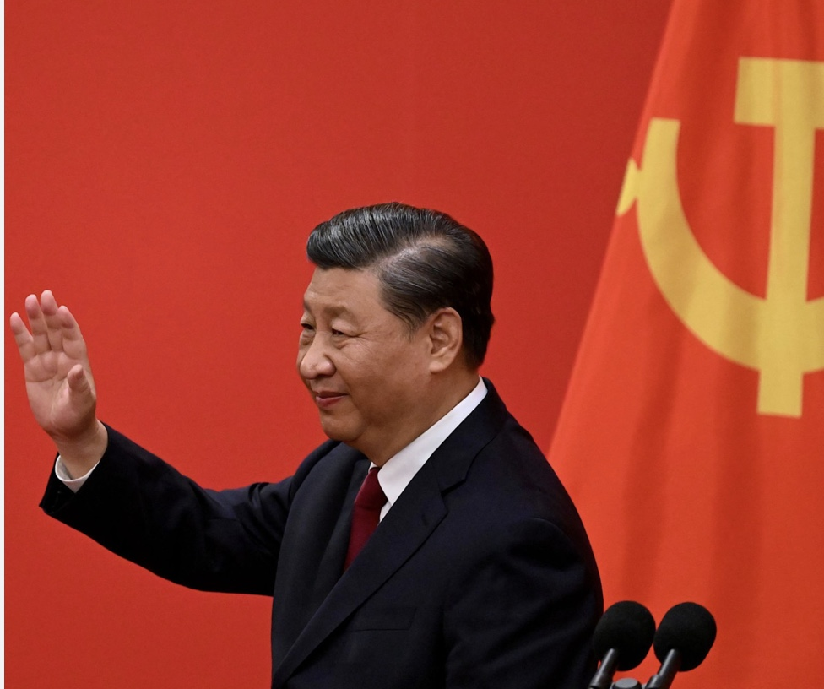
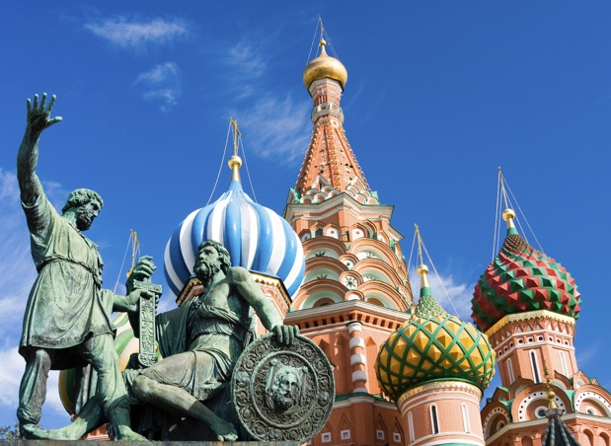
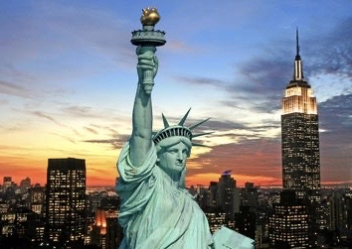
statism
Noun
the principle or policy of concentrating extensive economic, political, and related controls in the state at the cost of individual liberty.
2. support of or belief in the sovereignty of a state, usually a republic.
Synonyms: Big Government, Socialism, Authoritarianism, Communism,
Notes:
The biggest fear of many in this country ……that was founded on the ideals of freedom of the individual and freedom …from oppressive government…. is the growth of statism. ….Pure statism by definition is …. The principle of policy of concentrating extensive economic political …and related controls in the state ( or country) ….at the cost of individual liberty. … synonyms also associated with the term statism are ….BIG Government, ….Socialism, ….Authoritarianism, ….and Communism……..

Slide 5
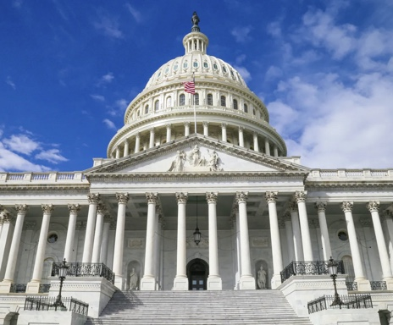
State Interventionism
Market economies with large amounts of government intervention, regulation or influence over markets.
Market economies feature high degrees of intervention are sometimes referred to as “mixed economies”.
Economic Interventionism asserts that the state has a legitimate or necessary role within the framework of a capitalist economy by:
Intervening in markets
Regulating against private sector overreaches
Subsidizing goods or services not adequately produced by markets
Notes:
Others would use the term State interventionism…. Which can be applied to government like China or Russia, but also to the US. ……The term statism also refers to market economies with large amounts of government intervention, ….regulation or influence over markets…. Most believe this applies to the US. …..These type of economies are often referred also to as ….Mixed economies,… free market and state interventions. ……Economic interventionism or statis if you wish , asserts the state has a legitimate role necessary ….in a capitalist economy for intervening in markets, ….against private sector overreach ….and in subsidizing goods or services not adequately produced by markets…..Again ……most would agree we live in a country of state interventionism and that it is growing, ……The question is it growing too much ….and is that hurting our economy ……and imposing undue hardship on business and citizens?

Slide 6
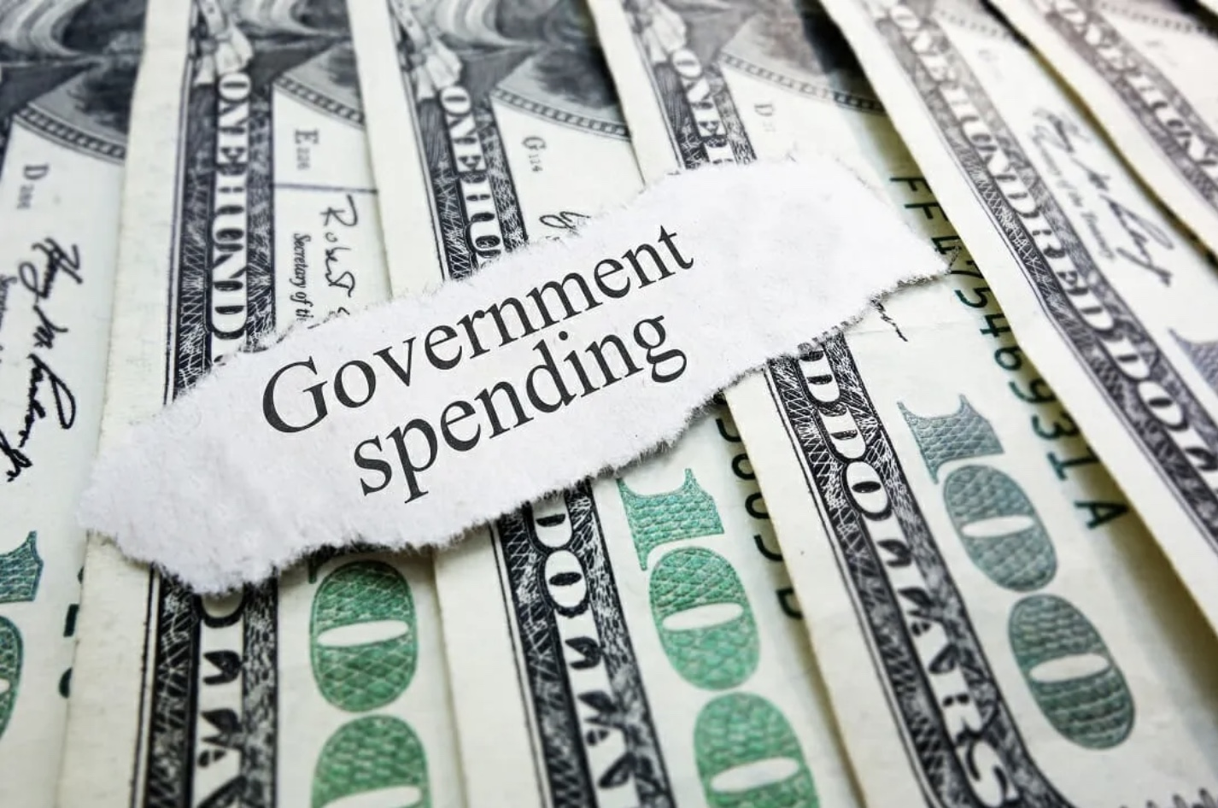
The Statism / Big Government Challenge
All governments at all times and places love to spend and accumulate power unto themselves.
Economists have always pointed out the costs of such interventions.
Debts must be paid eventually, through inflation or taxes, diverting wealth from the productive private sector, to the public sector where wasted to build up bureaucracies.
It is No solution to print more money, which reduces the value of currency, punishes investors in society, rewarding debtors & financial insiders.
Notes:
Here is the challenge ….and something truly difficult to balance, …..when is too much government intervention not healthy ….or produces a unwanted loss of freedom… business and personal. ……We should remind ourselves all governments at all times love to spend and accumulate power ……it is the natural order of things… and economist are always quick to point out …..that often there are high cost to the interventions in terms of taxes …and loss of freedom, …..but once created debts must be paid either through inflation …which we have seen as a result of government spending over the last three years ….which usually diverts wealth for the private sector to the public sector ……..and to building up additional bureaucracies. .. You can print more money of course, …..but that just devalues currency and punishes society at large….

Slide 7

New York Times: Drifting to Statism
2,500+ industrial policies were introduced last year, 3x the number in 2019
Economists warn top-down economic interventions could slow
worldwide growth
Faith in the superiority of free-market policies shaken in recent years by
a string of global jolts:
the pandemic, supply chain meltdowns, soaring inflation and interest rates, Russia’s invasion of Ukraine, and rising tensions between the United States and China.
Only three nations – Israel, South Korea, and Taiwan – improved their economic freedom scores between 2000 and 2021. Every other country declined.
The United States suffered the biggest decline, dropping from 8.84 to 8.14.
Source: The Drift to Statism in the Western World
April 19, 2024 by Dan Mitchell
Notes:
A report last month from the new York times …focused on the current drift in the the western world to additional statism.. 2500 new industrial policies impacting businesses…. 3X the amount created in 2019.. This is a western world event with most of the richest and most advanced economies ……are implementing these new regulatory policies…. Economist again warn of the impact of these overwhelming numbers of top down government interventions …..likelihood of slowing growth of economies and place hardship on businesses. ….. There is no question that free market ( capitalism )has been jolted in recent years by ….the pandemic, supply chain meltdowns soaring inflation and the Ukraine war… even so only three countries show an improvement in the economic freedom scores in 2021… every other country showed a decline in economic freedom scores. ……….Maybe or may not surprising is that the united sates showed …..the biggest declines in economic freedoms for al countries….. A 8.5% loss in economic freedom.

Slide 8
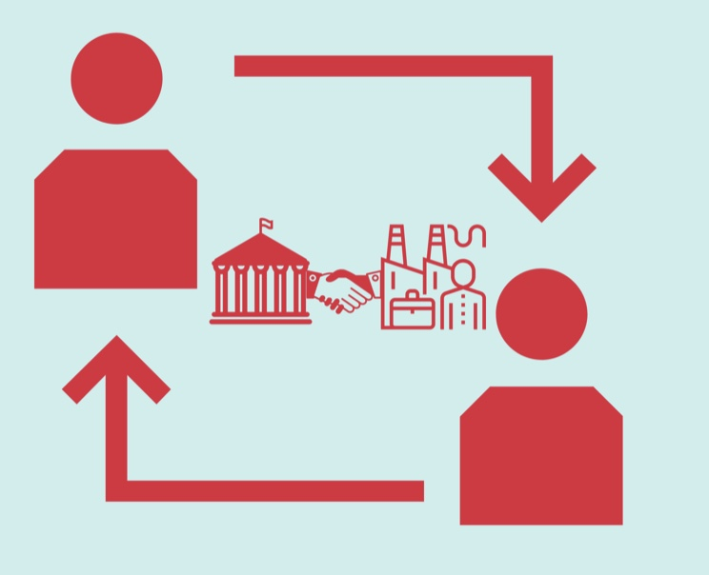
The Direction of Statism and State Capitalism
Source: Investopedia, Gov’t Regulations, Do They Help Business, April 10 , 2024
As technological breakthroughs continue, the dual nature of the government's relationship to businesses may increase, becoming both more regulatory and more collaborative at the same time.
Notes:
So if you feel the world is sliding into an increased statism you would be correct… and as technologies develop in general …….you can expect that you business relationship with the government will become …..more regulatory and io some degree more collaborative… government will most likely find a need to collaborate with big business, ……but with that comes compromise and a loss of freedom for big business…. The fallout may be that small businesses …..will be more challenged to be able to meet all regulations ……unable to participate or afford supporting the cost the regulations …. ……The trend therefore will be more pressure on small business ….and likely fewer small businesses will survive

Slide 9
Statism Capitalism and Intervention
The “model” state capitalist is China.
The economy has grown at a stellar pace, a big reason why is the role of the government.
The state has also aided the country’s rapid advance into global manufacturing.
Bureaucratic meddling in the financial system and government control of the value of the yuan – is creating an economy with:
Rising levels of debt,
excessive investment,
even more excessive external surpluses,
and a potential banking crisis.
Anyone who believes in state capitalism should take a visit to Russia,
many negatives are apparent
Notes:
Today and much in the news… as we have increased tensions with China.. The “model” state capitalist is China. …..hTeir economy continues to grow at a stellar pace, and a big reason why is the role of the government…….. Over the long term, the support of the state has also aided the country’s rapid advance into global manufacturing. …….But state intervention is having a clear downside as well. …..Too heavy a state hand – through, for example, bureaucratic meddling in the financial system …..and government control of the value of the yuan – ……..is creating an economy with serious distortions, ……including rising levels of debt, excessive investment, …….even more excessive external surpluses, ……and a potential banking crisis. ……But most of all, ….anyone who believes in state capitalism ……should take a visit to Russia ….and see first hand the apparent negatives of heavy statism… and control of most all business and personal activities.

Slide 10
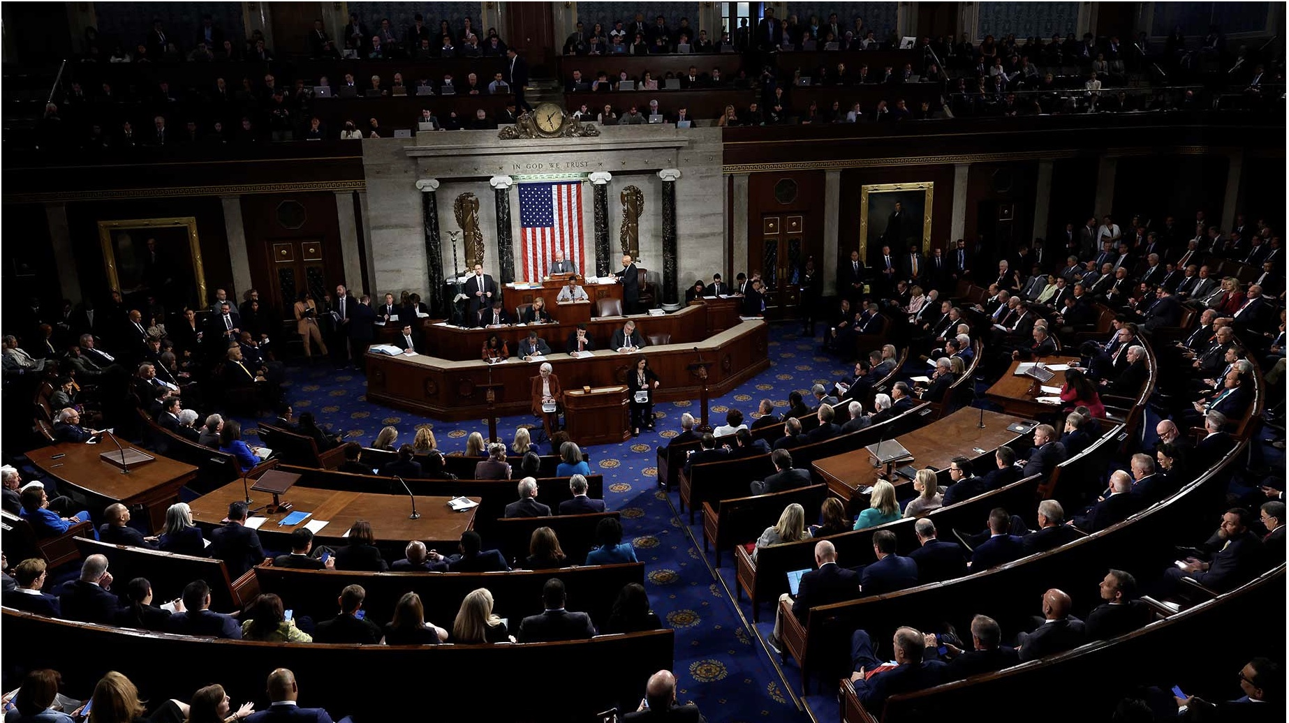
Americans’ baseline assumption:
Federal government overstepping its bounds by doing too many things that should be left to individuals & businesses and it has too much power. Americans have held position in most years since 2008.
Source: GALLUP, Gov’t Doing Too Much, Too Powerful
Notes:
Recent US Gallup surveys says… Americans baseline assumption is that the federal government is overstepping its bounds …….by doing to may things that should be left to individuals or state and local government. ……This is not new and has been the general consensus since 2008.

Slide 11
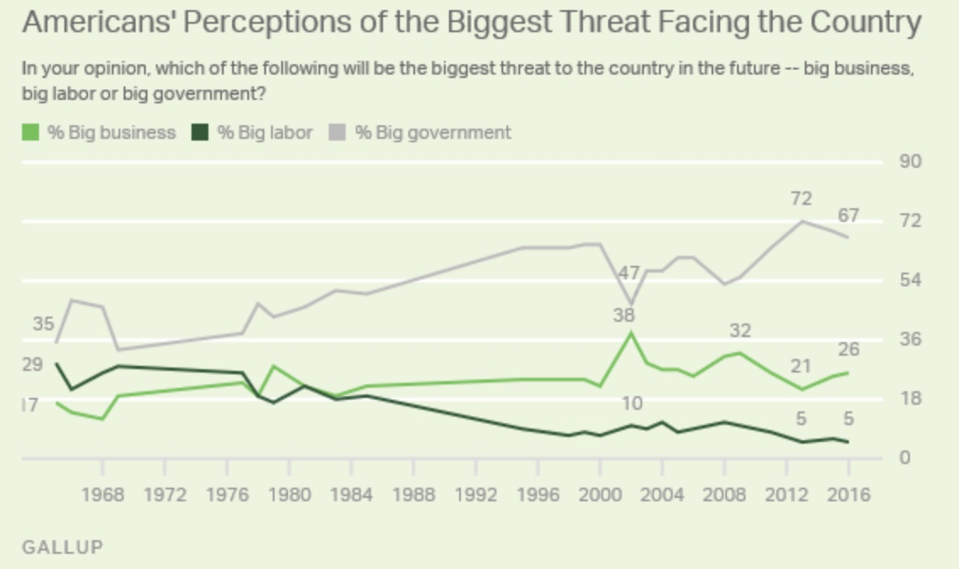
Notes:
The perception is growing that one of the biggest threats facing our country is…. the growing trend to bigger and bigger government. ……Not to understate there is also a concern over grow of big business and also big labor, …….but the concerns are far larger regarding the expanding role of government…. So you are not alone if you also have this concern and sense that government ……..is increasingly engaged in our business and lives. …….That influence is sometimes welcome and we do need standards across states foe things like transportation like air travel, food quality, etc…., ….but more often than not …..an unwelcome influence in areas of business and living ….that is unwanted and many feel unnecessary …….and not the role we want from our federal government.

Slide 12
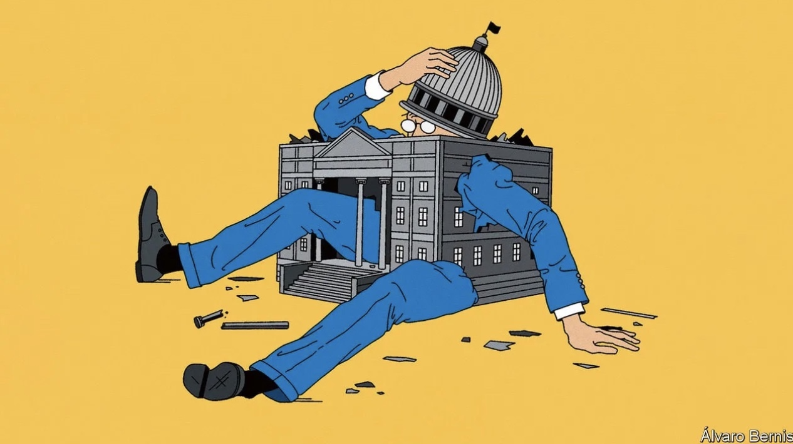
The world is entering a new era of big government
Threats of Big State:
Big bureaucracy
Institutional failure
Corruption
Result:
Threats become routine making people poorer and limiting individual freedom.
Increasing Debt to GDP:
80% world committed to Net Zero emissions
Global ageing Populations
Result:
Increases states economic footprint & intervention
Source, The Economist, The world is entering a new era of big government, Nov. 2021
Notes:
To some degree….. as our world becomes more complex ….we will need to accept that we are in a new era of bigger government…. And it is the whole western world that is experiencing this growth.. ….There is a definite trend to increasing debt tp GDP ratio….. ……Debt continues to be a larger percent of national GDP… that A couple of things driving this…… is that 80% of the western world countries are now committed to net zero emission to address climate change …..and the global ageing population that places more demands on governments ….and cost to care for the aging populations… ……That naturally increases the economic footprint of the state….the downside and what we see as a threat …….is the resulting growth of big government and often inefficient bureaucracy, ….institutional failure ….and growth in government corruption…. The result is these threats tend to …..make people poorer ( as governments increase taxation direct or indirectly, …..and limits individual freedoms.

Slide 13
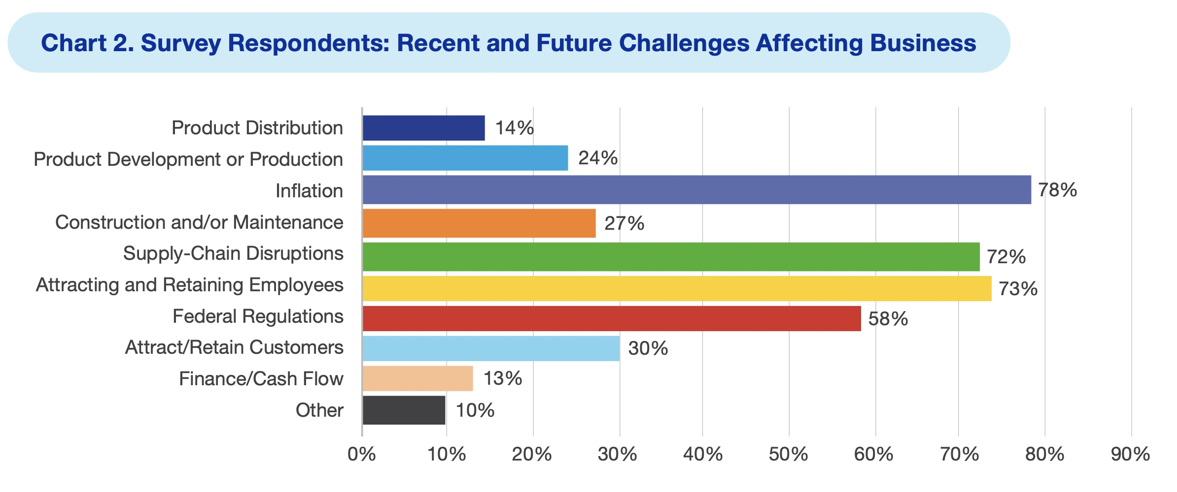
National Assoc. of Manufacturers
Cost of Fed Gov’t Regulation, US Economy,
Manufacturing and Business
Source Nat’l Assoc of Manufacturers Report Oct, 2023
Notes:
More specifically for business leaders, a 2023 survey identified that 58% of surveyed business leaders identified ….growth and cost of growing federal regulations a major challenge affecting the the future of their business …and the economy, ……this concern is especially true for manufacturing business.

Slide 14
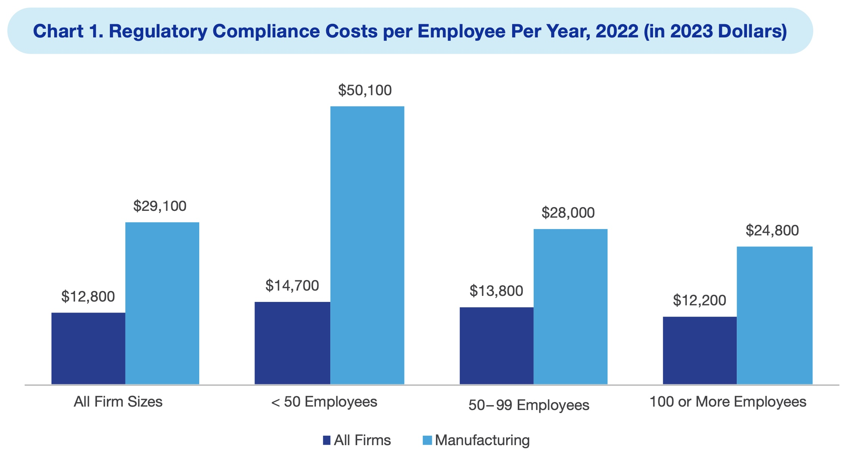
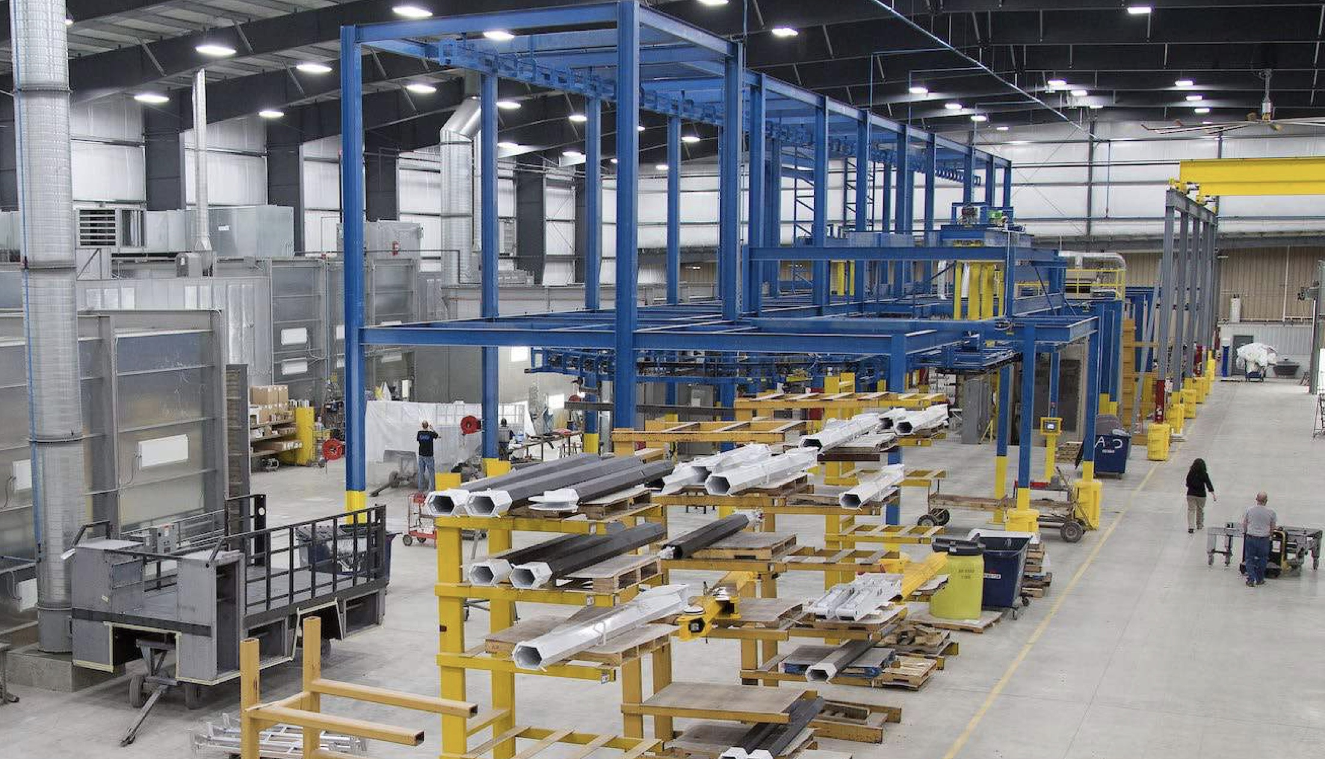
National Assoc. of Manufacturers
Cost of Fed Gov’t Regulation, US Economy,
Manufacturing and Business
Source Nat’l Assoc of Manufacturers Report Oct, 2023
Notes:
The concern is of course an outgrowth …..of the very real business implications of increased cost and competitiveness. ……Complying with government regulations are expensive…. and although we would all support many of the regulations for safety and transparency reasons, …..not all are welcome and questioned by many… the cost is disproportionately expensive for small businesses …..that cannot spread the cost across a wide employee base.. ..Therefore big business gains a somewhat competitive if still unwanted advantage ….and benefits …and small businesses are disadvantaged by the inability to spread regulation cost. ……The cost in 2023 of meeting federal regulations is $29k on avg for all manufacturing firms, .. 424K for large firms over 10 employees and a whopping $50,100 per employee for small manufacturing firms… this indirectly is a loss of freedom…… The freedom to create own and operate your own small business…. This is a real concern ….and if the regulations and bureaucracy continues to grow… we will have fewer small business, …more big business, ….less choice , …reduced competition and less freedom.

Slide 15
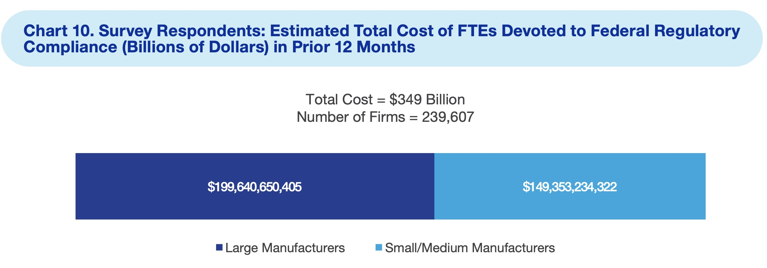
National Assoc. of Manufacturers
Cost of Fed Gov’t Regulation, US Economy,
Manufacturing and Business
Source Nat’l Assoc of Manufacturers Report Oct, 2023
Notes:
Just in manufacturing industries alone …… the cost of regulation compliance is $349 billion dollars annually. …….The challenge for the US economy is how much regulation and cost can business assume……. before we are no longer globally competitive ….and a greater number of businesses small and large fail….

Slide 16
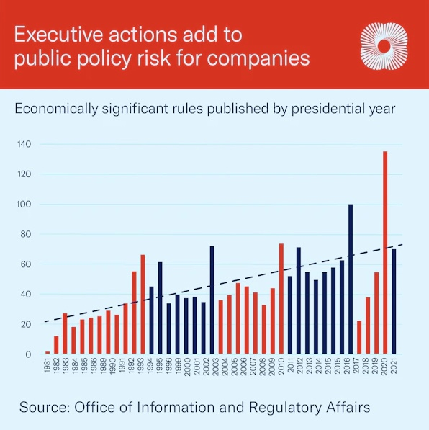
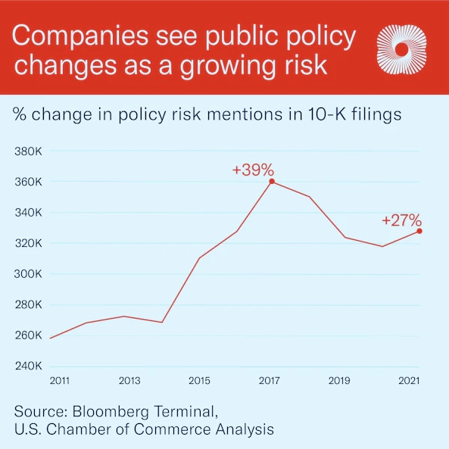
One way to measure the growing regulatory risk attached to executive action is by looking at the number of economically significant rules issued each year. Economically significant rules are those estimated to have an annual impact on the economy of $100 million or more or that adversely affect the economy or a sector of the economy materially.
Source: US Chamber of Commerce,
Public Policy Risk Soars ,
April 11, 2023
Notes:
Another way to look at the grow in statism and big government….. is the number of economically significant regulations created each year…… that create a cost to business of over $100 million annually…. As you can see that number continues to rise sharply… ……..also you can look at companies 10K filings and see how businesses identify formally the risk of growing regulation ……as a major business concern ….that number has dramatically increased since 2011. …….all this to demonstrate this is not just a feeling but real impact to business…..and that statism in the US is having a material affect on business operations

Slide 17
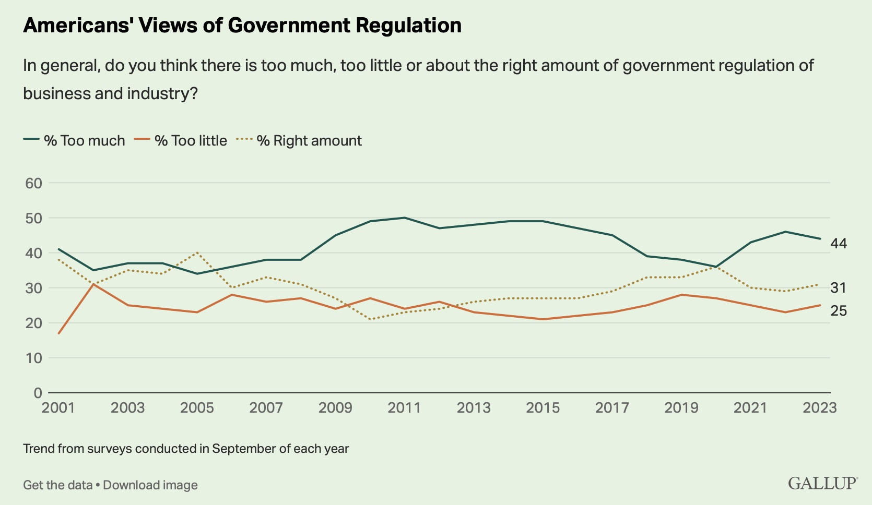
Source: GALLUP, Gov’t Doing Too Much, Too Powerful
Notes:
In general…. 44% of Americans identify for business concerns the federal government is imposing too much regulation on business.

Slide 18
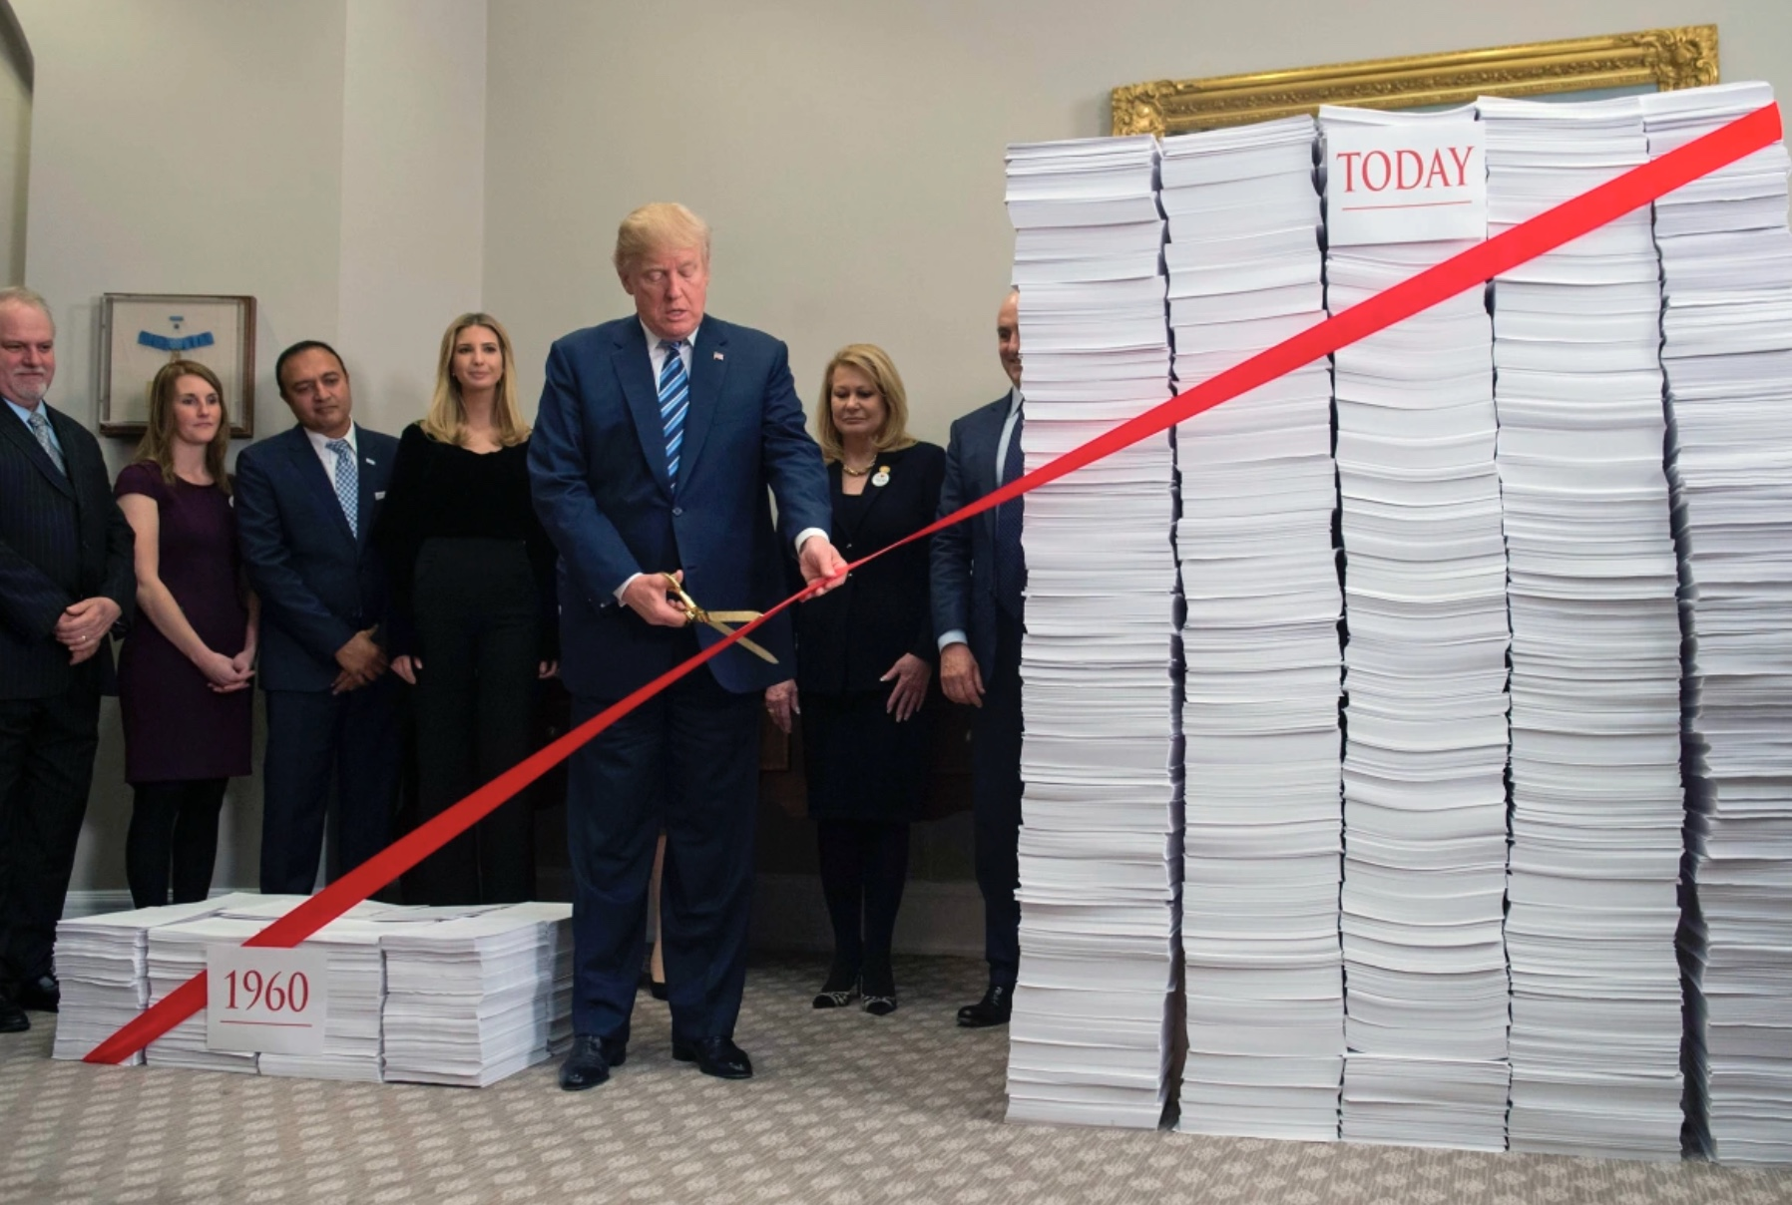

Federal Regulatory Blitz: Jeopardized America’s Economy
The most notorious cost of regulation is the paperwork, sometimes known as ‘red tape.’
The executive branch alone issues thousands of new regulations each year that add to the 200,000 pages of federal rules already in place.
The rules finalized by the current administration through 2022 impose costs of $10,000 per household
$1,300 more than the Obama Administration rules during the comparable timeframe.
RED Tape
Source: Committee Gov’t Oversight, June 14, 2023
Notes:
Additional proof is the number of regulatory pages or new regulations we must all comply with in some way……… Over 200K pages now in place at a cost of $10K annually per household . ……Most refer to this a government bureaucratic red tape.

Slide 19
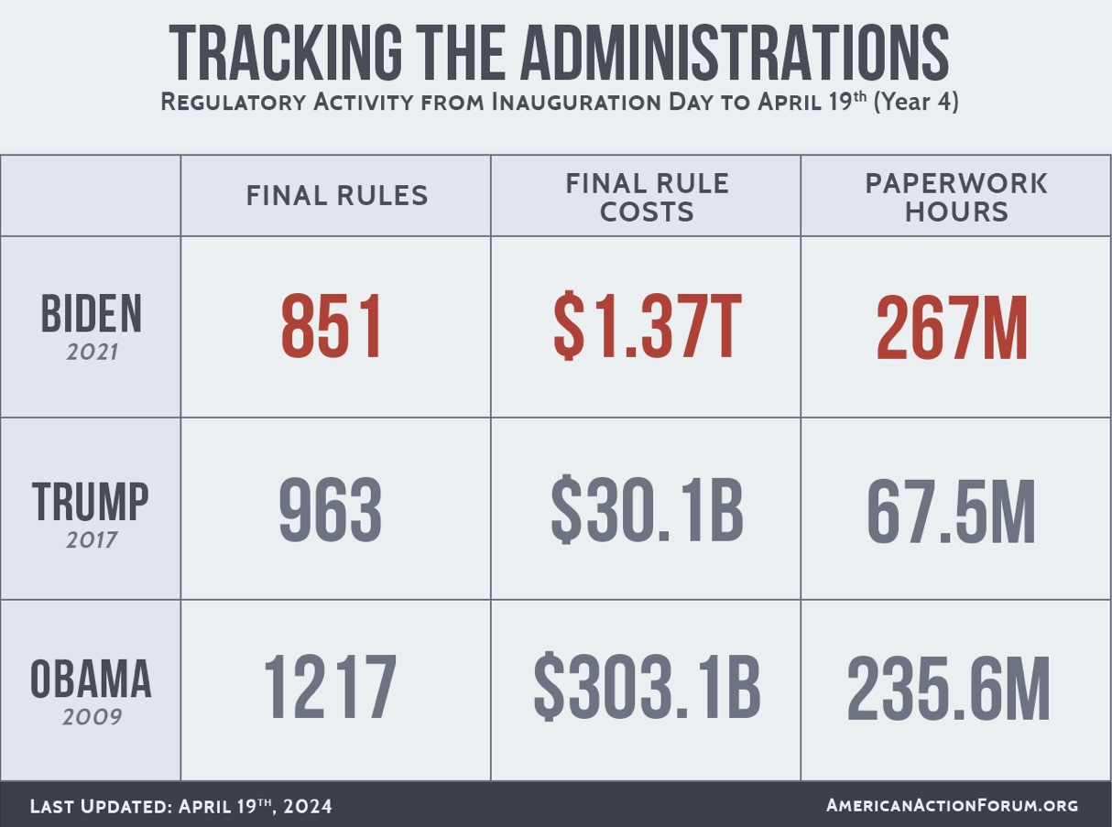
Government Regulatory Blitz: Jeopardized America’s Economy
The U.S. federal government is now issuing more rules at a higher price tag and a faster clip than ever before.
2021
Source: Committee Gov’t Oversight, June 14, 2023
2017
2009
Notes:
All of this can be a significant threat to business and our economy... The trend in new federal govt regulations is expanding at an accelerating pace.. …..You can see here the growth in various federal administration year of the increases… from $300 billion in 2009 ….to over $1.3 trillion new regulatory activity in 2021.

Slide 20
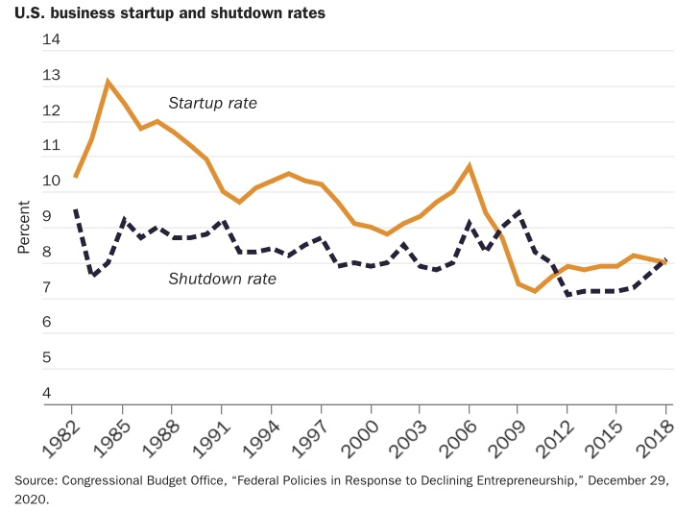
Source: Cato Institute: Entrepreneurs and Regulations, May 2021
Steady Decline in Small Business Start-ups
Notes:
Regulations often harm startups more than large and established businesses….. in at least three ways: ….disproportionate cost burdens, ….economies of scale in compliance, ….and entry barriers…….The drop in new business startups …is concerning for the health of overall economy, …..too much federal regulation is a barrier to small business startups ……and in heavily regulated industries the number of new startups is disproportionately low. ……New and especially small business start ups are good for the economy ……They revitalize communities, create jobs, sometime grow to be major businesses, ……and bring new innovation and competition. ….Over government regulation creating startup barriers stifle small business ….and place more power in the hands of big business. …….This would suggest regulation activities should allow for more subsidiarity….. or regulation should move closer to those impacted to state , county and local levels…. Allowing those most impacted by regulations….. to decide if they are needed, beneficial and affordable.

Slide 21

Corporations say they have a new No. 1 risk, and they’re spending big to defeat it
Fears about government regulation spiked sharply this year
Now the No. 1 threat to business, according to CFO’s surveyed by CNBC.
40% of CFOs say it’s their top concern
Biggest companies are spending big in response
Surge in lobbying among S&P 500 companies.
Source: CNBC: SEP 22 2023
Notes:
The other impact of all the new regulatory pressure brought on by increased statism … …….is a surge in lobbying… CNBC reported a major surge in lobbying in the past year… …….attempts to influence government regulation …..either to gain competitive advantage …..or eliminate the regulations hampering business growth

Slide 22
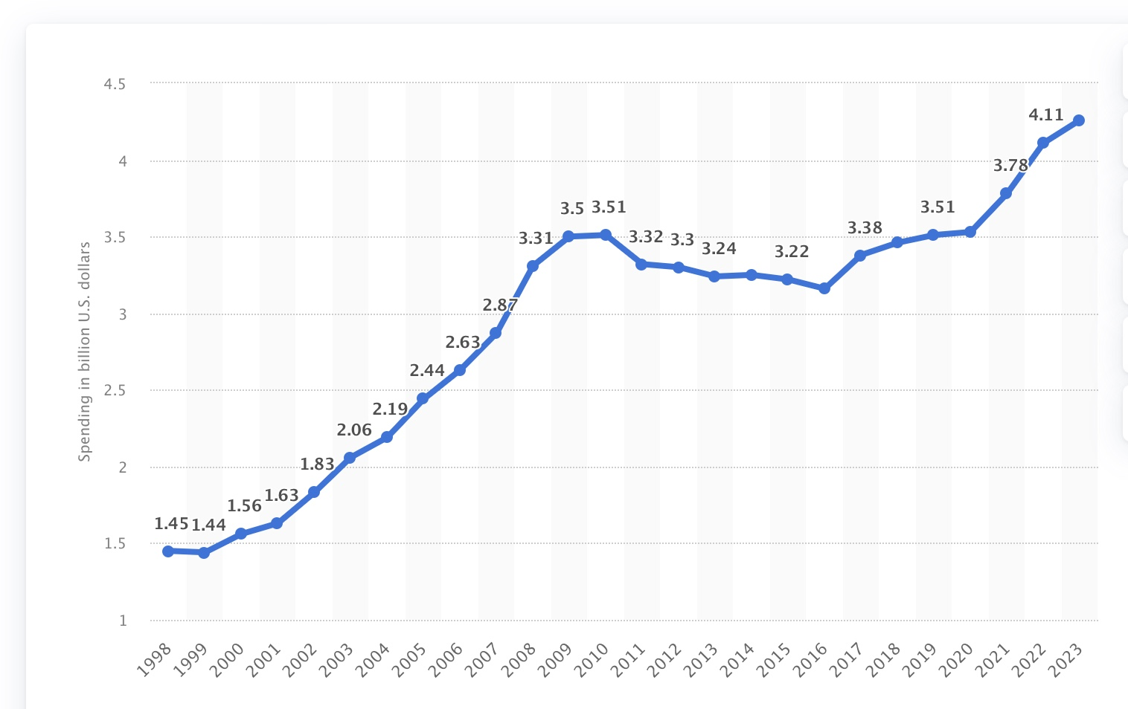
Total lobbying spending in the United States from 1998 to 2023 (in Billions)
Groups spent record $4.2 billion in 2023
Source: Statistica
Notes:
You can see just in the last 5 years …..the tremendous increase in lobbying dollars spent by groups… to influence government regulations and laws…..a record $4.2 billion lobbying dollars in 2023.

Slide 23
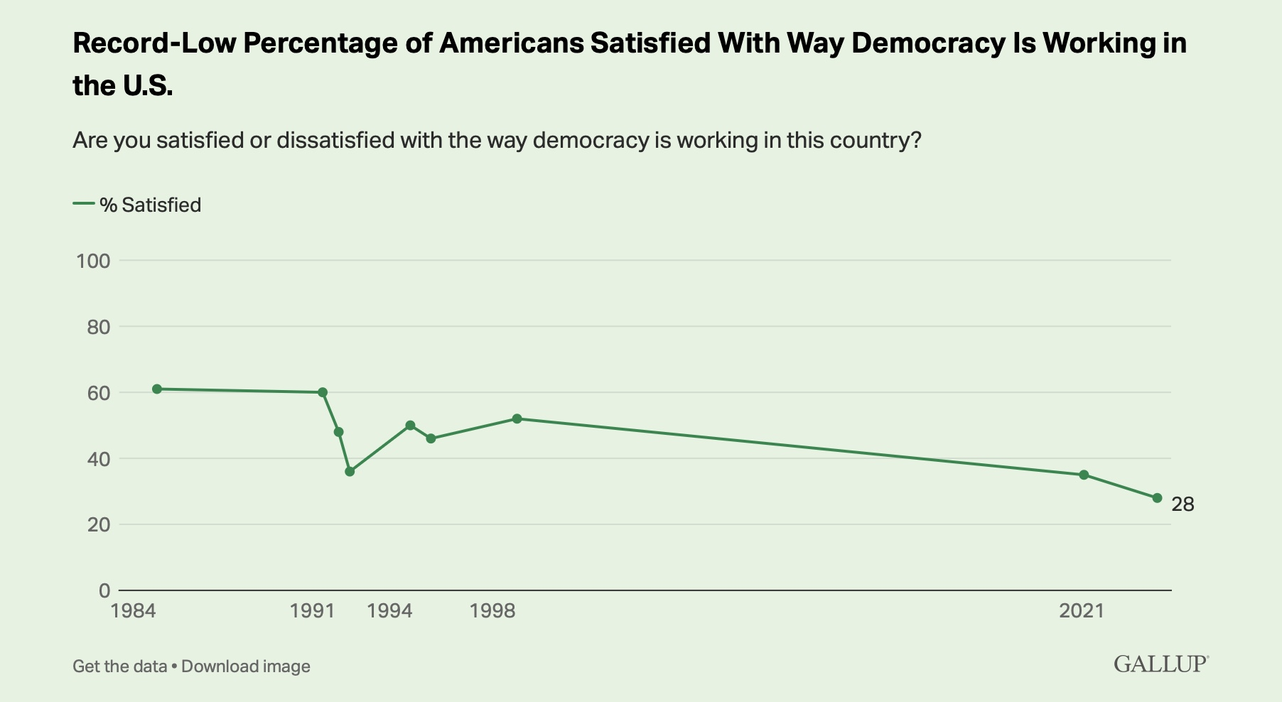

Source: Gallup: Record Low in U.S. Satisfied With Way Democracy Is Working. Jan 5 , 2024
Notes:
In Jan. of this year as a result of this sort of activity …….americans identified their satisfaction of democracy is in decline… down for 60% in 1984 to only 28% democracy satisfaction in 2024…. This suggest that we believe government is failing to represent the will of the people ……and I would suggest that as individualism grows….. as we become more divided in our views of satisfaction …..and and less focused on the common good…. A role that government should play… to support the common good.

Slide 24

How to measure State effectiveness
1. Uphold the Rule of Law:
Ensuring laws are applied equally and fairly.
2. Provide Public Services:
Efficiently providing necessary services to its citizens.
3. Protect the Rights of Individuals:
Safeguarding freedom, rights, and liberties.
4. Manage Resources and the Economy:
Effective economic policies and resource management.
5. Ensure National Security:
Protecting the nation’s sovereignty and citizen safety.
Source: Medium, Effective Federal Government, Dec 4, 2023
Notes:
How then would you measure government effectiveness.. ! We might ask is our government effectively without overstepping managing these 5 key roles…..Do they uphold the laws of the land ? ……..Is the state effectively and efficiently providing necessary services, ……are freedoms and liberties being safeguarded, …….are economic resources and policies well managed, ……and are we protecting our citizens.

Slide 25
How to measure State effectiveness
Characteristic
Definition
Strength - Relative influence over other stakeholders in the world.
Transparency - Degree openness in government communication & data availability.
Economic - Sound financial footing. Judgment of value delivered vs. cost of delivering.
Public Good - Products / services by the government to improve quality of life.
Social Good - Products / gov’t services promote social, procedural, & economic justice.
Notes:
Or ….. You might ask… regrading strength is
Strength. …..Does fed govt maintain. Relative influence over other stakeholders in the world.
…..On Transparency. …….Deliver a Degree of openness in government communication and data availability. ……On Economics. ……Provide for Soundness of financial footing. Judgment of whether the value delivered is worth the cost of delivering. …….On Public Goods. Are Products and services provided by the government to improve quality of life. ……And last…. do Social Goods. ….Products and services provided by the government to promote social, procedural, and economic justice.

Slide 26
Actions to Limit Government Increase individual freedoms
No New Bureaucracies
– maximize role of markets, drive individual choice
Nimble & Efficient State
– less bureaucracy, eliminate lackluster depts.
Impartial State
– Narrow interest, more transparent, ethos for true public service
Notes:
The prize is enormous. ….The difference between good government and bad ….will be measured not just in the rapid transition to net zero emmissions… and the provision of a sustainable safety-net for the old, ……but in a society that is fairer and a lot more prosperous. …In the 20th century …..classical liberals ensured that the growth of government accompanied the progress of humanity. ……The same might yet be true in the 21st. …..We might consider a movement to create ……no new bureaucracies providing for more individual choice, ……..eliminate non performing federal departments, ……and narrow the interest of federal govt… not continue the expansion into everything that was never meant to be …..an area of federal control or authority.. ….Returning more power to the state, …county, …local governments and directly to the individual… that increases freedom.. ….Eliminates unnecessary business cost and intrusion, …and can lead to a stronger economy ….and more global competitiveness.

Slide 27
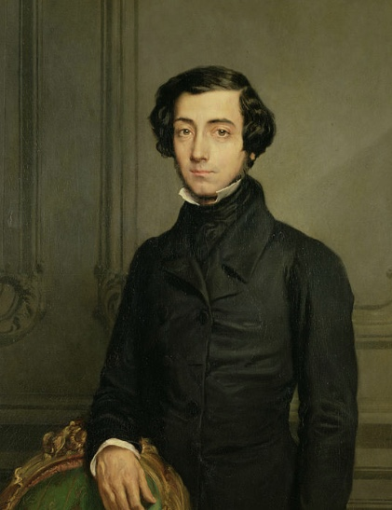
Dangers of Democracy
Alexis de Tocqueville (1831)
Peered into the fog of America’s future, he said:
“I do not fear that they will meet with tyrants in their rulers but rather with guardians.” A government led by such men, he said, “does not destroy, but it prevents existence; it does not tyrannize, but it compresses, enervates, extinguishes, and stupefies a people, till they are reduced to nothing better than a flock of timid and industrious animals, of which the government is the shepherd.”
Source: Hillsdale College: The opiate of the Elites, May 1997.
Notes:
America is a country …many of us are finding increasingly difficult to recognize.
…….for sure …Democracy is not at an end, but it is in the balance. …..Alexis de Tocqueville peered into the fog of America’s future in the late 18th century, …..he said: “I do not fear that they will meet with tyrants in their rulers ….but rather with guardians.” …..A government led by such men, …he said, …..“does not destroy, but it prevents existence; …..it does not tyrannize, ….but it compresses, enervates, extinguishes, and stupefies a people, ……till they are reduced to nothing better than a flock of timid and industrious animals, …..of which the government is the shepherd.”
……..We must remember that the true source of our security and our freedoms ….is not secular but spiritual. ……Until we recapture this truth, …..the relationship between the individual and the state ……will remain misshaped…… and we will continue to place the Golden Calf before the Golden Rule.

Slide 28
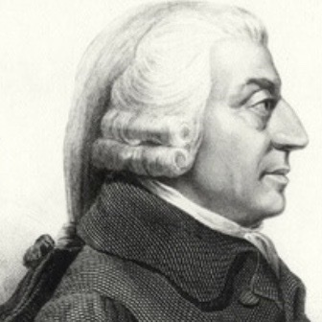
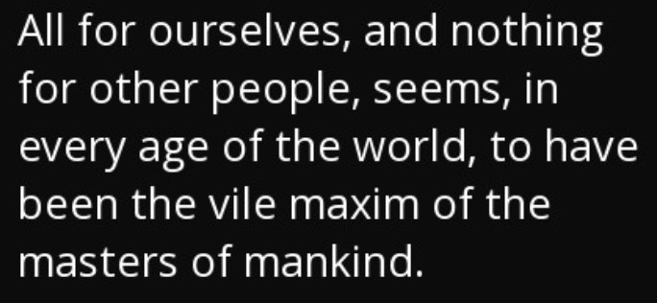
The Alternative Return to:
Structure that generated our industrial order needed for long-run survival
System that brought us industry, technology, and rapidly advancing prosperity
Without war, militarism, or stifling governmental bureaucracy
That system is laissez-faire capitalism
Adam Smith called “the natural system of liberty,” a system that rests on an ethic that encourages:
individual reason
purpose
and achievement.
Notes:
Ina very simple business terms ….as business leaders we may consider promoting a return to a more….. Adam Smith laissez faire capitalism….. without so much statist federal government intervention… give more freedom back to the markets… a natural system of liberty …. Based on individual reason, ..purpose and achievement….not government control….that purpose should and ….must include serving the common good

Slide 29
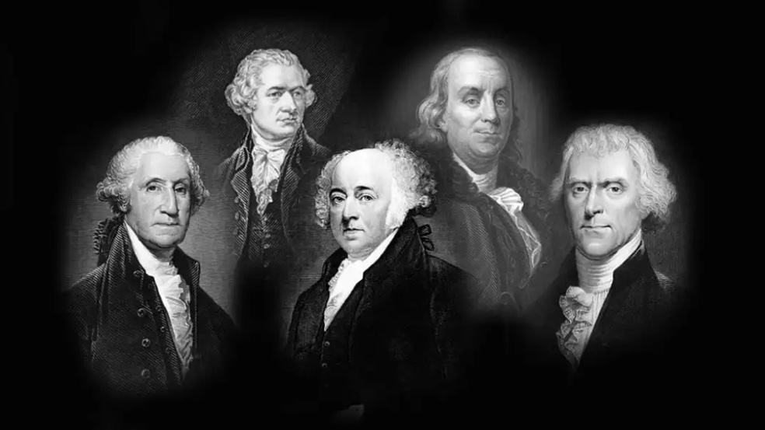
Revisit US Constitution
Amendment IX: “The enumeration in the Constitution, of certain rights, shall not be construed to deny or disparage others retained by the people.”
Amendment X: “The powers not delegated to the United States by the Constitution, nor prohibited by it to the states, are reserved to the states respectively, or to the people.”
Founding Fathers promoted Christian perspective
...Men ought to obey GOD, not man.
The Founding Fathers believed that rights of people and decision-making should be moved to or closer to the people impacted… heavily promoting States vs. Federal rule
Source: The United States of America, Peter Lillbach, April 2015
Notes:
The Founding fathers believed not in a divine-like state….But promoted a Christian perspective ... Men ought to obey GOD, not man. …..The bill of rights in Amendment IX: provides for , ….“The enumeration in the Constitution, of certain rights, shall not be construed to deny or disparage others retained by the people.” …..And in Amendment X: “The powers not delegated to the United States by the Constitution, …nor prohibited by it to the states, are reserved to the states respectively, or to the people.” …….The Founding Fathers believed that rights of people and decision-making should be moved closer to the people impacted… heavily promoting States vs. Federal rule. …..as we consider the growth in big government and of federal regulation laws ….and other potential encroachments that pose impact…. to individual and business freedoms ……., let us ne reminded the founding fathers did not want a extensive reliance on the federal governments wisdom, …..goodness or even competence, ….and that citizens should not expect the state to do ……what families, churches and local communities should do with communal decisions, …….setting moral standards and giving meaning to life. …….They did not propose the federal government …..should take control of our social authority or personal guidance.

Slide 30
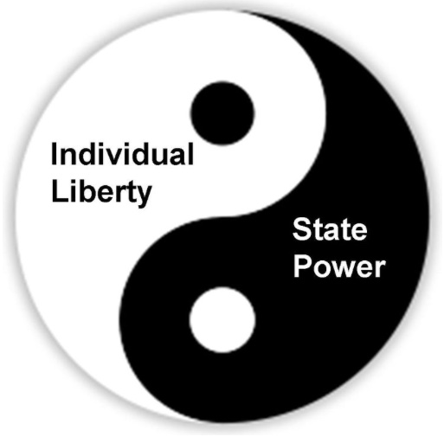
Individual Freedom Vs Common Good
Numerous federal regulations now protect individual freedoms, but often harm the common good and impose hardships and cost to business
Secular individualism frequently negates the common good
Duality should exist in individual rights and social common good
That requires an underlying standard of the common good
The common good requires an overflow of generous love
and a sometimes painful obedience to truth
Achieving the Common Good is hard work
Notes:
Federal regulations now often protect the individual as feedom at the expense of the common good….secular individualism can negate the common good, there should be a duality that balances individual rights and the social common good, that requires and underlying standard of the common good… and the common good requires a overflowing of generous love and sometimes a painful obedience to truth….. And the reason we often don’t take this path is achieving the common good is in deed very hard work… for us as business leaders and for

Slide 31
Response to Statism by Christian and Catholic Business Leaders?
Promote Catholic Social Doctrine
Affirm one’s personal responsibility family, business, community, state, etc..
Having responsibility is to have freedom
Rejecting responsibility is to reject freedom
Natural Law written in our hearts, C.S. Lewis... Caring for others, good done, and evil avoided
Observe subsidiarity – true democracy is a product of local institutions and self-reliance
The basic principle of true democracy is the sacredness of the individual endowed by GOD with inalienable rights
In US our constitutional belief is men endow the state with rights, Statism believes state endows men with rights, individual value only in supporting state
Source: C.S. Lewis on Mere Liberty and the Evils of Statism Review, Aug. 2011
Notes:
As Christian business leaders we can certainly start by applying catholic social doctrine to our own business operations, ….affirm our responsibility for ….family, business community and effect programs ….that truley serve the common good, …..replacing federal government’s need to control all aspects of our lives.. …Simply care for others, ….do good and avoid evil… ….promote subsidiarity in a true democracy sense …of moving decisions to the lowest level of govt and community, ……respect that democracy is based on the sacredness of the individual endowed with certain inalienable rights, …..and that our US constitution grounded in belief that men endow the state with rights, ….not the state endowing men with rights.

Slide 32
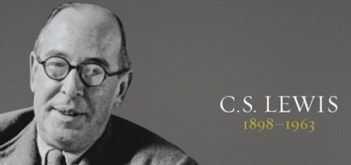
Response to Statism by Christian and Catholic Business Leaders?
Assume responsibility and assert GOD
The welfare state contradicts principle of solidarity, by state intervening directly and depriving society of it’s responsibility
Total Statism – is based in Humanism
Humanism, belief that man through his own capacities and powers is capable of perfection
Humanism denies the human mind need not faith and human power need not grace and therefore, denies GOD
Total Secular statism is by definition, Godless humanism
Source: C.S. Lewis on Mere Liberty and the Evils of Statism Review, Aug. 2011
Notes:
Furthermore…. it requires us to acknowledge increased statism marches us closer to a welfare state ……that will deprive our American society of its responsibilities and statism is based on humanism …a belief that man through his own capacities is capable of perfection…. Yet be reminded that humanism denies that man needs faith nor grace to achieve perfection… and therefore denies GOD and…. that secular statism becomes GODless humanism… this is the biggest fear that I believe is the source of the most angst and fear among most Christians and Christian business leaders ……when we consider rapidly growing statism in the US . …….That we will end up with a statism government …..that reduces our individual freedoms, ….moves us to a welfare state and ….eliminates GOD completely….. as government will touch and control so many aspects of our lives.

Slide 33
“Concentrated power is not rendered harmless by the good intentions of those who create it.”
Milton Friedman, Capitalism and Freedom
“I hope we have once again reminded people that man is not free unless government is limited. There’s a clear cause and effect here that is as neat and predictable as a law of physics: As government expands, liberty contracts.”
Ronald Reagan
Notes:
Just two thoughts to close before we open up for discussion and comments from the group… …..Milton Friedman the great economist said .. ..Concentrated power is not rendered harmless by the good intentions of those who created it. …..And this quote…. I hope that we have once again reminded people …..that man is not free unless government is limited. ……There a clear cause and effect here…. that is neat and predictable as a law of physics… as government expands, liberty contracts…. That from former President Ronald Reagan. Now open for comments, discussion and feedback from everyone on the call…..

Slide 34
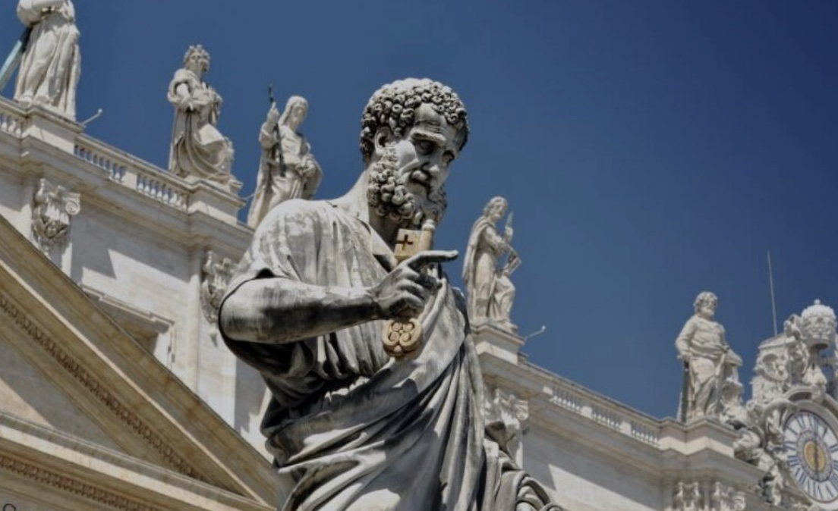
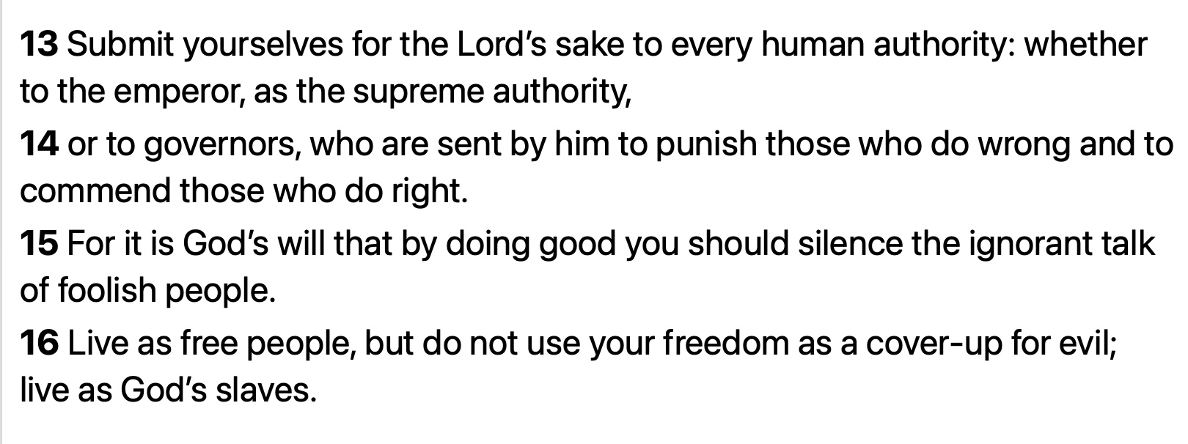
1Peter 2:13-16
Notes:
Last…. Saint Peter instructed we must respect government authority, Trust that GOD’s plan is always at work and as a government…. of the people by the people ….we must do our part to promote, even if we don’t always achieve….. a GODLY government, by first placing our ultimate trust …..in GOD, not man.
13 Submit yourselves for the Lord’s sake to every human authority: whether to the emperor, as the supreme authority,
14 or to governors, who are sent by him to punish those who do wrong and to commend those who do right.
15 For it is God’s will that by doing good you should silence the ignorant talk of foolish people.
16 Live as free people, but do not use your freedom as a cover-up for evil; live as God’s slaves.

Slide 35

Jesus, I Trust in You

