Slide 1
10-25-24 Rev. 43

Slide 2
Gen Z
Hire Them or Fire Them
10-25-24 Rev. 43
Notes:
As we all know our workplaces are continually under some type of change…. Today we will talk about a change we are always faced with ...and that is the coming of the next generation of employees …… the newest generation now entering the workforce is Gen Z….. And they are like ...all that preceded them ....unique in their own way… presenting challenges and opportunities for our leadership…… understanding the nuances of this generation will help you to better engage them... to maximize their value to your organization, while creating a fulfilling workplace for them

Slide 3

Notes:
Gen Z… ……You have seen them already.... born between 1995 and 2010…. First ....they look different…. Much more casual than many of us especially in our early days of work…. Some think a bit too casual in their dress and appearance at times…. The other tell tale sign is they are connected….. Like even too many of us ...in my generation… they are extremely addicted to their devices….always with a need to be in touch with everything and everyone at any given moment…. The most connected generation ever in the workplace… their values and experiences are different ....and the world that we have given them ...has shaped their attitudes, world view and their work ethic……. Keep in mind they are somewhat the product .... of the world we have given them ....so if you don’t like some of their behaviors…. Remember that to some degree …..we are responsible for these behaviors that we must know engage

Slide 4
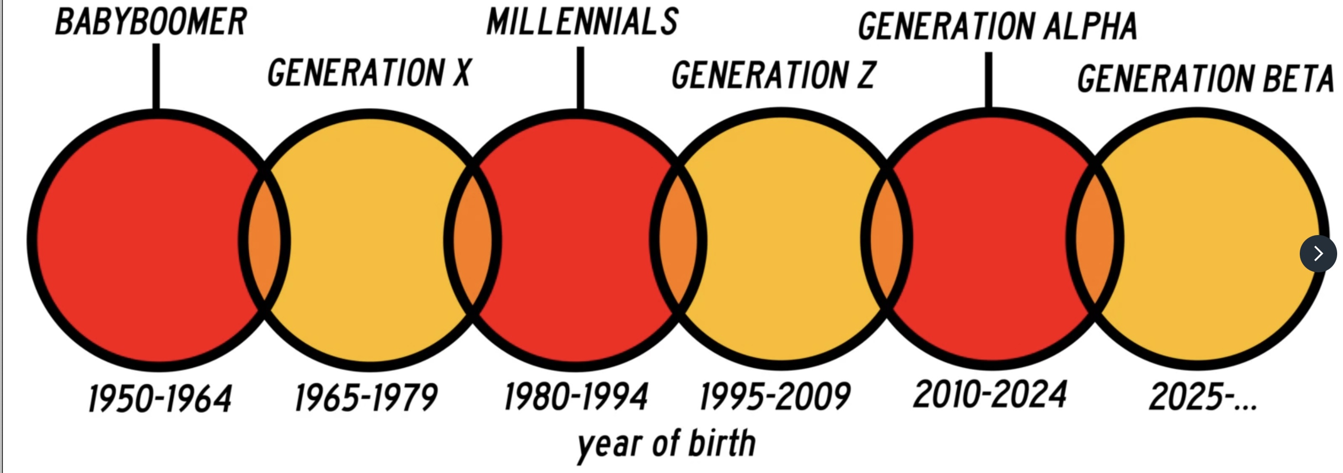
Notes:
Most in the workplace now are from these generations…. Gen Z are children of Gen X…. And just so you know. ......The next 2 generations, not yet in the workforce are already named ....gen Alpha and Gen Beta…… so this is a on-going change and we must be prepared as leaders for the uniqueness of each generation as they enter the workforce or miss out potentially on maximizing their impact to our companies

Slide 5
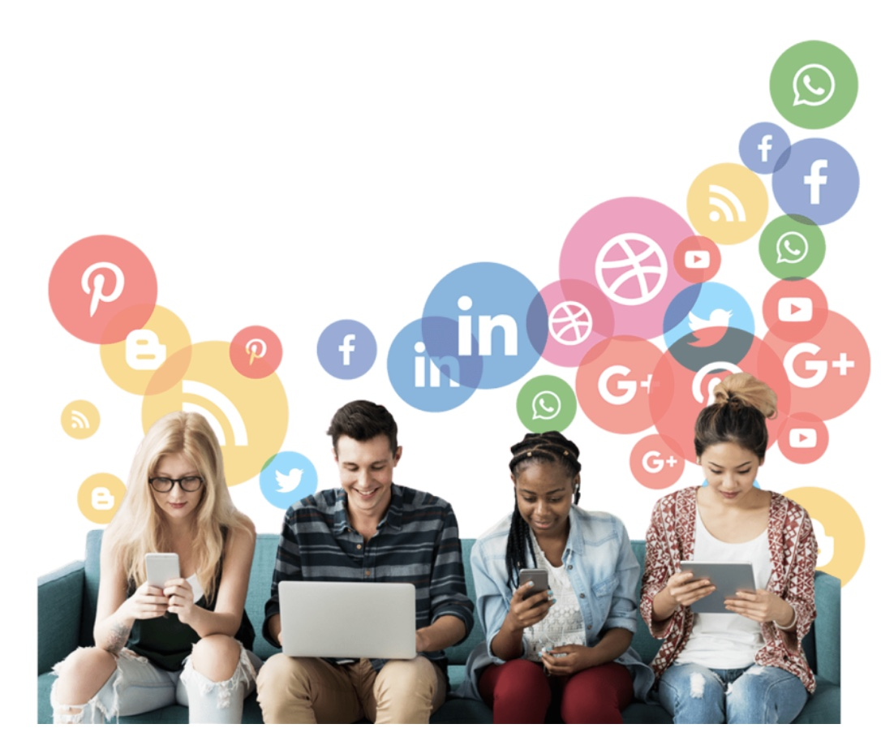
GEN Z
IGen
Centennials
Plurals
% Workforce
35% - 2030
Notes:
They are known as Gen Z…... The 'Z' in the name means "zoomer", as this is the first generation known to 'zoom' the internet. they are also called I-gen ... short for internet generation… Centennials ...or the first generation born in this century ....and plurals because they are a very diverse group. ....This generation will be the first ....non-Caucasian majority generation... in the US history… and they currently represent about 25% of the workforce ...but will represent over a 3rd of the workforce in less than 6 years at 35%..... That's is a pretty significant change…..

Slide 6
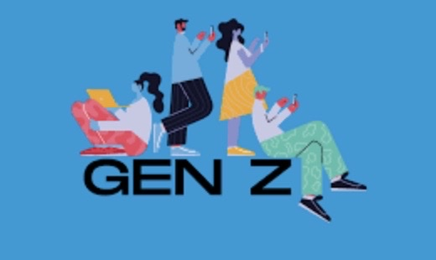
What’s next
Woke
ESG
Next?
DEI
Source: The Economist, America is becoming less Woke, Sept 2024
Gen Z, the most woke generation
Likely to retains this outlook as it ages
Increases woke views among the broader population.
Notes:
so what is next with this new generation…..We can safely say this is the most woke generation ever….. Also they are very attuned to ESG .. Environment , social and governance concerns... not just in their personal lives, but very much so in the workplace…they support diversity equity and inclusion … or DEI initiatives… they don’t just support it ....they actually won’t tolerate anything less….. They will leave a workplace they view as not supporting these social justice expectations….....they are most likely to retain this outlook as they age ....and will influence woke views and drive that to the broader work population…. That certainly will impact your leadership, ...hiring and recruitment ...and workplace policies. ...That is not to say that you will need to change your values, ....but you will need to at least understand the new values this generation brings with them…..

Slide 7
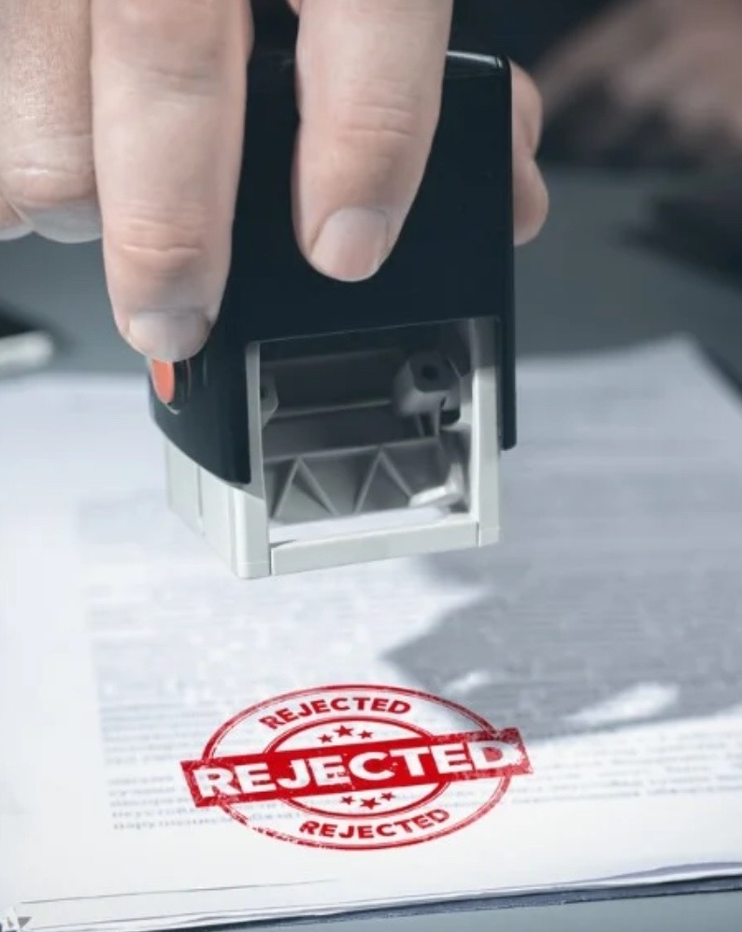
First impressions may be bad
Struggle with eye contact
Dressed inappropriately
Use inappropriate language
Refuse to turn on camera in virtual interview
Brought a parent to interview
Source: Human Resource Director, Employers Avoid Hiring Gen Z, Jan. 2024
Gen Z job interview challenges
Notes:
Many HR leaders and hiring managers say that they have bad first impressions of Gen Z…. In interviews ….. They struggle with eye contact, ...dress inappropriately for the interviews, holey jeans, sloppy dress, etc… .....they frequently use inappropriate language, ....even refuse to turn on the camera ...for the now commonplace virtual on-line interviews ...and more than a few bring a parent with them to the interview?!!! ...Certainly different from previous generations……so from the get go… even in the interview process you will face new challenges from this generation

Slide 8
38% - managers, directors & exec’s avoid hiring Gen Z grads
46% - willing to hire overqualified older employee
60% - offering benefits to attract older workers
59% - willing to pay higher salaries to attract older workers
48% - allowing new remote work to older workers
Gen Z -27% workforce 2025
61% - Often late for work
59% - miss deadlines
57% - unprofessional dress
53% - poor quality work
63% - view as entitled
58% - too easily offended
41% - poor relations co-workers
Source: Human Resource Director, Employers Avoid Hiring Gen Z, Jan. 2024
Unprepared for workforce
Notes:
By the end of 2025 this generation will make up 27% of the workforce….. So what are your counterparts saying about this latest generation of worker???? .....38% of managers and execs say ...they avoid hiring recent Gen Z grads, ...46% are now seeking to hire overqualified older employees… give them enhanced benefit offers and willing to pay them more to attract older non- gen z employees… and 48% are allowing more remote work with older employees to avoid hiring gen z employees….. That I think is really dramatic and says something about the new generation ....but also I think something about our flexibility regarding hiring expectations. ....The fact is ....they are coming whether we like it or not ....and you probably cannot avoid hiring them for much longer…. .....In general the criticism is that this generation is not well prepared for the workforce….. They do often demonstrate what most employers consider bad behavior … such as 61% of employers say they are often late for work, ....miss work deadlines, ...dress is unprofessional, ...53% say that produce poor quality work, ....they are viewed as entitled, ....too easily offended ....and 41% report they have poor relationships with co-workers…. Not a very good scorecard…. ….. And these are real challenges that you will have to address…. You cant just overlook these bad behaviors…..

Slide 9
Want more….
57% - lack professionalism
55% - don’t respond to feedback
52% - lack work ethic
52% -poor communication skills
51% - cost more to train
50% - lack motivation
32% - lack technological skills
47% HR managers have
recently fired a
Gen Z graduate
Source: Human Resource Director, Employers Avoid Hiring Gen Z, Jan. 2024
Unprepared for workforce
Notes:
Just to drive home the stark differences as gen z enters the workforce…. 57% employers say they lack business professionalism.. ..Don’t respond well to feedback, ....lack work ethic… ....have poor communication skills, ....cost more to train, ....lack motivation.... and 32% really surprisingly say they lack technology skills…. That doesn’t even seem to make senses giving they are the first generation really raised and educated on computers….. 47% of HR managers say they have recently fired a gen Z graduate…. all this Looks a bit bleak I know…… the fact is ....again ....they are a product of the world we gave them……..

Slide 10

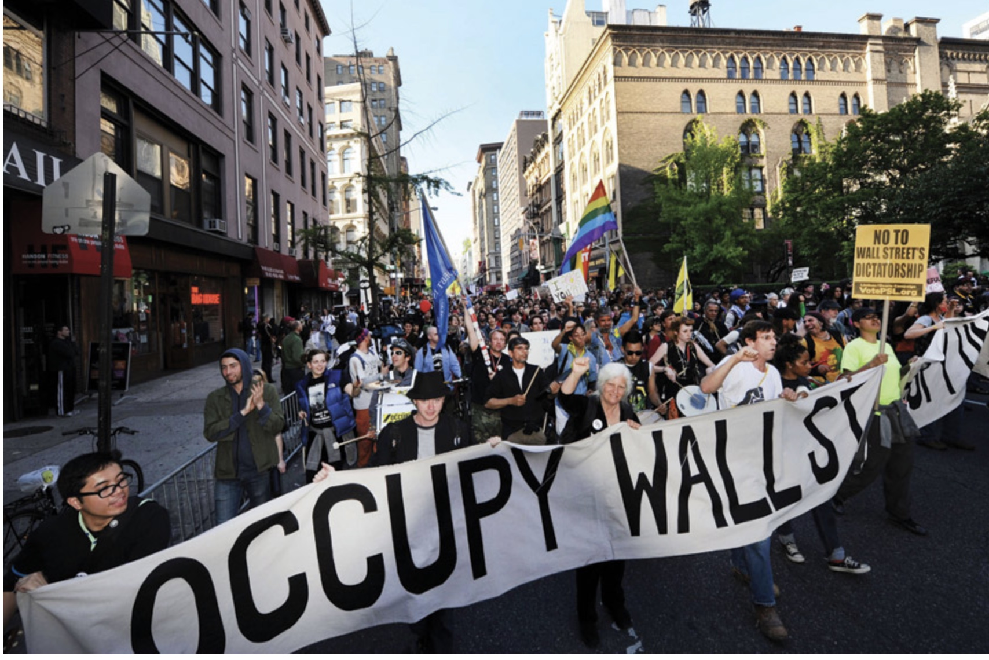

Gen Z
2008- 2009 recession
Global pandemic
Always SMART technology
Notes:
Some of the biggest influences on this generation is the recession of 2008-2009…. ...They saw their parents struggle economically or suffer a job loss during their younger years…. The global pandemic and the social isolation has impacted them... and the fact they have always been connected with various forms of smart technologies ....has had a huge impact on their actions and behaviors…

Slide 11

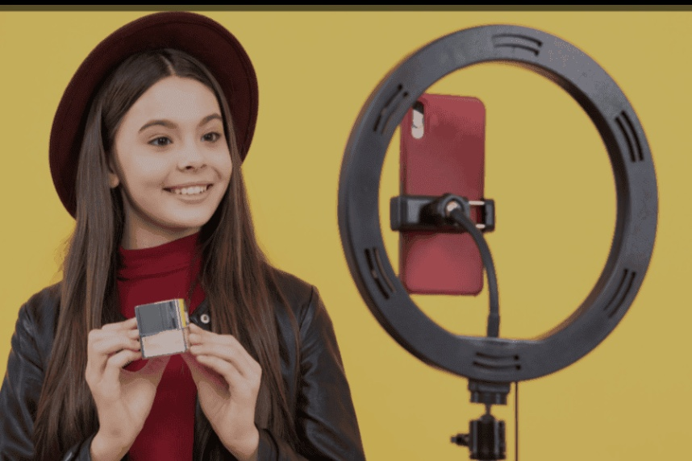
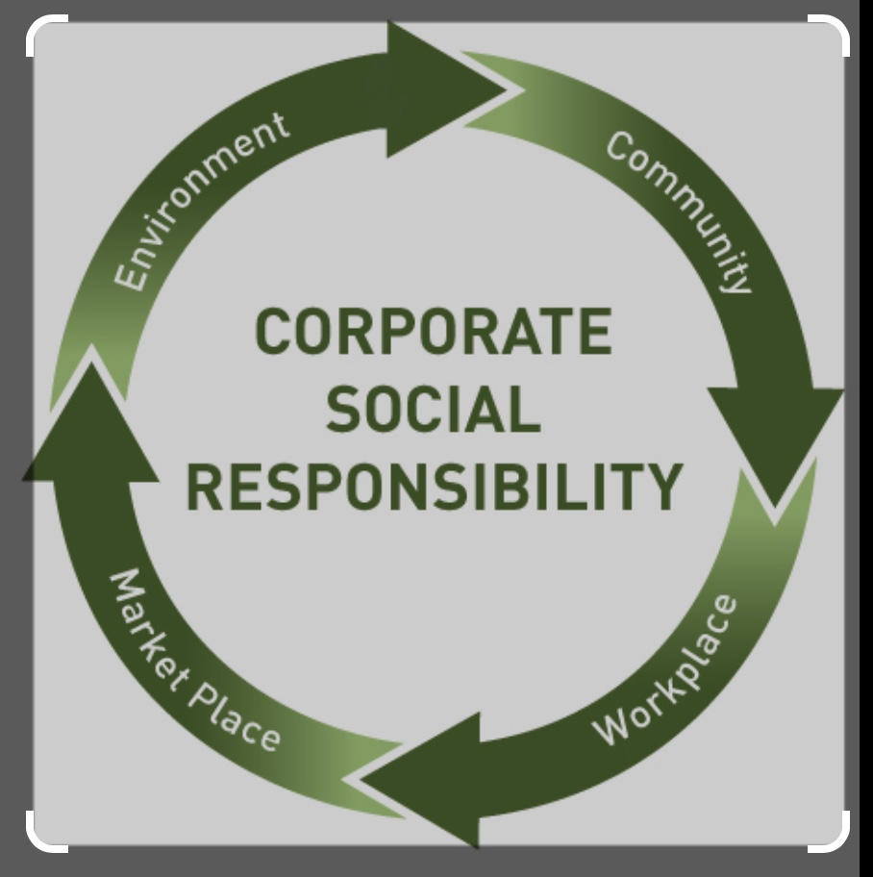
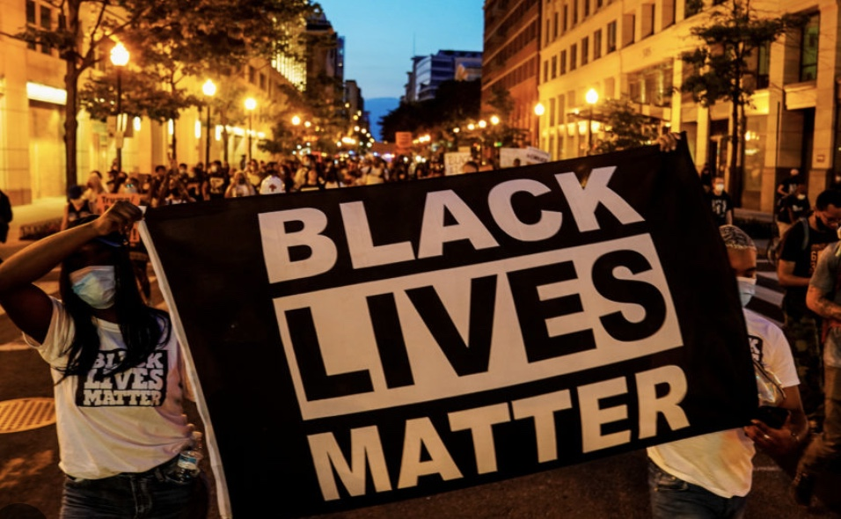
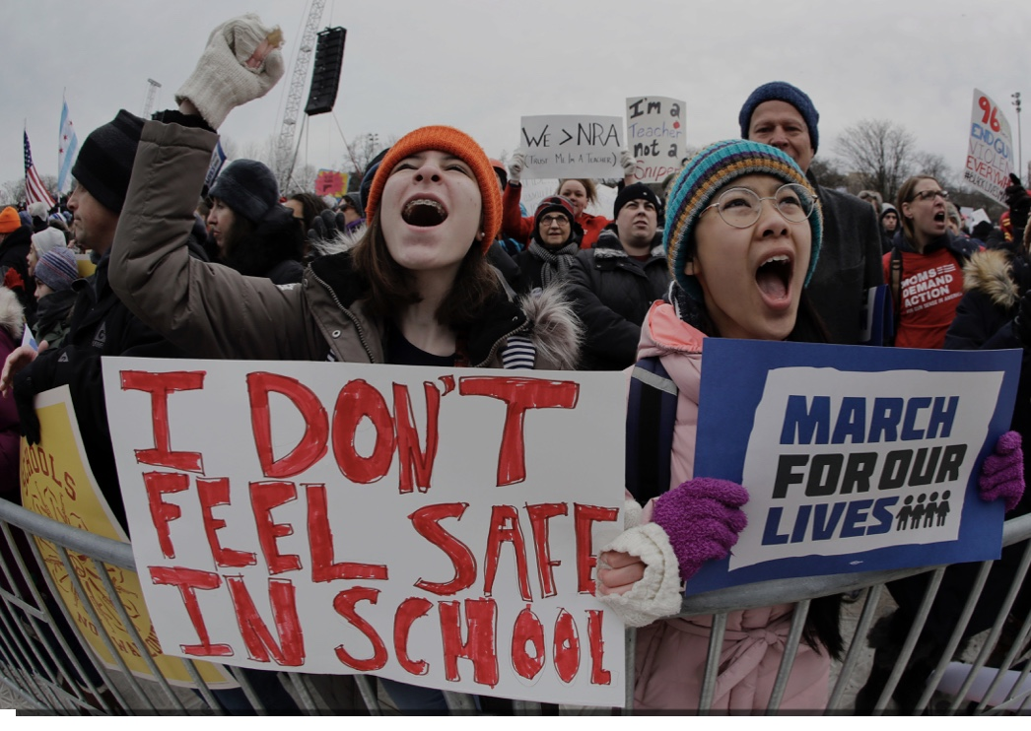
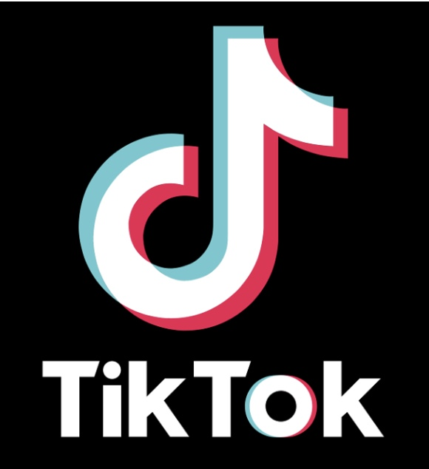
Gen Z
Invention Facebook, Twitter, Snapchat, Instagram,
Tik Tok, YouTube
Computers in Curriculum
Black Lives Matter
The Rise of
Influencers
Gun
Violence
Corporate
Social Responsibility
Notes:
In addition... they have grown up living and connecting on many social networks, ...like Instagram, tik tok, facebook etc… they experienced the social protest of black live matters ...and other social protest, ...they always had computers in their education, ....they experienced the negative impacts of gun violence in schools ....and they are among those first impacted by internet influencers .....shaping much of their thought and world view…. Right or wrong the influence is there….. And last ....they are much aware of CSR .....or their expectation for corporate social responsibility ...as to support environment and social issues. ... So again these are the life events ...that have most influenced their thinking ....and now their expectations at work….

Slide 12
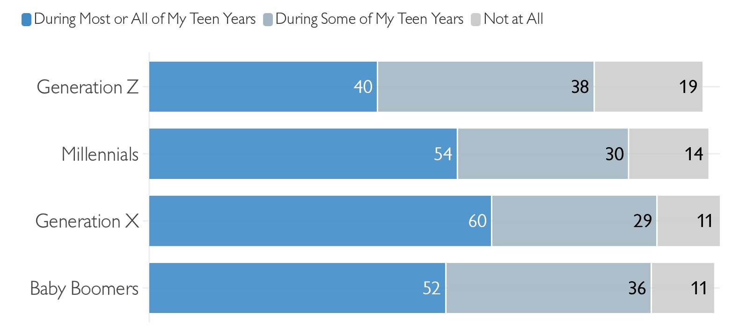

Gen Z Adults Spent Less Time with Friends as Teenagers
Source: Survey Center on American Life
Notes:
Another interesting influence…. Growing up ......maybe because of smart devices… they spent much less time than previous generations with their friends….. Less face time… therefore less time building necessary in-person social skills… like being able to read body language…

Slide 13
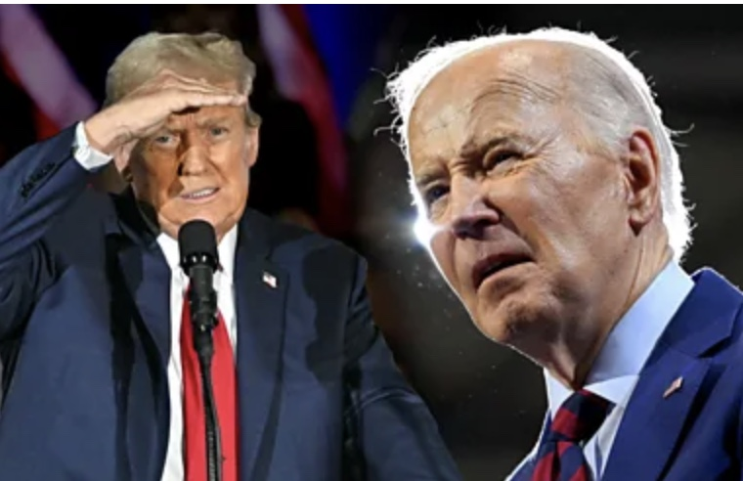
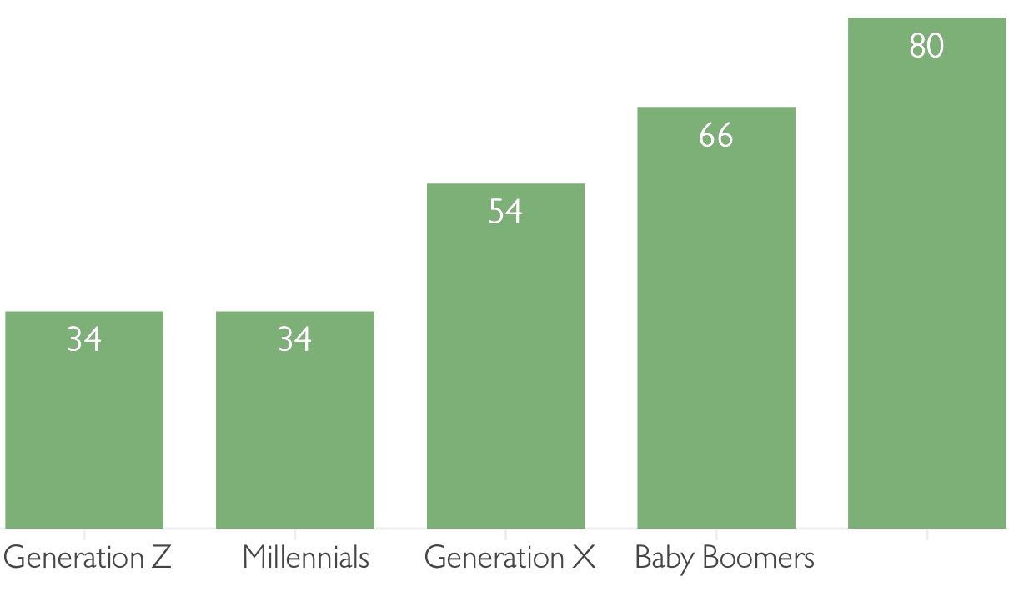
Gen Z - Less Trusting of Political Leaders Growing Up
Source: Survey Center on American Life
Silent Gen
Notes:
No big surprise here…… can you imagine…. Gen Z is less trusting of political leaders…. And this has been on a decline for many generations... falling from 80% with the Greatest generation to only 34% political trust with gen Z….. And as a result you can extend this perceived lack of trust..... to almost any authority figure… business leaders included

Slide 14

Notes:
So to share a story about how this may impact us an employers… I share the story of the circus performer who made a living by pushing a wheelbarrow across a high wire that spanned a niagara falls . The crowds came out in droves to watch him and to cheer him on. “Do you believe I can do it?” he would ask them. “Oh, yes! We believe you can do it,” they chorused back in acclamation.
“So, who’s going to get in the wheelbarrow?” he asked. And silence fell.
That’s because who jumps in a wheelbarrow to go across niagara falls with someone you just met…. That’s because building trust takes time.. It doe not happen overnight.. You have to work at it…. The point here is this is a vey non-trusting workforce coming our way and you will have to work harder than ever to establish the necessary individual and work trust with them….. It will be a challenge that you find unnecessary, but it will still be a challenge to address…

Slide 15
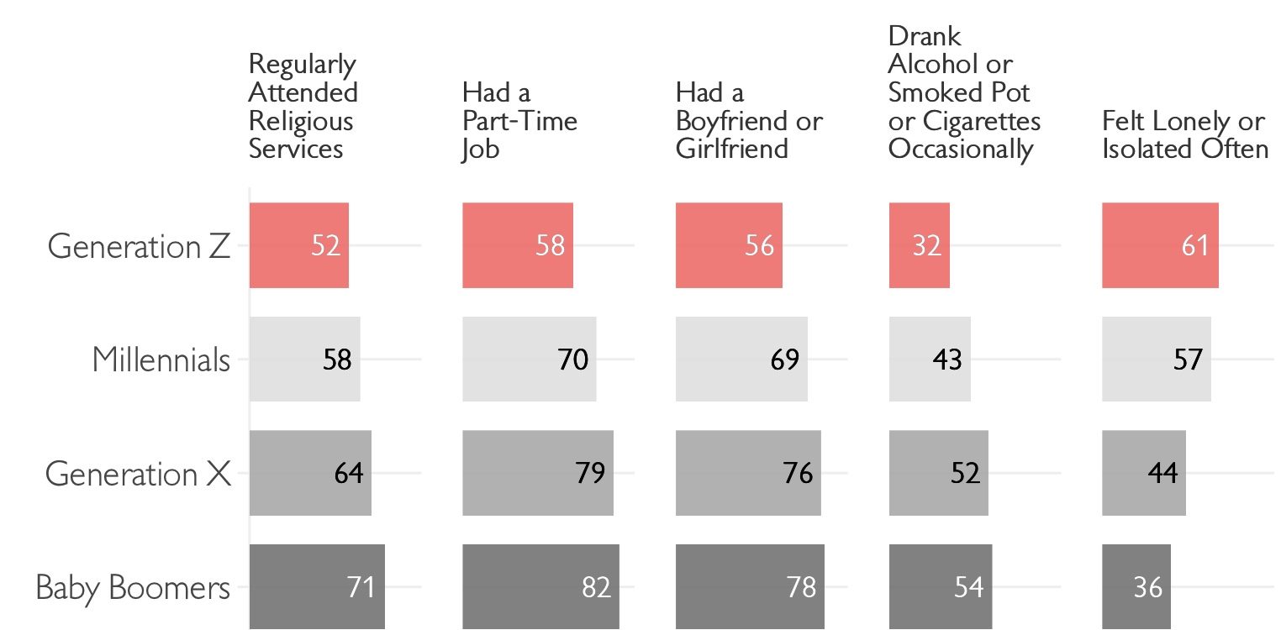
Gen Z’s Unique Teen Experiences
Source: Survey Center on American Life
Notes:
Other interesting influences on gen z worth noting…. Fewer regularly attend religious services, ....or had a part-time job growing up… fewer had a boyfriend or girlfriend, ....on the positive ...fewer drank, smoked or used pot, .....but significantly more than any previous generation in their teen years they view as been very isolated ....or lonely by 61% ....compare that to the baby boomer generation that reported only 36% ….. Again this may explain some of their behaviors of poor communication skills, ....being too easily offended, ...and poor relations with co-workers

Slide 16


Gen Z traits
Intense realism
Focus on financials
Intense competitive spirit
Anxiety and
Self-Pressure
Source: Podcast Gen Z: Simon Senik
Sense of
Entitlement
Notes:
They also have a very intense realism.. they are pragmatic...they are focused on financials. ....but pay is not their primary concern....they are intensely competitive, ....do possess a sense of entitlement ........have high anxiety and are self pressured.

Slide 17
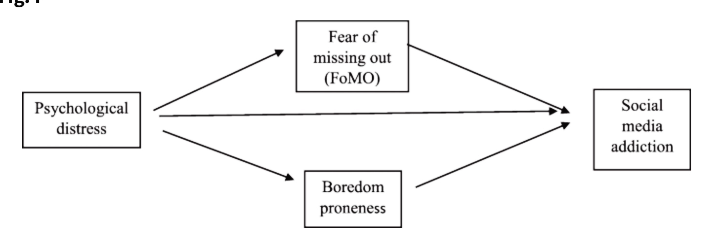
Social Pressure coupled with FOMO
Fear of
missing out
Difficulty with time to chill
Often not “present”
Gen Z traits
F O M O
Source: Journal of Tech. in Behav. Sciences: Mediating Roles of FOMO. June 2023
Fear of
Missing out
(FoMo)
Psychological
distress
Social
Media
addiction
Boredom
proneness
Notes:
The generation is very anxious…. And often distracted… and that may be driven by their FOMO .... or fear of missing out… one of the traits of this generation ....that has high social pressures, .....coupled with the fear of missing out, ....isolation and boredom .....have driven to social media addiction….. They can't stay off ....tik tok, Instagram etc….. They really do fear they will miss out on some event ....or information and that creates anxiety for them …. It also means for us a employers…they have a difficult time just relaxing .....or chilling ....and they often are not present.... because they are thinking about or responding to the latest post….. Or the news just released in China….. or some other distant part of the world

Slide 18
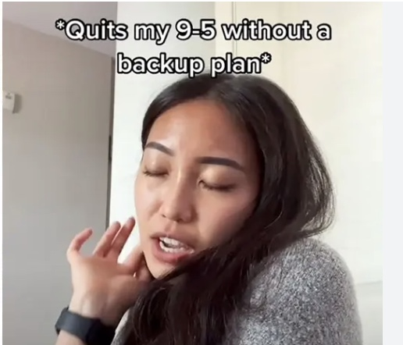
Conflict avoidant
Avoid conflict with boss
Comfortable quitting
without new job
Most have side hustles
Abundance of jobs – Linked-In
Often get higher pay Glassdoor job lookup
Source: Journal of Tech. in Behav. Sciences: Mediating Roles of FOMO. June 2023
Must show path to promotion
Notes:
Another trait is they avoid conflict…..this generation generally speaking.... avoids conflict with the boss… they may actually quit without having a new job… something most other generations would never do… one reason may be ...most gen z’ers have a side hustle…. You can bet they have some other form of income beside their primary occupation ....and so they feel comfortable quitting without another job lined up.... and without addressing their real reason for quitting…. The other reason is there are an abundance of jobs available to them.... on linked in , glass door and other websites.. ......They could have 15 different immediate job opportunities and because of these websites… they may see they could actually increase their pay…. So how to deal with this as an employers? …. One of the best things you can do ...is to provide them with a very defined and known path to a promotion….. If they know what they must do to be promoted .....then they will be less likely to shop websites for another job…..

Slide 19

Lack social capital
Many onboarded during covid
Started in hybrid work culture
Zoom – no water cooler talk
Transactional relationships
Generates feel of disconnected
Remote, text, video calls – limits relationships
Notes:
These employees lack social capital… a number were onboarded during covid, .....started in a remote or hybrid work culture, ....lived on Zoom with out the benefit of water cooler talk, ....find many of their work relationships are purely transactional…. ....Getting work assignments over zoom, completing and getting another set of work assignments…… no real interactions or depth to work relationships….. And all this generates a feeling of disconnectedness from work, ....managers and co-workers….. So in essence we have limited their relationships and social interactions ....at the very time we are attempting to form good work habits in their early years of work..... to be quote "good employees"…. So you see why they may struggle socially at work

Slide 20

Struggle with stress more
Fewer coping mechanisms
Comfortable talking mental health
Few deep relationships, the Text Gen
Trouble prioritizing
Most stressed out generation
Previous Gens – leave life at door
Gen Z – sees more blended life
Allow talk about stress / anxiety
Provide mental resources to help
Source: Podcast Gen Z: Simon Senik
Real sense of entitlement, but also most insecure
Notes:
By far this is the most stressed out generation.. They struggle more with stress, .....they have fewer coping mechanisms, ....surprising comfortable talking about their mental health issues ....( something my generation would have avoided at all cost)… ....they have fewer deep relationships… they are the text generation… and they have trouble prioritizing work… they are so distracted by all the inputs and events around them, ....remember they must be connected all the time due to the fear of missing out…. FOMO….with Previous generations ...well we left of our lives at the door when we checked into work .. .This generation is much more about work-life balance ....a blended life,,, they feel allowed to talk about stress and they expect employers to provide mental health resources…. That is why they are so viewed as entitled….. But they are ...at the same time...very insecure

Slide 21
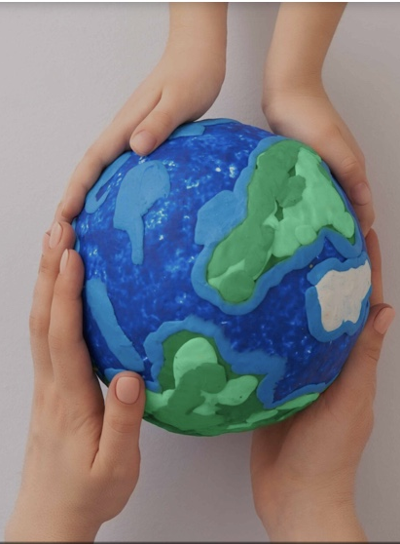
Most global
generation
Technology connected to world
Know what happening everywhere
Events in Euro or Asia happen to them
Greatest generation previous most global
World View
& Peace
Source: Podcast Gen Z: Simon Senik
Hyper-Connectivity is driving
Gen Z world view
Notes:
This is also the most global generation since the greatest generation… with technology they are highly connected to the whole world… know what is happening everywhere in the world ...at any moment… if it happened in China it is happening to them… their hyperconnectivity is driving their world view… for that reason there is hope ....they will help to work harder to drive world peace and cooperation

Slide 22

Highly inclusive
Don’t care:
Expectation, work to represent people in proper way
Responsible with environment
Take action, protest, not just talk
Results in:
What your sexuality is
Gender
Skin color
Advice:
Be more empathetic and more curious
Less judgmental on labels, weakness / strengths
Notes:
They are highly inclusive.. They don’t care about your sexuality ....your gender.... or skin color… they simply just don’t care…so they expect ....fair representation at work and tolerate nothing less, ....they expect employers to be responsible regarding the environment .....and they are much more likely to take action on issues and join protest, not just talk disagreement….. How do you respond then as an employer?… you must be more empathetic and more sincerely curious about their interest and less judgmental ... avoid placing labels on them

Slide 23

Engage
Gen Z
Digital Education: Invest in digital education platforms that cater to Gen Z's learning preferences, fostering creativity, critical thinking, & digital literacy.
Sustainable Policies: Address environmental concerns implementing sustainable policies aligned with Gen Z's values, demonstrating commitment to a greener future.
Flexible Work Solutions: Create an environment that supports freelancing & remote work, accommodating Gen Z's desire for work-life balance & flexibility.
Youth Involvement: Encourage Gen Z's active participation in decision-making processes, give them a voice in shaping policies affecting their future.
Digital Privacy and Security: Ensure robust digital privacy & security measures to safeguard Gen Z's personal information in an increasingly connected world.
Source: Linked-In, The Evolving Lifestyle of Gen Z, Aug. 2023
Notes:
You can engage this generation by investing in digital platform to educate them… opening up their creativity… you will need to pay attention to sustainability practices.... especially concerning environment, .....offer flexible work solutions to address their need for work-life balance…. Get them involved in your teams and decision making, ......give them a real voice at work to help shape policies, .....and work hard to safeguard their digital privacy… it is a real important and sensitive issue for Gen z….

Slide 24

Employers will need to stress
soft skills training
Communication
Presentations
Speaking up
Source: Human Resource Director, Employers Avoid Hiring Gen Z, Jan. 2024
90% of Gen Z employees face social discomfort & anxiety
Notes:
As employers you will need to train and stress developing soft skills .....with this generation… .....communication skills, ....presentations ( they lack good presentations skills surprisingly), .....and teach them to speak up….. They are a no-speak up generation by nature….. 90% of this generation ....feels social discomfort and anxiety…..

Slide 25

How to Lead Gen Z at Work
Encourage innovation /work balance
Lead by example
Understand needs
Provide growth opportunities
Leverage desire for change
Focus on individual
Treasure work-life balance & mental health
Don’t tell – example, vision, feedback
Flex hours,more PTO, priority mental health
Challenges, learning, new experiences
No status quo , catalyst for change
Must feel valued
Source: Forbes, How Leaders Can effectively Manage Gen Z, Jan 2023
Notes:
To lead gen z .......encourage good work life balance, ....lead by example, ....don’t tell, but show your vision and offer feedback…. ....Understand their needs – show with flexible hours and PTO ...and prioritize good mental health, ....provide growth opportunities ... by giving them challenges and new work experiences, ......leverage their desire for change ....by allow them to participate in decisions…. And place value on them as individuals... Gen Zers must feel valued to be productive….

Slide 26
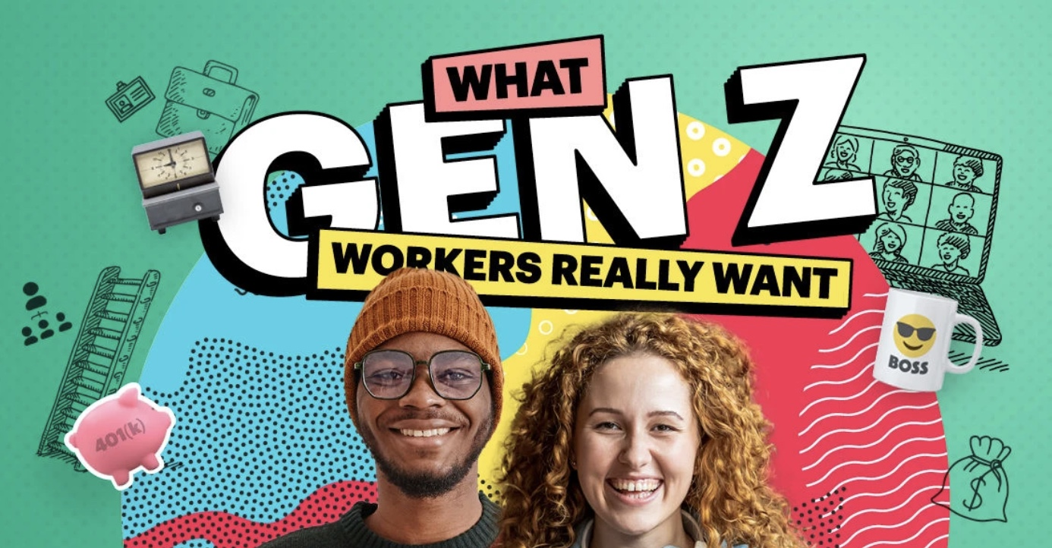
How to Lead Gen Z at Work
Be open to learn from them
Walk the cultural walk
Understand work part of life
Understand their values
Promote open communication
Information and connectivity guru’s
No toxic culture, discrimination
Encourage Speak-Up Culture
Give purpose in work focus
Take time to know them
Source: Forbes, How Leaders Can effectively Manage Gen Z, Jan 2023
Notes:
As leaders we must be open to learn from this generation .......they are indeed info and connectivity gurus......We have to walk the cultural walk on non-toxic cultures or discrimination….. ....Understand work is just part of their life.. So give them a purpose in their work….understand their personal values, ...take time to get to know them, ...and promote a speak-up culture in your business..

Slide 27
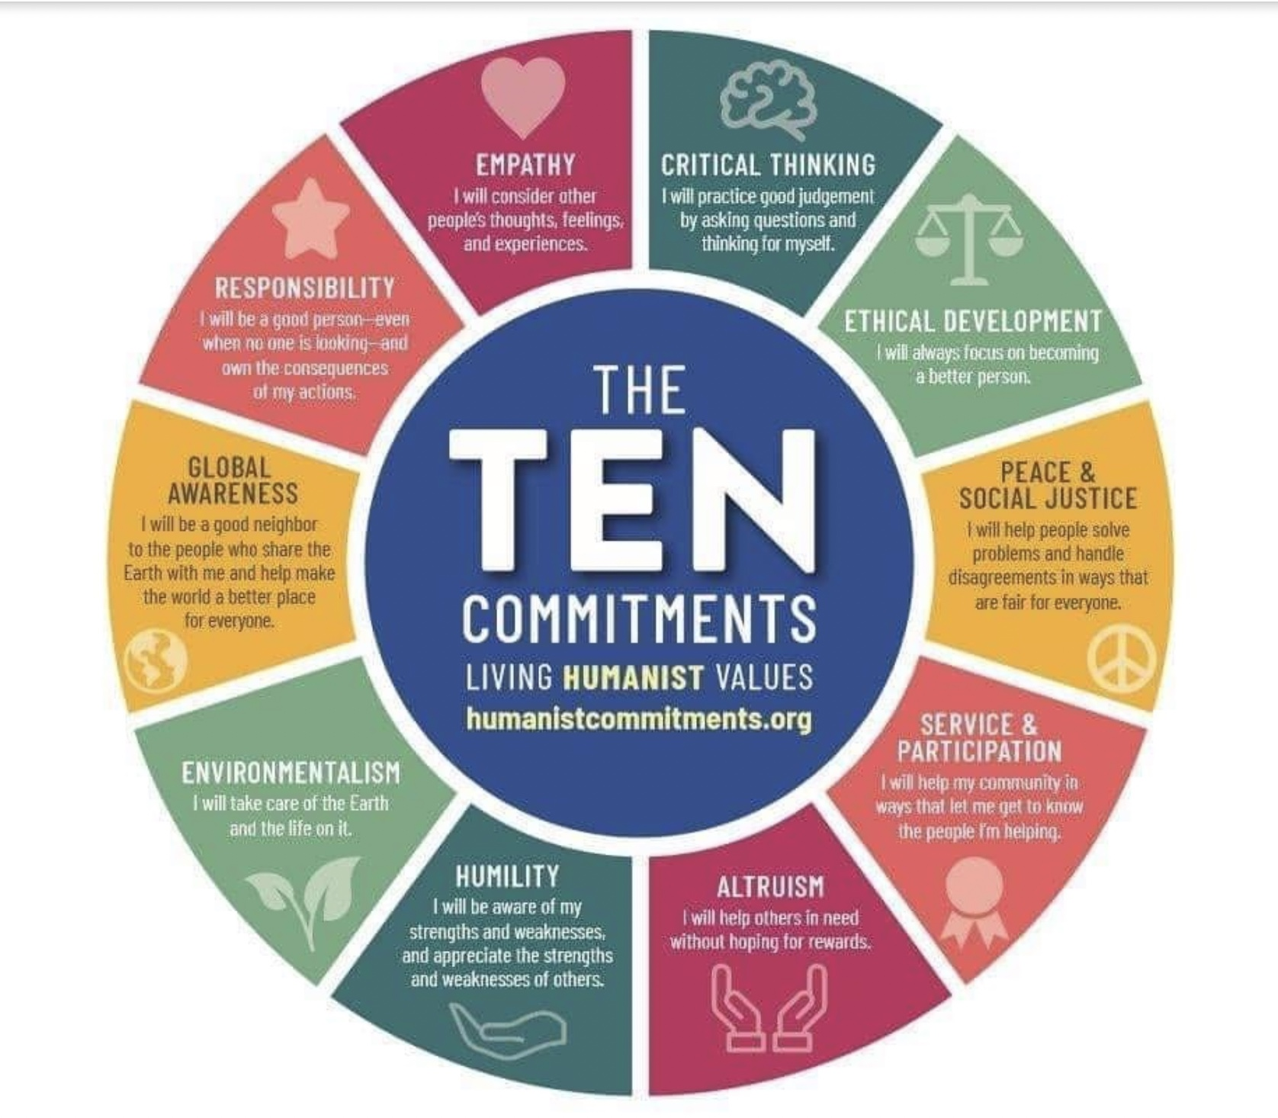


Our obligations to Gen Z
Help discover their personal WHY /purpose
Pass on core values
Lead with virtues that build character
Apply ethics in daily decision-making
Teach core competencies
In Faith:
Commitments
Love GOD passionately
Impress Truths practically
Give testimony personally
Notes:
hopefully I have shared some new insights about this next generation ....Z ........so that we can prepare to welcome them into our workplace…. Of course ....we don’t just need to better understand them ....but like every generation the current generation of leaders .....holds certain obligation to the younger generation… in business ....we should start by helping them identify their personal why and purpose... and if possible .....align with our business purpose… we should pass on core values ....by practicing them consistently, .....lead with virtue in all things ..that builds and teaches character ....setting an example for this newest generation, ....apply ethics in our decisions ...and teach core competencies….we also need to teach leadership in things like humility, ....social justice, ...empathy, ...ethics, ... and service to others… the ten commitments of humanity outlines some of these ...that we should teach for a better more Christian world ....and last in our faith ....we certainly have an obligation to show and demonstrate ....by our actions .....passionate love for GOD, ...Impress truths of our faith on this generation ...by visibly practicing our faith in all that we do every day, ......and to give personal testimony of our faith ......by actually living the gospel each day.

Slide 28

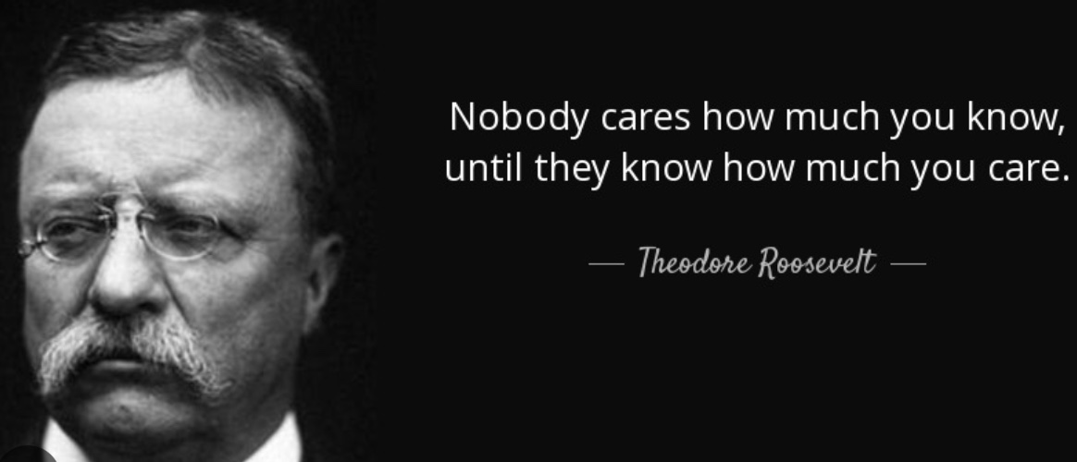
Source: A-Z Quotes
Notes:
Last… let me say this. We know that as Christian leaders we must serve others first….. And we demonstrate that by words followed by real action……we demonstrate our caring in a million little things everyday .......that show we really do have empathy for our employees ....and care about them and their individual futures……. Yes ...we have a much different generation coming at us very fast….. If we are empathetic leaders ....we. will get to know them, ...ask and get their sincere feedback, ....respond to their concerns, ....we can create a more stable productive work environment, ....attract the best talent from this generation to our companies, ....reduce employee turnover .. ….. And truly incorporate the best of this generation to build stronger sustainable businesses… we can only do this .. if we as leaders ....purposely facilitate a new era of employee openness ...and increased empathy for others. ....As challenging as this may be for some leaders …….who today see Gen Z as entitled, coddled, and poorly prepared for the workforce….. We can give this new generation the best of our values and virtues .........while being open and responsive to their unique needs. .....Maybe we just need to remind ourselves daily of the words of Teddy Roosevelt…. Nobody cares how much you know ....until they know how much you care……

Slide 29
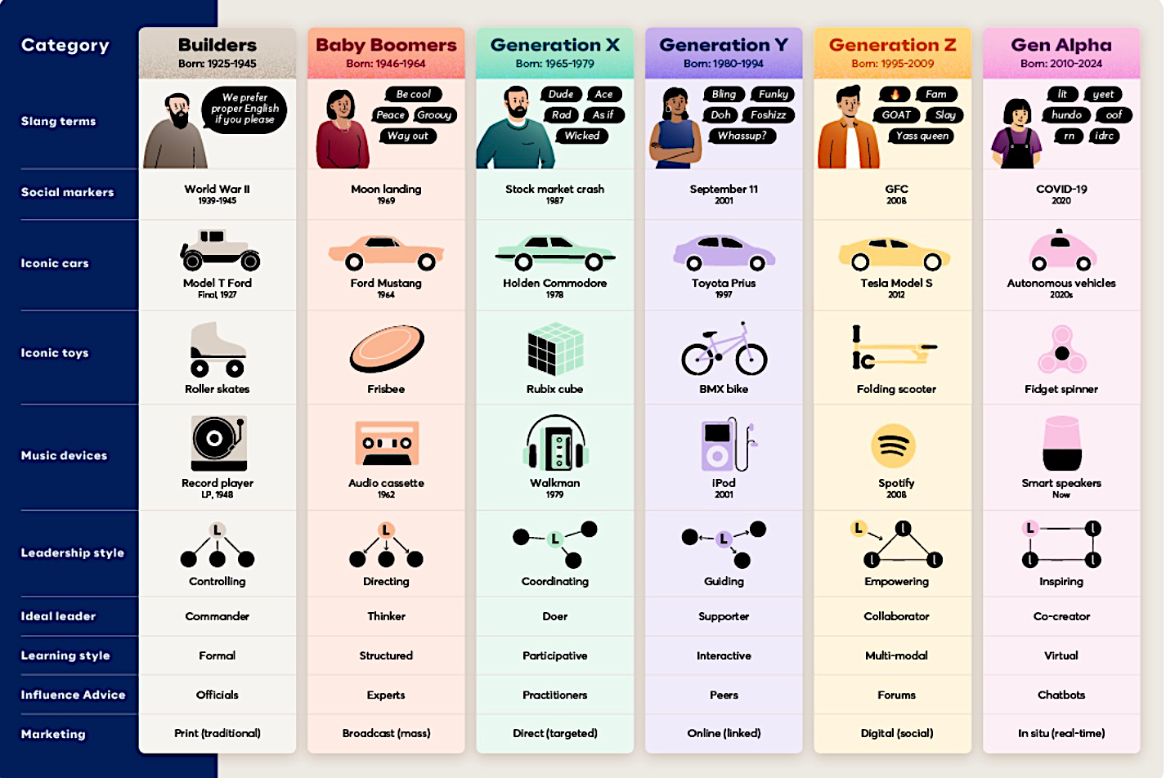
Source: McCrindle: Gen Z and Gen Alpha Update
Notes:
Here is a quick graphic view of the different generations and some of the things that influenced their upbringing and their world view… their language . Toys, music devices, and leadership styles are all different….

Slide 30
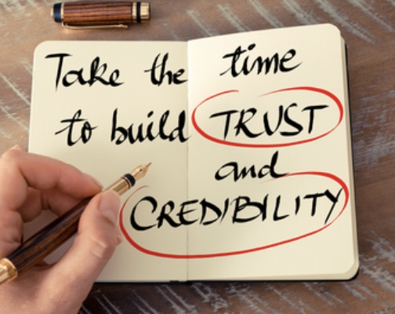
How to build workplace trust
1. Talk Straight
2. Demonstrate Respect
3. Create Transparency
4. Right Wrongs
5. Show Loyalty
6. Deliver Results
7. Get Better
8. Confront Reality
9. Clarify Expectation
10. Practice Accountability
11. Listen First
12. Keep Commitments
13. Extend Trust
TM
Audeo Leadership Workshop
Notes:
Other actions you will need to be very conscious to practice to build triudst with th new generation…..can take.. Talk straight. Be upfront.. Direct. Always demonstrate a respectful tone, be transparent… share info , don’t make others guess or without info.. Something goes wrong then fix it,,, don’t just le tit f=go.. Show loyalty… support those on your team, deliver the results…. As we already said. Finish the job correctly and on time, work to improve your skills, confront reality.. Don’t be overly optimistic, face facts on what needs to be done and how long and how much it will costs, clarify expectations on both sides,, from the person assigning the work and the person doing the work, be accountable.. If you do something wrong admit it, listen first and seek to understand before being understood, keep Your commitments and promises and extend trust first….. Don’t always expect others to trust you before you demonstrate you trust them… trust is always a 2 way street.

