Slide 1
Coaching & mentoring
Developing Employees for a Better Future
6-22-24 Rev. 38
Notes:
The days of command and control leadership are over. Today’s successful leaders practice active listening and asking powerful questions. They speak less and listen more. And, they ask more and tell less. Motivating employees is no longer based on fear and retribution, instead it is focused on developing team members by empowering them to succeed.
The International Coach Federation, which is the governing body for professional coaching, has identified eleven core coaching competencies, which define what it takes to be a great coach and to leverage their own coaching skills for success.

Slide 2
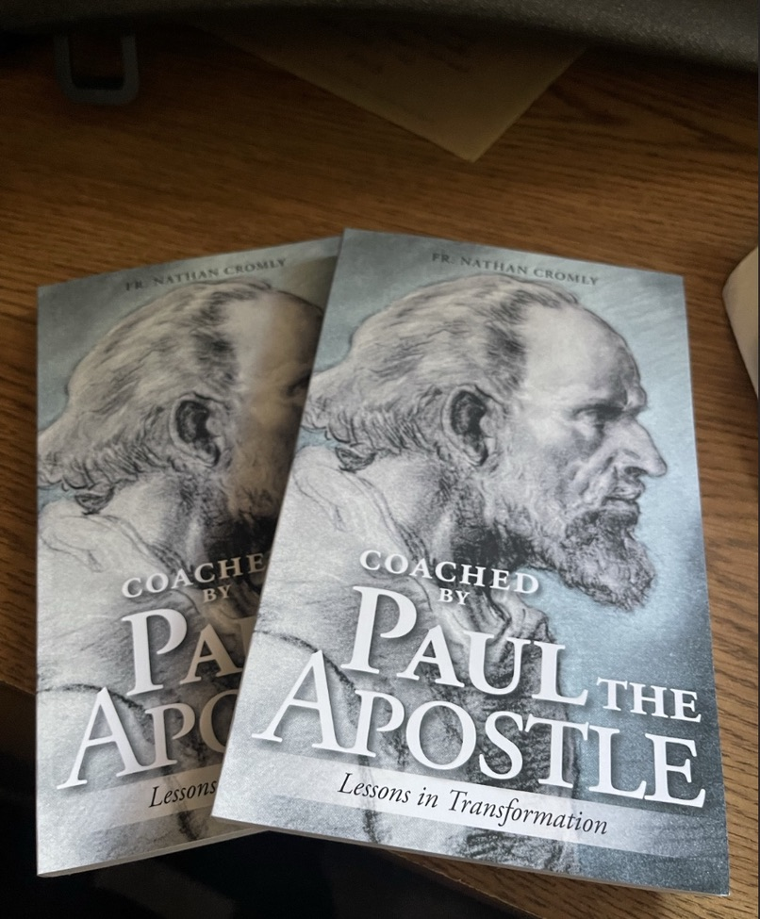
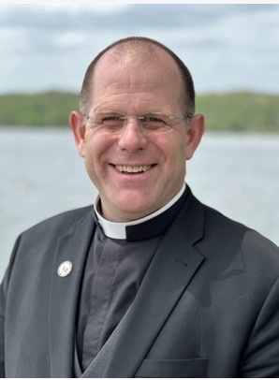
August Release:
Father Nathan Cromly
Coached by Paul the Apostle
Lessons in Transformation
Notes:
SO I will end where we started… and that is that coaches and mentors are invaluable in the lessons they can teach….I was planning on saving this to the end of the discussion today, but I think it is worth noting early here that Coaching is important to all parts of our lives. Father Nathan as many of you know just published his first book… and the title is appropriate to todays discussion on Coaching and mentoring.. The book is Coached by Saint Paul, lessons ion transformation and in general follows Fathers audeo methodology of leadership…..with St Paul as the Coach…. We can learn many great coaching lessons from historically great coaches and in this case saints…. But in todays business world we generally think of a coach as a supervisor a manager, an executive, owner or sometimes someone external to our business but that has great experience and insight…. Someone that we can activedly connect with to guide us to greater success and productivity.

Slide 3
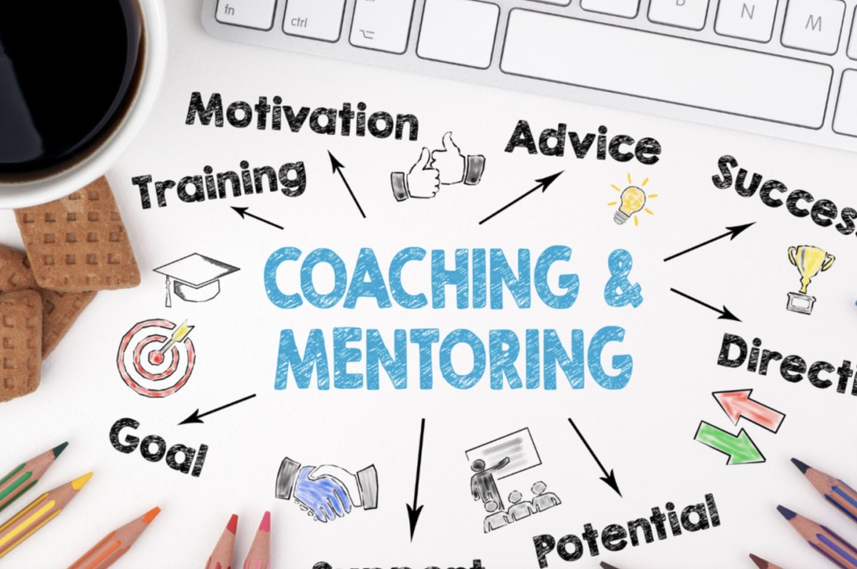
Notes:
The days of command and control leadership are over. Today’s successful leaders practice active listening and asking powerful questions. They speak less and listen more. And, they ask more and tell less. Motivating employees is no longer based on fear and retribution, instead it is focused on developing team members by empowering them to succeed.

Slide 4
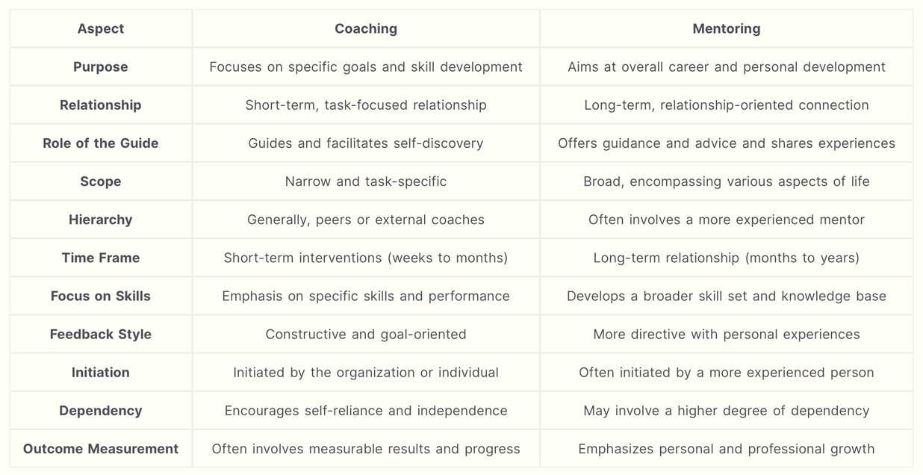
Notes:
We will talk about coaching and mentoring today. The two are similar but different…. In general we can say that coaching is more specific on tasks, short term focused with an emphasis on skills. Mentoring on the other hand is more long-term oriented. towards larger career goals and personal development… often over a period of months but very often over years… it is about sharing experiences , guidance and advice. It is often more broad and encompasses more aspects of life and business. It is about developing the whole person, developing character , virtues and self mastery.

Slide 5
"Coaching is unlocking a person’s potential to maximize their own performance. It is helping them learn rather than teaching them."
Sir John Whitmore

Slide 6
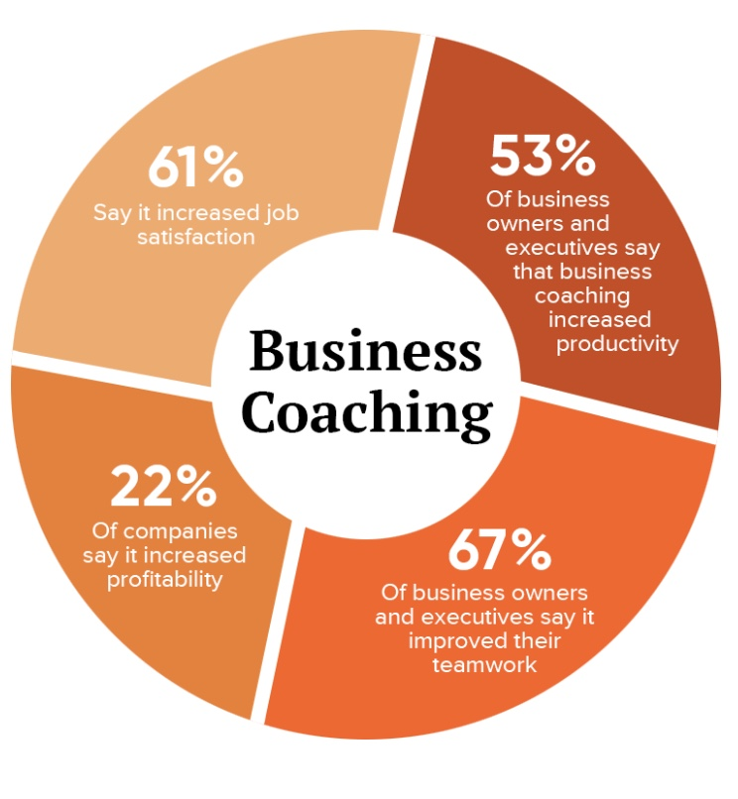
Notes:
Business coaching does have positive impacts… 53% of business owners report that coaching increases productivity, 67% say it improves work teams, 22% say it increased their profitability and 61% say it increases employee job satisfaction…. So it is clear this is a business opportunity that deserves some leadership discussion

Slide 7
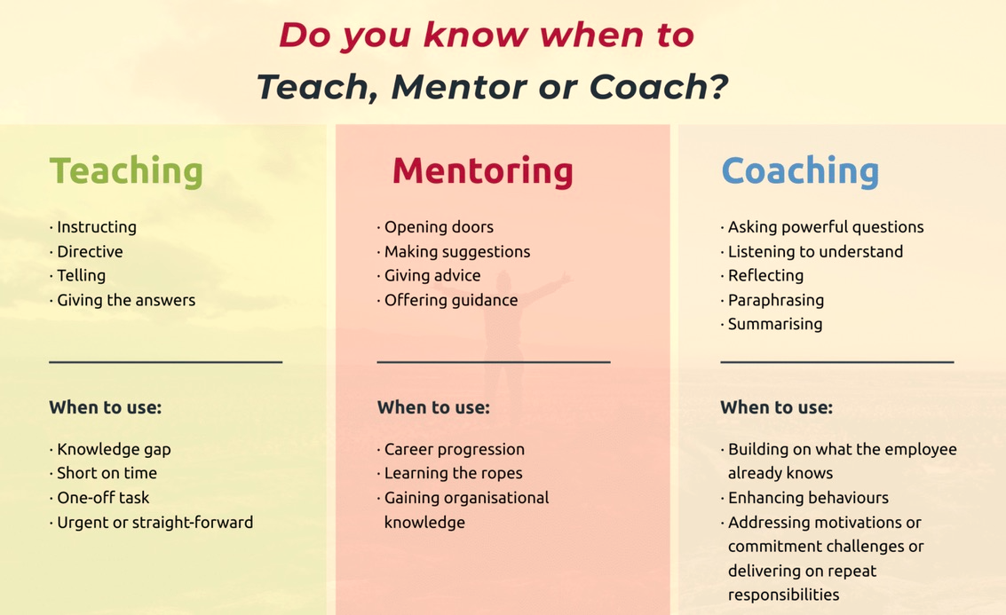
Notes:
As a leaderer you often must teach, coach and other times mentor, but when is each appropriate? Teaching is the most specific…. Instructing directing and often telling.. Y9ou do when there is a knowledge gap often for a one-off task
Mentoring isis doen to help open doors for an employee, when suggestions are needed, advice is requested, use to aid career progression, its about learning the ropes, and gaining broader often hard to find organizational knowledge.. Coaching is about asking questions, listening, reflecting…. We coach to build upon what the employee already knows, to enhance behaviors, address motivations and commitment to specific jobc hallenges

Slide 8
51% of companies with strong coaching culture have higher Revenues Vs Competitors
73% - coaching improves work performance, communication & interpersonal skills
86% of companies report recouping investment in coaching
The median coaching ROl is 700% the investment
7X
Source: The Benefits of Coaching in the Workplace 2023, Luisa Zhou - April 2024
99% who hire a coach are "satisfied" or "very satisfied"
80% people who receive
coaching say self-confidence increased
Notes:
80% of people who receive coaching say their self-confidence
increased
70% of those who are coached improve their work performance,
relationships, and communication
86% of companies report recouping their investment in coaching
and more
99% of those who hire a coach are "satisfied" or "very satisfied"
73% of coaching clients report that coaching helps them improve
their work performance, communication skills, interpersonal skills,
relationships, work/life balance, and wellness
• 51% of companies with a strong coaching culture have higher
revenues compared to their competitors
The median coaching ROl is 700% (7x) the investment

Slide 9

Notes:
The International Coach Federation, which is the governing body for professional coaching, has identified eleven core coaching competencies , which define what it takes to be a great coach and to leverage their own coaching skills for success.
The desire of every manager and leader is to have his employees reach their full potential. To realize and use their unique gifts for their own personal vocation and to benefit the business

Slide 10

11 Core Competencies - Coaching
Active Listening
Powerful Questioning
Direct Communication
Set Foundation
Meeting Ethical Guidelines & Professional Standards
Establish Coaching Agreement
Establish Trust & Intimacy
Coaching Presence
Creating Awareness
Designing Activities
Planning & Goal Setting
Managing Progress & Accountability
Co-Create Relationship
Source: Understand 11 Core Competencies, April 26, ‘21 Master Coach Univ.
Communicating
Effectively
Facilitate Learning
& Results
Notes:
These are the 11 core competencies of Coaching as set by the Master Coach university and International Business Coaching Federation.
First.. Set foundation -Only coach if needed.. That’s ethical …If not what’s needed – send client elsewhere. 2 establish coach agreement –what are the boundaries , what can and cannot discuss / explore. Next create relationship – with honesty , integrity and respect that creates necessary trust. Show coaching presence with instilling confidence, positive energy creating a bond. You must establish effective communication by Active listening – use of body language , show genuine interest in employee, use open ended questions that motivate and push employee forward, and be direct , articulate, clear and give positive feedback. Last facilitate learning and results through creating awareness about obstacles or challenges standing in way of employee success something they may not be able to see, help employee set goals through learning and self discovery of what is most needed for their success and skills development, set the goals, measure and celebrate small successes forward, and last set reviews of progress holding employee accountable for progress while providing positive encouragement to maintain momentum. These 11 steps help define and guide your coaching relationship

Slide 11

Notes:
To a certain degree as a leader coaching and mentoring employees is a risk….. You have to take a leap of faith that employees will actively engage, accept your advice and guidance and act on your recommendations and feedback… you also must create a new level of intimacy that runs athe risk of being misunderstood, may be viewed as favoritism and the investment will not always be rewarded with long-term loyalty and employment… still you must develop employees and prepare for the next generation of company leadership… or run the risk of business failure in 2nd and 3rd generations. This is a major concern for most leaders especially privately and family owned businesses…. Can family members be coached and mentored to success or will you need to seek next generation leadership outside the family?

Slide 12

Notes:
One of your biggest challenges as a coach and as a mentor is to bridge the gaps in the employees skills and areas of needed development and knowledge. Often the employee is painfully unaware of these gaps… they don’t know what they don’t know and only someone else can help lead them to comprehend where they must place focus. It’s a challenge for you as the coach and the mentor… first to spend the time, observe and actively listen to identify the needed improvements and then of course to deliver the message in a manner that does not overwhelm the employee and keep trust in place so you can affect the change. This underlines the fact that you can always coach teach and mentor, but to be effective you must limit the number of these engagements because significant time may be needed to create the necessary insights to coach and mentor for real results.

Slide 13
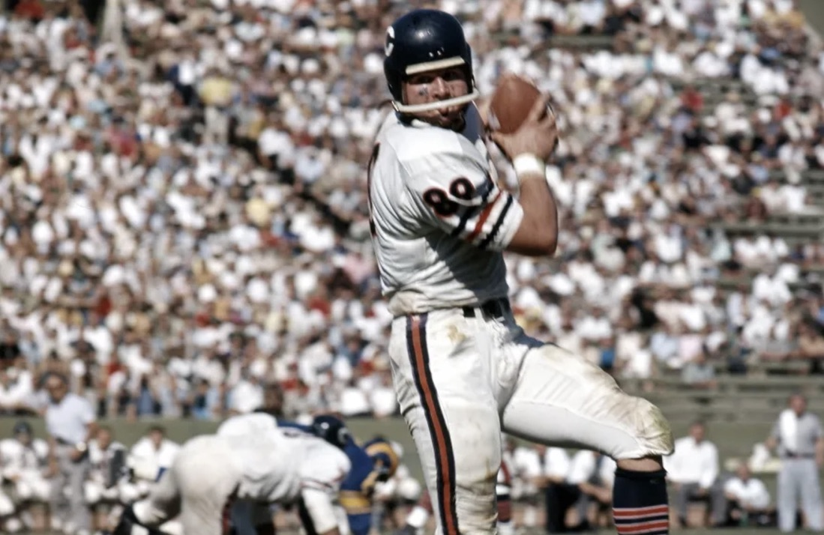
Notes:
I like sports analogies.. because they are so relatable to what we do in business. So we all know some great coaches in sports… I am not especially a Chicago bears fan, I like the story of the 1985 Chicago bears and Coach Mike Ditka and his run in Chicago from 1982 leading up to their 1985 superbowl win.. Its is a great study in coaching. The bears had not won a divisional title in 22 years and were really non-competitive with one after another losing season… in comes Ditka…a former player at Chicago that changed the style of NFL play for tight ends.. A tight end that was tough , athletic and could run after the catch… he set a new standards for the position.. So he knew the game … as a coach he came to Chicago.. Told the players .. Good news and bad news in 1st meeting .. We will win a super bowl in 3 years bad news half of you won’t be here to see it. During that period the Chicago bears arguably Practiced harder than any other nfl team, built confidence, assembled probably the must diverse group of personalities and talent ever on a pro football team… but he built player relationships, took chances with players, trusted their instincts, establish a strong coaching presence, was a clear straight forward communicator, accepted feedback from his players, saw talents they did not know they possessed ….the 300 # FRIG became a running back, a receiver, and a offensive blocker…. He set clear goals… and held the team accountable. And probably more than anything create player awareness of how good they could be instilling confidence and motivation they craziest group of talents and personalities ever assembles to meet the goal of winning a superbowl in 3 years time. I

Slide 14
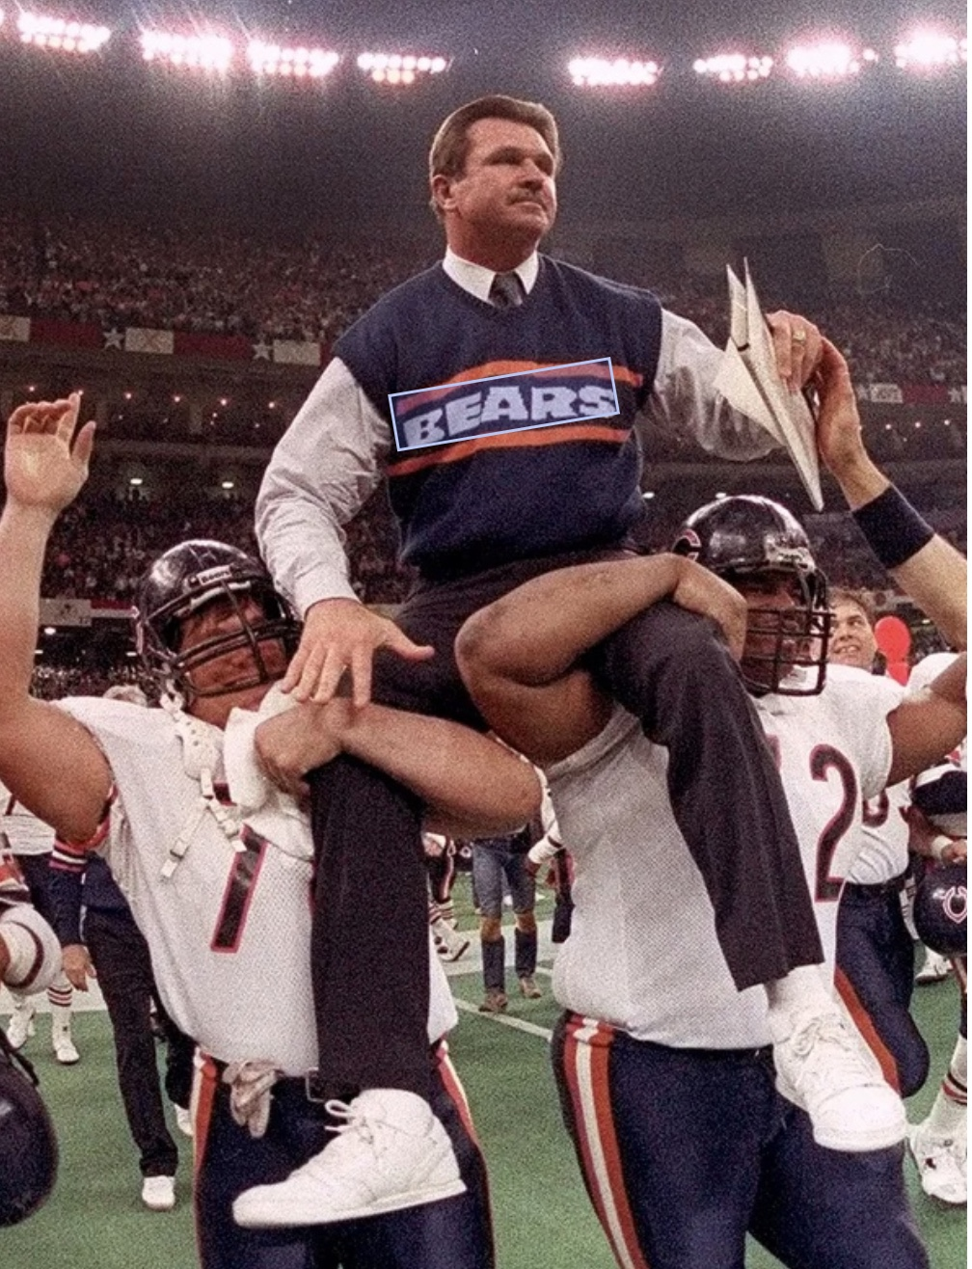
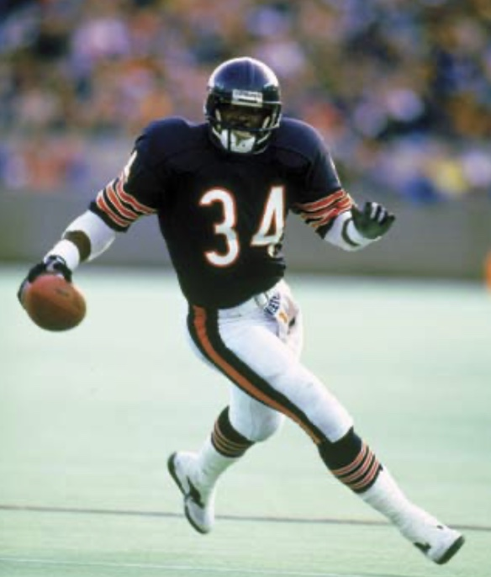
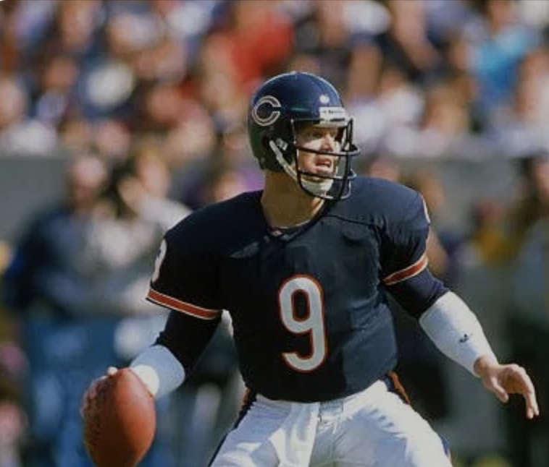
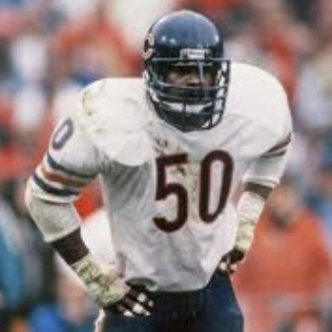
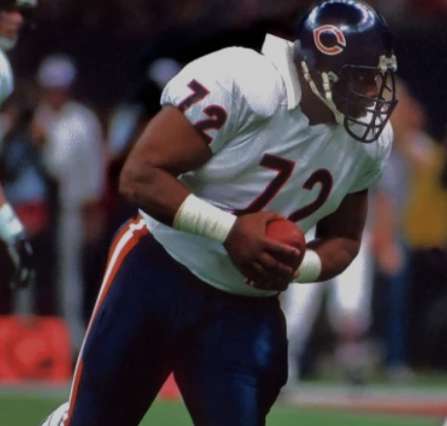
Chicago Bears
Superbowl Champions
1985
Notes:
During that period the Chicago bears arguably Practiced harder than any other nfl team, built confidence, assembled probably the must diverse group of personalities and talent ever on a pro football team… but he built player relationships, took chances with players, trusted their instincts, establish a strong coaching presence, was a clear straight forward communicator, accepted feedback from his players, saw talents they did not know they possessed ….the 300 # FRIG became a running back, a receiver, and a offensive blocker…. He set clear goals… and held the team accountable. 10 games into the season the players created the Superbowl shuffle video…. Not many coaches would condone such a thing… and it was bold……10 games into a 14 game regular season they declared to the world we are going to win the superbowl with their shuffle video that was played everywhere…. probably more than anything Ditkas created player awareness of how good they could be instilling confidence and motivation for the craziest group of talents and personalities ever assembled to meet the goal of winning a superbowl in 3 short year’s time.

Slide 15
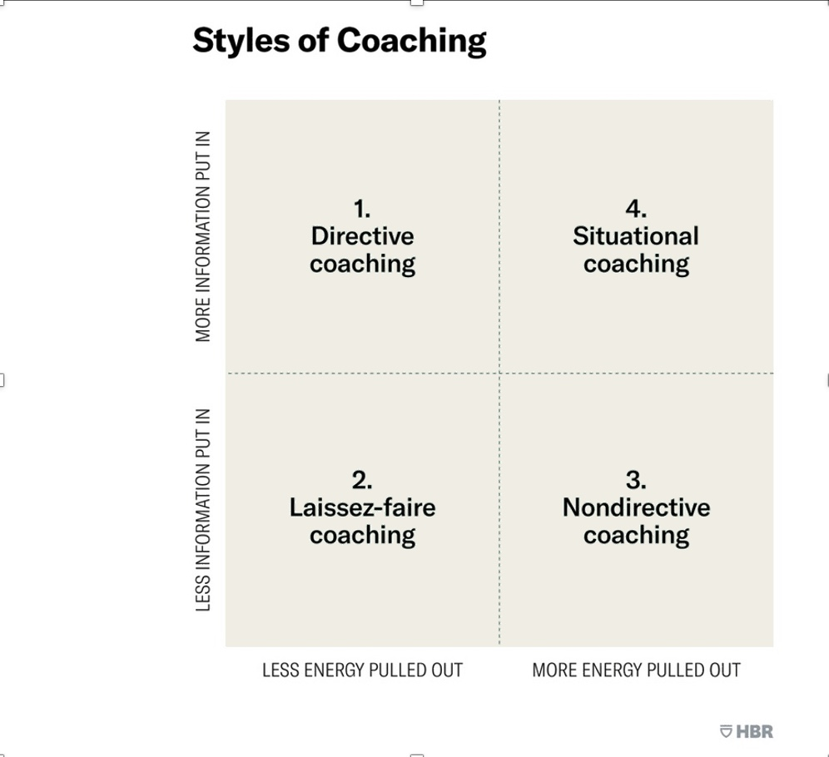

Styles of Coaching
Source: Harvard Business Review
Notes:
There is clearly more than one style of business coaching and it is often situational …
Directive
The directive approach is a process of telling, teaching or giving of feedback. It involves the sharing of knowledge that has accumulated over the years while the recipient listens and hopes to absorb as much as possible. This method is important where a person needs to have information or know-how. ….The non-directive approach is based upon listening, questioning and withholding judgement. This process helps others learn to resolve their problems and cope with challenging situations on their own. It is used to draw wisdom, insight and creativity and is highly energizing for the employee and helps build a sense of empowerment and ownership.
Situational - The situational approach is a balance between directive and non-directive styles. This optimal approach requires coaches to solicit ideas, needs or views from the employee. They will then help the employee find the answers they need and may also offer ideas or information as needed. Last, Laissez-Faire
The laissez-faire approach is hands off. Neither push nor pull behaviors are used significantly and the recipient is allowed to do things for themselves. Individuals will access support as and when it is needed. For the most part, the coach will take a step back and monitor progress.

Slide 16
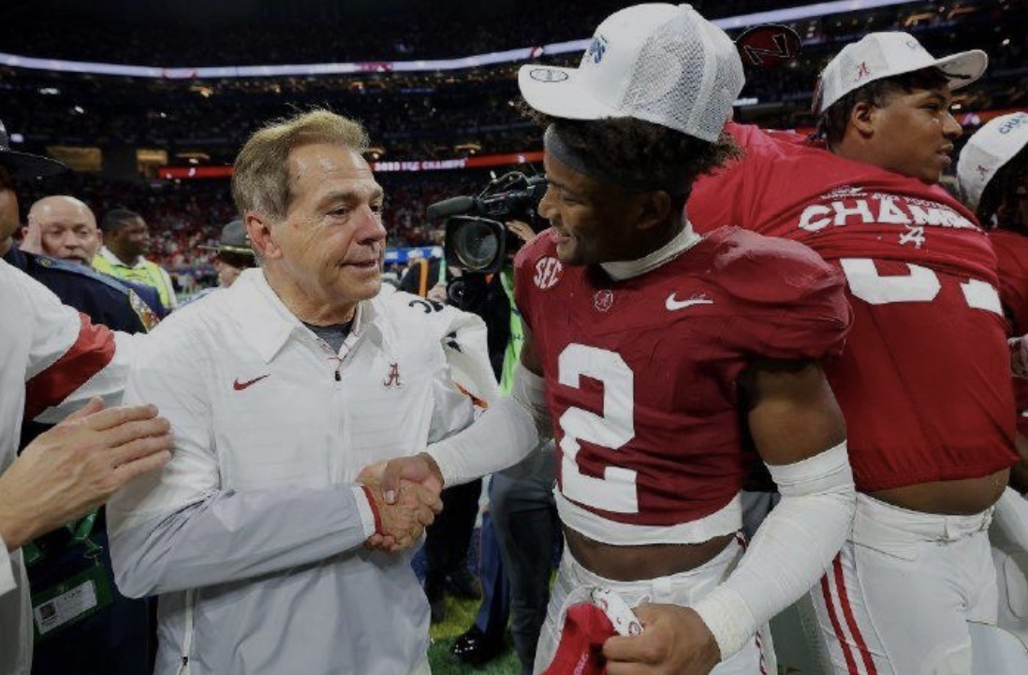
Notes:
Most of you know I live in Alabama and I could not speak on coaching skills without mention of Alabamas coach Nick saban…. What stands out for me about his coaching which applies to any business environment also is his genuine concern for the players welfare… player after player testifies to his genuine concern not only for their immediate football success but the long-term of character that he drove to all players. it’s also interesting to note that the major criteria for retiring this past year is that that intimacy and ability to coach , teach and mentor over the long term has been largely lost due to the college football portal and the NIL pay for play system that has players moving between teams frequently and the inability to create a long term relationship….

Slide 17
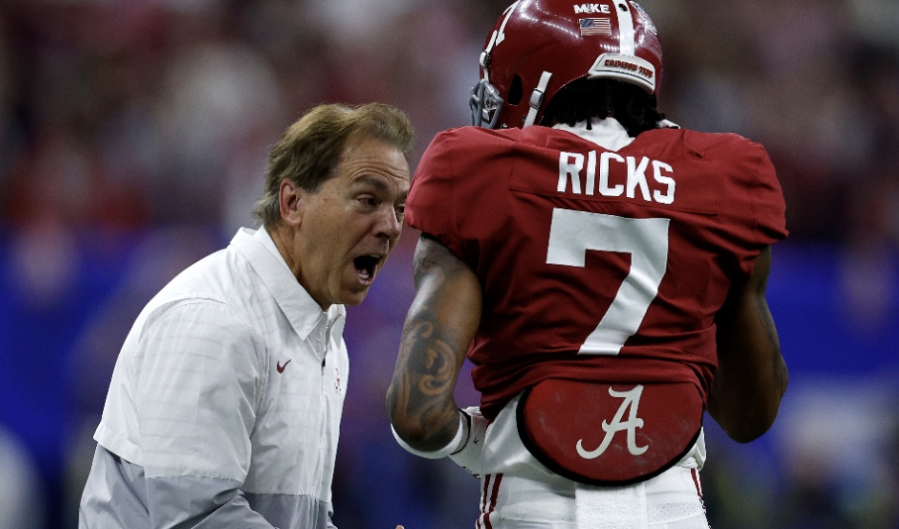
Notes:
Although tough , demanding, unapologetic for his systematic approach to coaching.. His players always knew he had their best interest at heart.. That level of trust and confidence allowed him to coach, teach and mentor player to be the best they could be….. Its hard to be an effective coach even in a business environment without creating some level of intimacy with those who you coach while still keeping the relationship professional. Saban did that as well, consistently year after years as well as any coach…

Slide 18
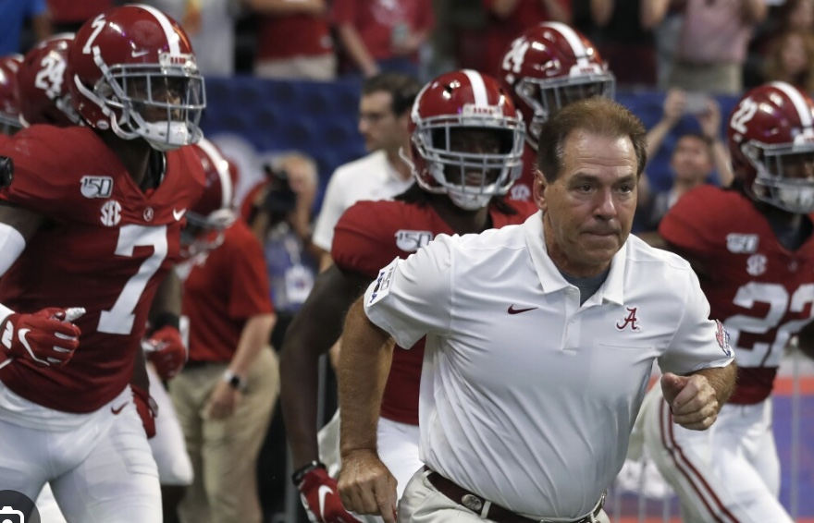
WTKR
Notes:
it’s also interesting to note that the major criteria for retiring this past year is that that intimacy and ability to coach , teach and mentor over the long term has been largely lost due to the college football portal and the NIL pay for play system that has players moving between teams frequently and the inability to create a long term relationship…. Coaching but especially mentoring is the long game…. You are building skills, values, character and virtue over the long haul….. Building future leaders. A point for all of us to consider as we embark on a coaching and mentoring effort.

Slide 19
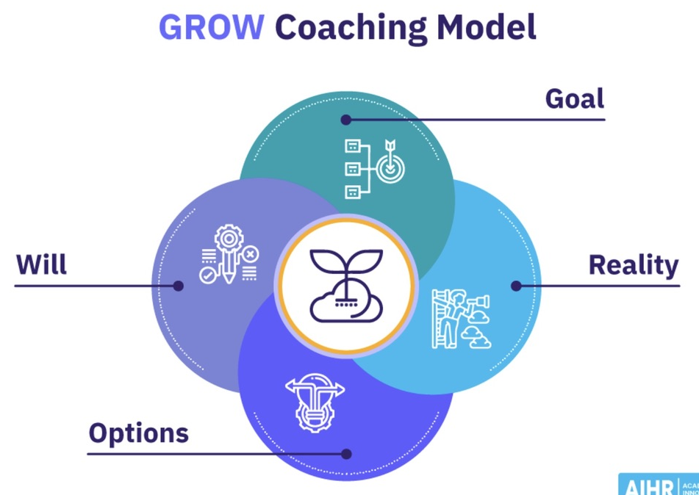
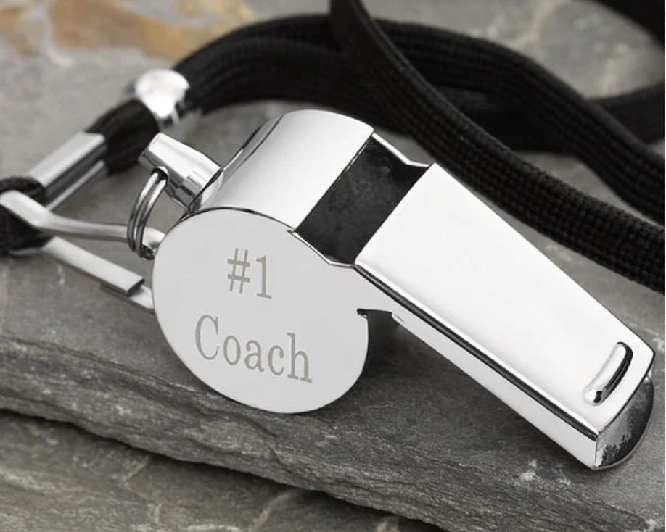
Source: The Leader as Coach, Herminia Ibarra and Anne Scoular, Dec. 2019
Notes:
The GROW model was devised in the late 1980s as a way of training yourself to think in new ways about your role and value as a leader. It emphasizes the needed to listen, question and draw insights out of the people you supervise. The four steps are:
Goal, Reality, Options and Will

Slide 20

The Grow Model for Coaching
Source: The Leader as Coach, Herminia Ibarra and Anne Scoular, Dec. 2019
Goals – the coach helps employee determine goals
( Smart Goals )– Specific, measurable, achievable relevant, timebound
Reality – coach ask questions to identify the employees weaknesses / challenges
Options – Coach and employee brainstorm different options and strategies to close gap between goals and reality
Will – coach helps draw action plan for achieving goals, identify specific steps, assigns responsibilities, set deadlines

Slide 21
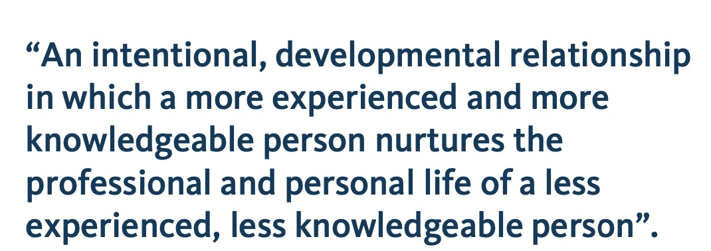
Mentoring Definition
Source: Gonzaga Organizational Development, 2022

Slide 22
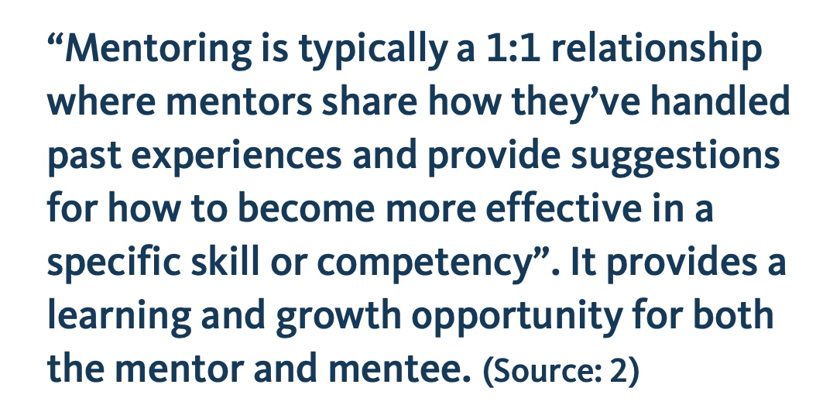
Mentoring Definition
Source: Gonzaga Organizational Development, 2022

Slide 23

Advisor - offers suggestions from personal experience or expertise. Strength - act as sounding board.
Protector - ensure mentee does not make career detrimental mistakes. Strength is offer a safety net.
Developer - to point out red flags Empowers to develop capability to solve their problems independently.
Broker - has strong network. Connects with learning opportunities, connecting to experts in different areas.
Challenger - play the devil’s advocate. Encourages mentees to come up with solutions, Vs. complaints.
Clarifier - act as guides and can provide valuable organizational info
Sponsor - open doors. Put mentee’s name forward for a promotion or new opportunity.
7 Types of
Business Mentors
Source: 15 Tips for Mentors, Ryan Curruthers, February 6, 2023
Notes:
Advisor - this type of mentor offers suggestions on what the mentee should do based on their personal experience or expertise. Their strength is their ability to act as a sounding board.
Protector - some mentors take on the role of protector over their mentee. Their goal is to ensure the mentee does not make a mistake that could be detrimental to their career. The strength of a protector mentor is that they offer a safety net for the mentee.
Developer - mentors that listen well and are eager to point out red flags for mentees are called "developers." This type of mentor empowers a mentee to develop the capability to solve their problems independently.
Broker - this style of mentoring is done by those with a strong network. The mentor will connect the mentee with learning opportunities by connecting them to experts in different areas.
Challenger - mentors who opt for the challenger style will play the devil’s advocate with their mentee. This encourages mentees to come up with solutions rather than complain about their issues.
Clarifier - for mentees who are more independent, a clarifier mentor would be a great fit. These mentors act as guides and can provide valuable organizational information for their mentees.
Sponsor - mentors who aim to open doors for their mentees are considered sponsors. These mentors will put a mentee’s name forward for a promotion or new opportunity.
Affirmer - these types of mentors are great listeners and provide a safe space for a mentee to discuss challenges. Affirmers are empathetic and understanding, which can boost the self-esteem of their mentees.

Slide 24
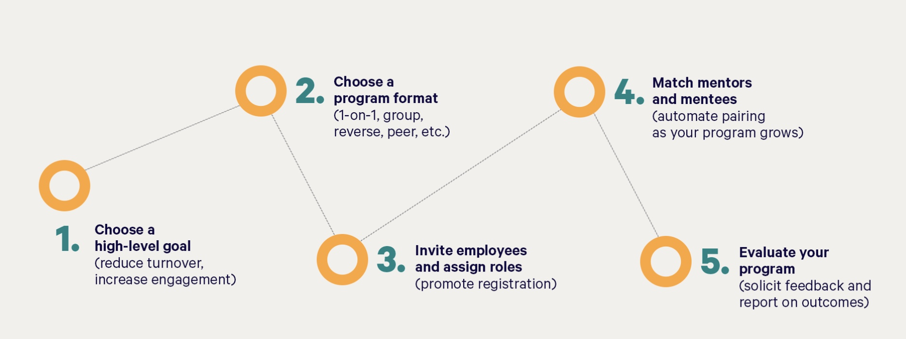
High level steps to starting
a mentoring program
Source: Together Website: 5-Step Guide To Start A Mentoring Program

Slide 25
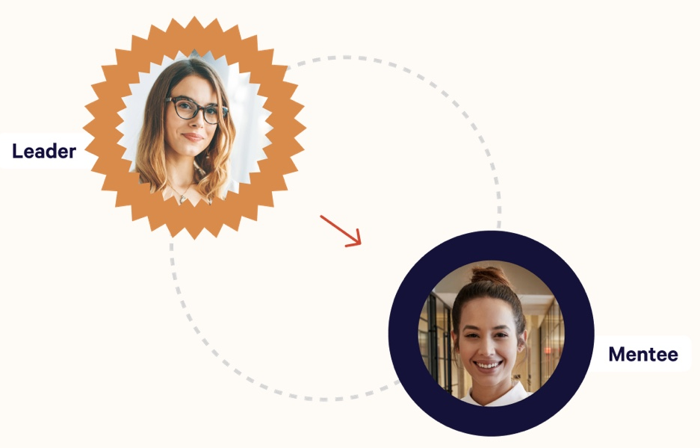


4 Mentoring Approaches
One-0n-One
Group
Source: Together Website: 5-Step Guide To Start A Mentoring Program

Slide 26
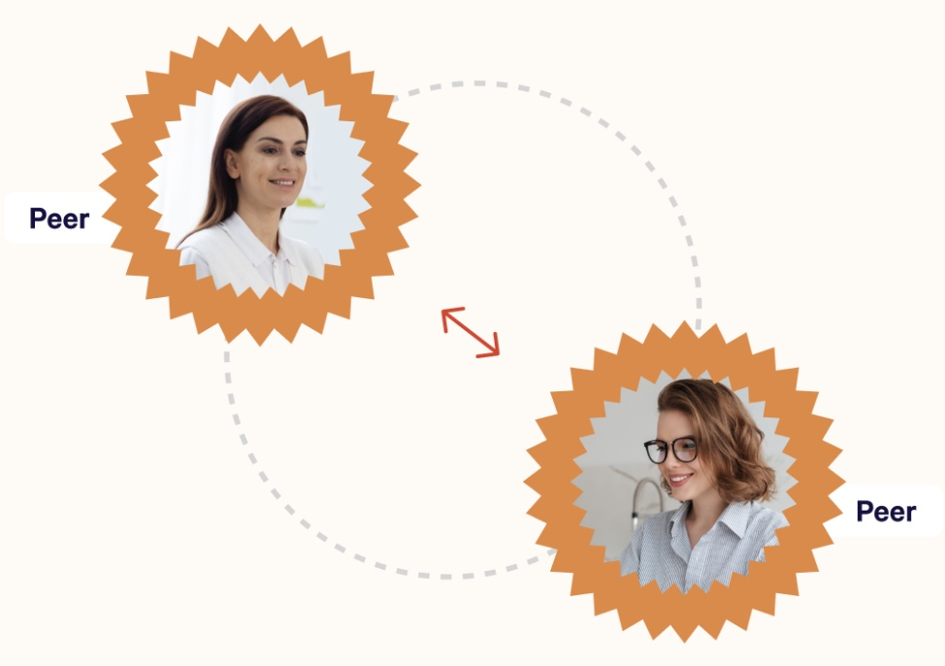
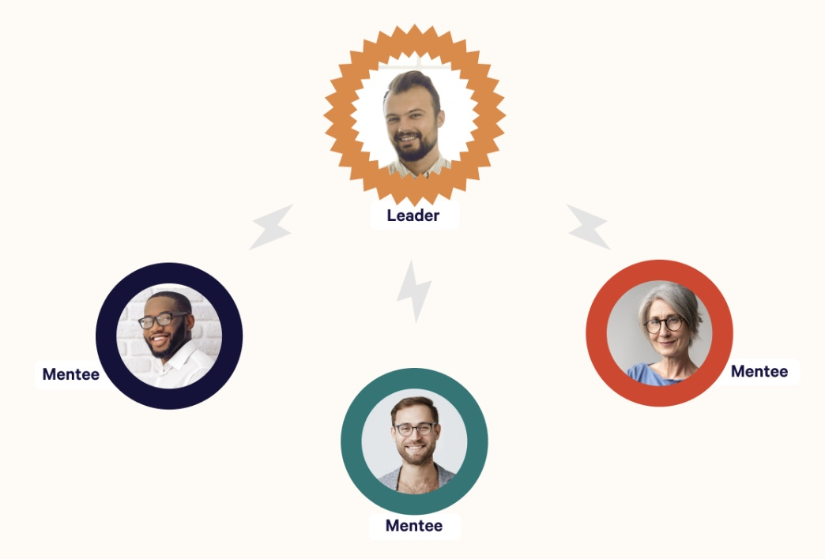
4 Mentoring Approaches
Peer- to Peer
Flash Mentoring
Multiples

Slide 27
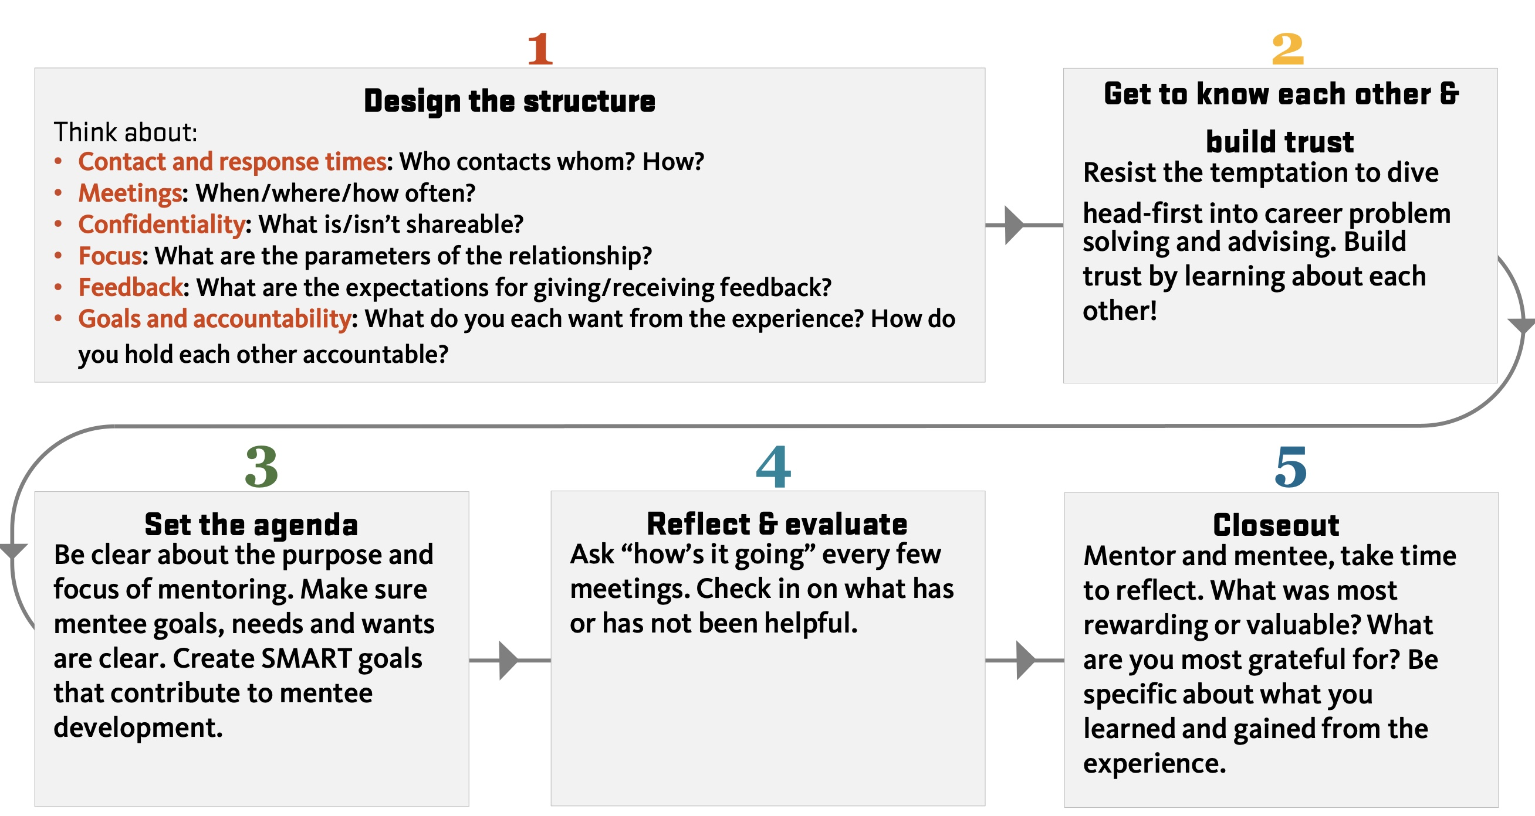
Structure of Mentoring Relationship
Source: Gonzaga Organizational Development, 2022
Notes:
If you want a quick look at how to structure the mentoring relationship this is a great 5 step guide…. Whithout going into the detail… you design the structure of the relationship, get to know each other, building trust, set an agenda and purpose and goals, review and evaluate progress regularly and as many relationship do come to an end you may want to officially take time to closeout and reflect on what was gained from the mentoring experience.

Slide 28
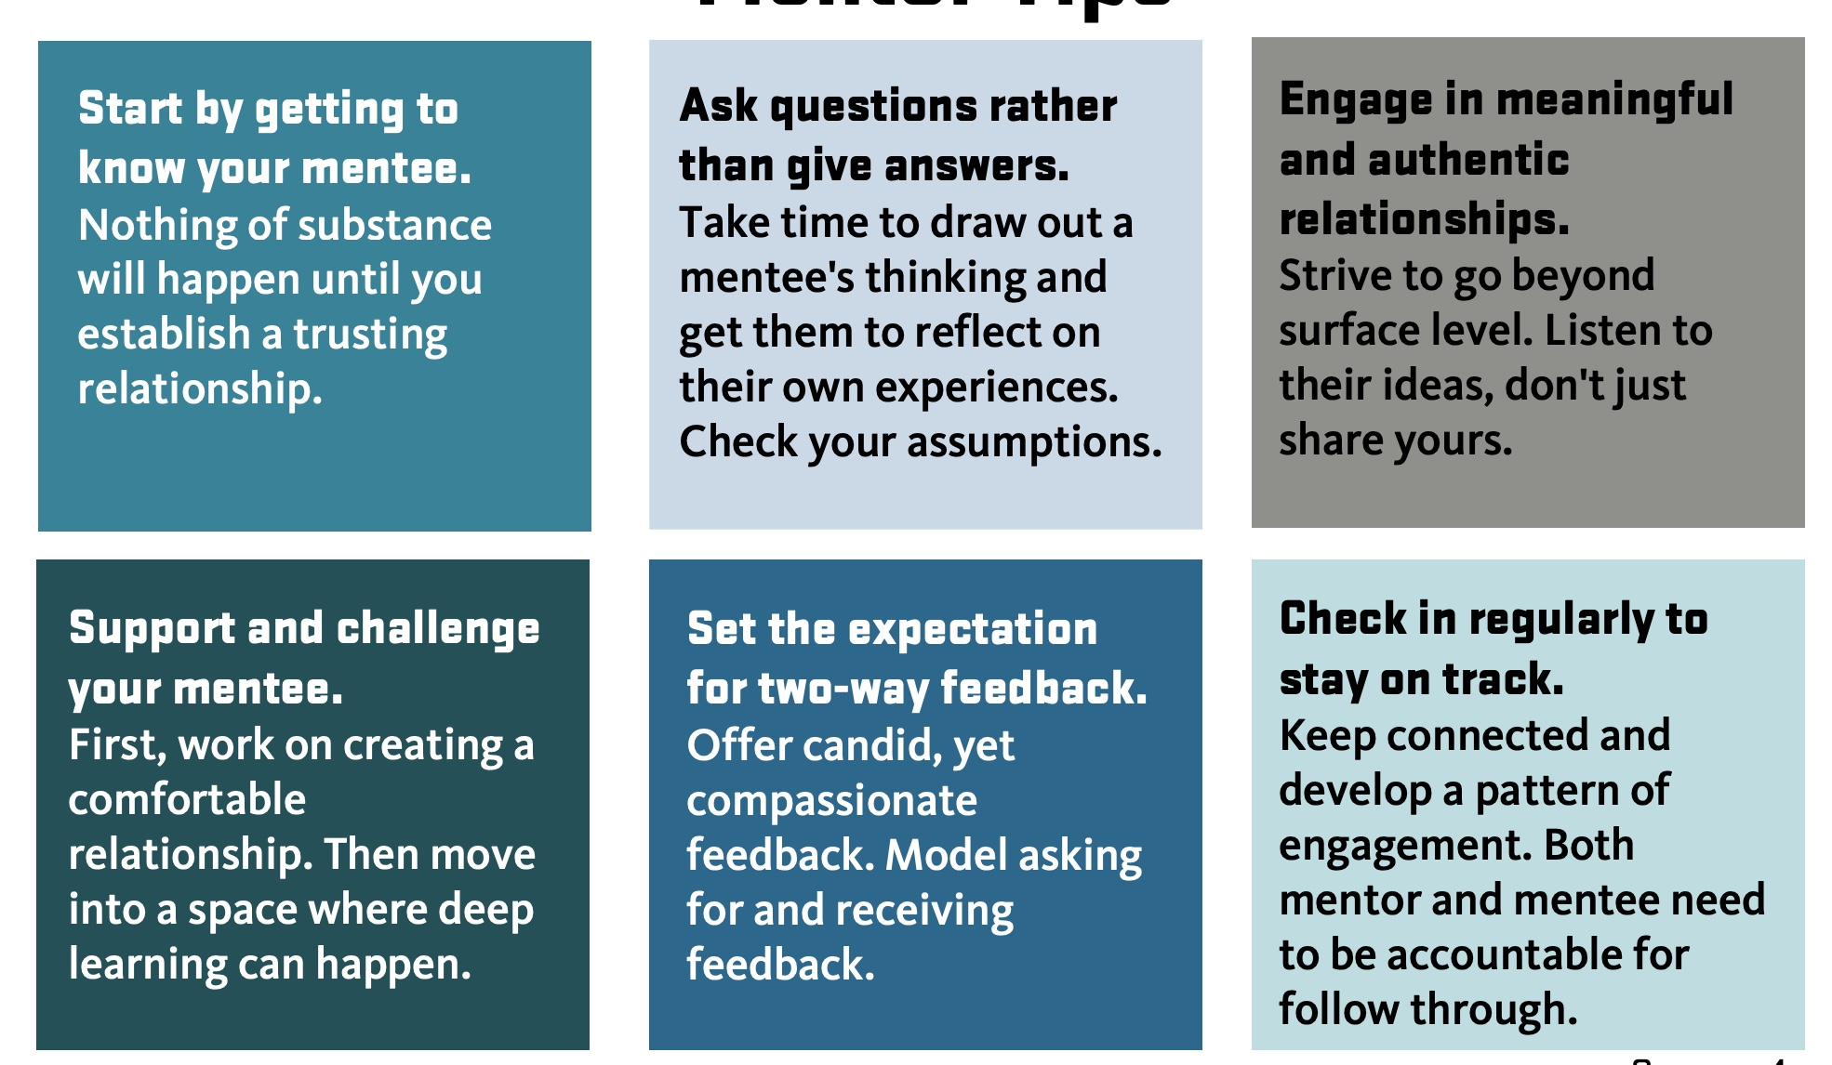
Mentor Tips:
Source: Gonzaga Organizational Development, 2022

Slide 29
Pick mentor who shares your values & definition of success
Find someone who attained specific goals you seek
Look for someone able willing to build new relationships
Select mentor with differences that challenge you
Meet with your potential mentor
How to
Choose A Mentor
Source: How To Choose a Mentor in 5 Steps, Indeed Editorial Team, June 24, 2022
Notes:
How to choose a mentor
Several factors are essential in making mentorship valuable for both parties. Both compatibilities and differences are important to consider, and both can add valuable attributes to the relationship. By finding the right mentor, you can build a solid foundation to make this new professional relationship as healthy and beneficial as possible. Here are some steps that can help you choose a mentor:1. Pick a mentor who shares your values and definition of success
When you're looking for expert advice, it's important to consider your own character traits and values and seek out someone who shares those with you. Some differences between you can help bring new perspectives, but shared objectives can enable you to build a strong relationship. If you and your potential mentor have the same goals for your work and your industry, you can more easily understand their approach, and they can tailor their advice to your specific situation.If there's someone in your network that you're considering as a mentor, you'll already know a little about whether the two of you are compatible. When you're looking to make a new connection, research into their career, professional connections and online presence can help you make an educated judgment about their values and motivations.Related: Character Traits: Definition and Examples2. Find someone who has attained specific goals that you are aiming for
Whether you are looking to change careers, move ahead in your current position or industry or give your career a strong start, it's important to think through the specific goals you'd like to achieve. Once you know what you are trying to do, you can narrow down your pool of potential mentors.If you're working toward a specific job title, you might find someone who fills and exceeds that position in a way that you admire. If your goal is to transition into a new field, it's a good idea to do some research about the career paths of potential mentors so you can find a model. When you're trying to start a new business or work for a specific company, someone who has done it before can guide you best.3. Look for someone able and willing to build new relationships
Both you and your mentor need to have the time and energy to build a new professional relationship. And as your mentoring relationship grows, a mentor who is active in your professional field can broaden your network and introduce you to more opportunities. They should be invested in your success, which can help you develop detailed goals and the steps to achieve those goals.At the beginning of your mentoring relationship, you may want to spend more time communicating with each other, whether it's in person or via phone or email. As you become more familiar with each other, you may only feel the need to check in occasionally. Considering the time investment throughout the relationship can ensure you both are committed and willing to work together.4. Select a mentor who has differences that can challenge you
While compatibility is important, it's also helpful to think about how a mentor can help you grow in new ways. If you have a professional challenge or weakness, a skill you are looking to master or a new field you'd like to work in, try to find someone who has mastered that. They can help you grow in that area by giving you the specific tips and resources that their own personal experience has given them.In addition to diverse abilities, consider looking for a mentor who has a different approach or background than your own. In a relationship founded on shared professional values, a diversity of experiences can help you both integrate more mindfulness into your professional processes and see new solutions to your challenges.Read more: How To Ask Someone To Be Your Mentor5. Meet with your potential mentor
When you've found a potential mentor, have a meeting to get to know them before officially asking them to be your mentor. A conversation over an in-person lunch or coffee can help you double-check your compatibility and see how closely their personality matches what you found out through your research. This meeting can also be a great time to talk about what they're looking for in a mentee and whether that fits your personality and career stage.

Slide 30

Seeking a Mentor
Join professional communities in your field
A mentor will have something in common with you.
May work in the same industry.
To find a good match, expand your contacts.
Join groups and professional communities in your field
Leading to discovering ideal mentor.
Source: Radical Candor: 7 Reasons Mentorship is Integral to Growing Career
Notes:
How can you and your employees , family and friends seek seek a mentor.
You can Join professional communities in your field. A mentor will ideally have something in common with you. For example, they may work in the same industry. To find a good match, expand your contacts. Joining groups and professional communities in your field can help you grow your network, leading to discovering an ideal mentor

Slide 31
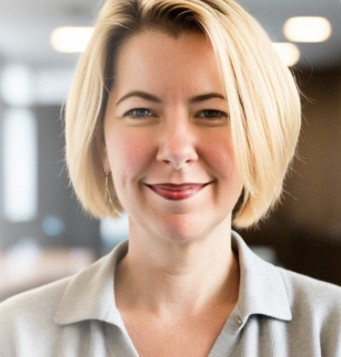
Seeking a Mentor
Don’t look to your direct manager
Role supervisor is to insure the team meets goals.
Supervisor not solely focused on your career journey.
May play a key role in your development
Consider third party for mentorship.
Gives you a different perspective that can be beneficial.
They’re like a coach.
Source: Radical Candor: 7 Reasons Mentorship is Integral to Growing Career
Notes:
You most likely don’t want to look to your direct manager, but someone at a higher level or even outside your work space.. The role of a supervisor is to make sure that the team meets its goals. They often are very good coaches. But they are not entirely focused on your career journey. Your boss may play a key role in your development, but it’s best to seek a third party for mentorship. It gives you a different perspective that can be beneficial.

Slide 32
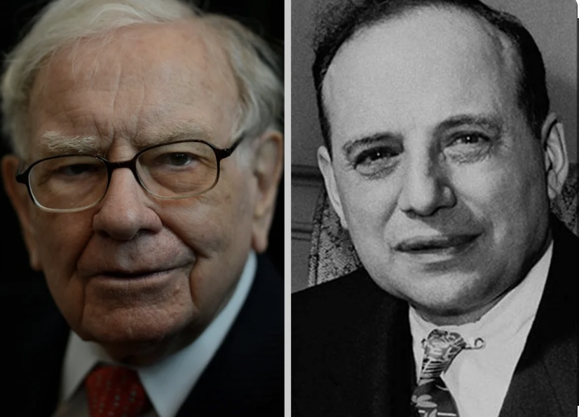
Characteristics of Excellent Mentors
Good listener/sounding board
Flexible
Value diversity of perspectives
Knowledgeable
Nonjudgmental
Able to give constructive feedback
Honest and candid
Able to network and find resources
Successful in career
Willing to devote time to developing others
Eager to learn
Source: ASHA Partners
Warren Buffet
Benjamin Graham
Mentor
Notes:
A mentee-mentor relationship entails work, commitment, and follow-through on both sides if it's going to be successful. Consider the following traits to assess your mentoring skills and areas that you wish to develop to ensure that the mentoring you offer is effective and has lasting value.
Good listener/sounding board
Flexible
Value diversity of perspectives
Knowledgeable
Nonjudgmental
Able to give constructive feedback
Honest and candid
Able to network and find resources
Successful in career
Willing/able to devote time to developing others
Eager to learn

Slide 33
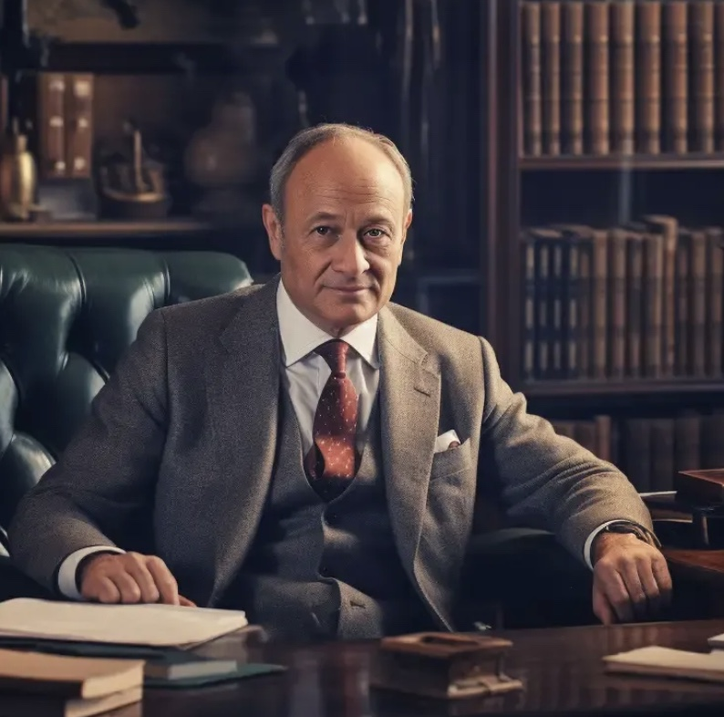
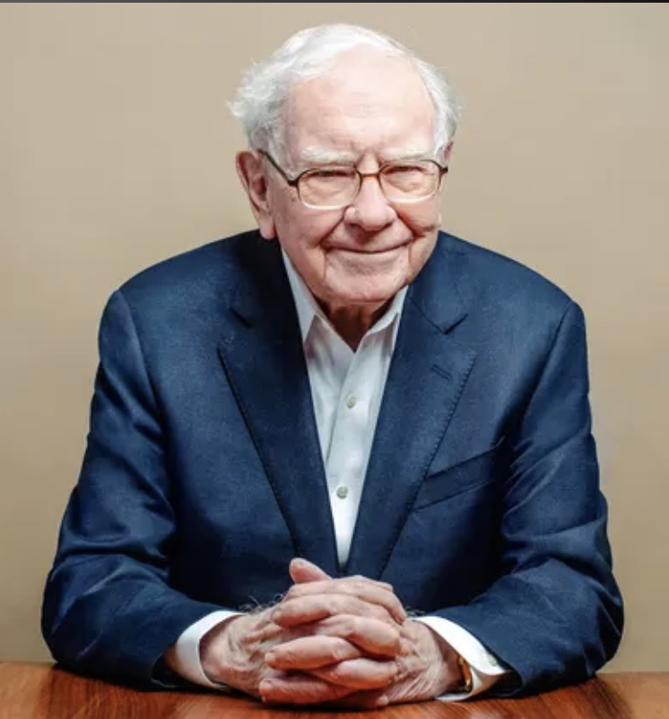
Three Life Lessons from Mentor:
Do something Foolish
Do something Creative
Do something Generous
Mentoring Advice Example:
Graham to Buffet
Notes:
So what does great mentoring advice look like… so for one famous and highly successful mentoring relationship. Warren Buffets college professor and mentor Benjamin Graham gave him this advice. 1, Do something foolish….Graham mentored buffet that it’s not great intelligence but the ability to disregard the mob fears and enthusiasm and focus on a few simple fundamentals which will require a willingness to be patient and sometimes look unimaginative or even foolish is essential. 2. Do something creative. Graham advised that anyone can be creative as long as you are willing to push beyond borders and think outside the box. Buffet was able to absorb Grahams lessons and advance then even further with his own creative ideas.
3. Do something generous – Graham provided an example of an absolute open-ended no-scores kept generosity of ideas, time and spirit. If clarity of thinking was needed, Buffet learned Graham was the place to go. Buffet has famously adopted this advice with a generosity of his own. So that’s what great mentoring looks like… Graham was a great mentor with great life advice… buffet was a good student who has applied his mentors advice in an extraordinarily successful manner.

Slide 34
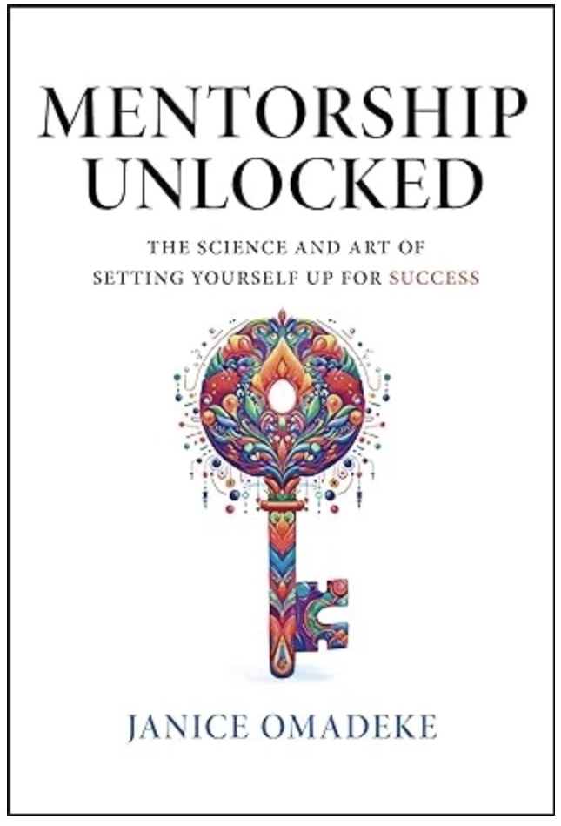
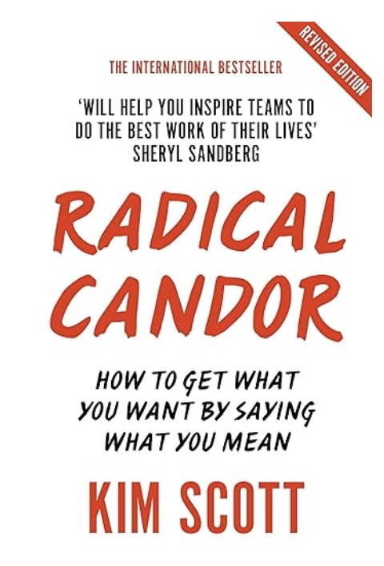
Notes:
If you want some reading on mentoring and seeking mentors…. You may consider these two books to on the subject. Which may also be good reading for your leadership team and next level of supervision to deepen their knowledge and ability to mentor and seek mentors…. All will enhance your employees development, your ability to create a company of mentors, and unlock hidden employee potential

Slide 35




Set Mentoring Goals
1
Reduce employee turnover
2
Employee succession
3
Promoting diversity and inclusion
4
Increased engagement among employees
Notes:
If you are interested in launching a company wide mentoring effort you need to set specific goals for your mentoring program… your goals may look something like this which are common needs in many businesses. …. You may be focused on reducing employee turnover… or creating a plan for employee and leadership succession. Possibly a goal of promoting diversity and inclusion or simply and we hear this often at saint John Leadership Network…. Mentoring to Increased engagement among employees. Whatever your goal mentoring is certain to enhance your employee capabilities, knowledge and ability to more greatly contribute to the success of your company…. And create more satisfied, dedicated and capable employees.

Slide 36
August Release:
Father Nathan Cromly
Coached by Paul the Apostle
Lessons in Transformation
Notes:
SO I will end where we started… and that is that coaches and mentors are invaluable in the lessons they can teach…. As a business leader I hope that you have a great coach and mentor…. if not its never to late to build that essential relationship… and as a business leader I hope you are already formally acting as coaches and mentors to others… and if you have not… you may want to consider a formal mentoring program at your company, the benefits are numerous. Also keep in mind we are focused on business but we should not limit ourselves to just one coach or mentor… we can have mentors in various aspects of our lives, business, family, faith, etc…. Its great to have an active relationship with our mentor, but we should also be reminded we can still garner advice and coaching lessons from those that came long before us….. Like Saint Paul . If you haven’t read Fathers new book , I highly recommend the coaching advice you will find their to enhance your spiritual life. Like to now open for your comments, recommendations and your experiences on how coaching and mentoring has influenced your leadership and your advice to the group on building coaches and mentor programs within your business.

Slide 37
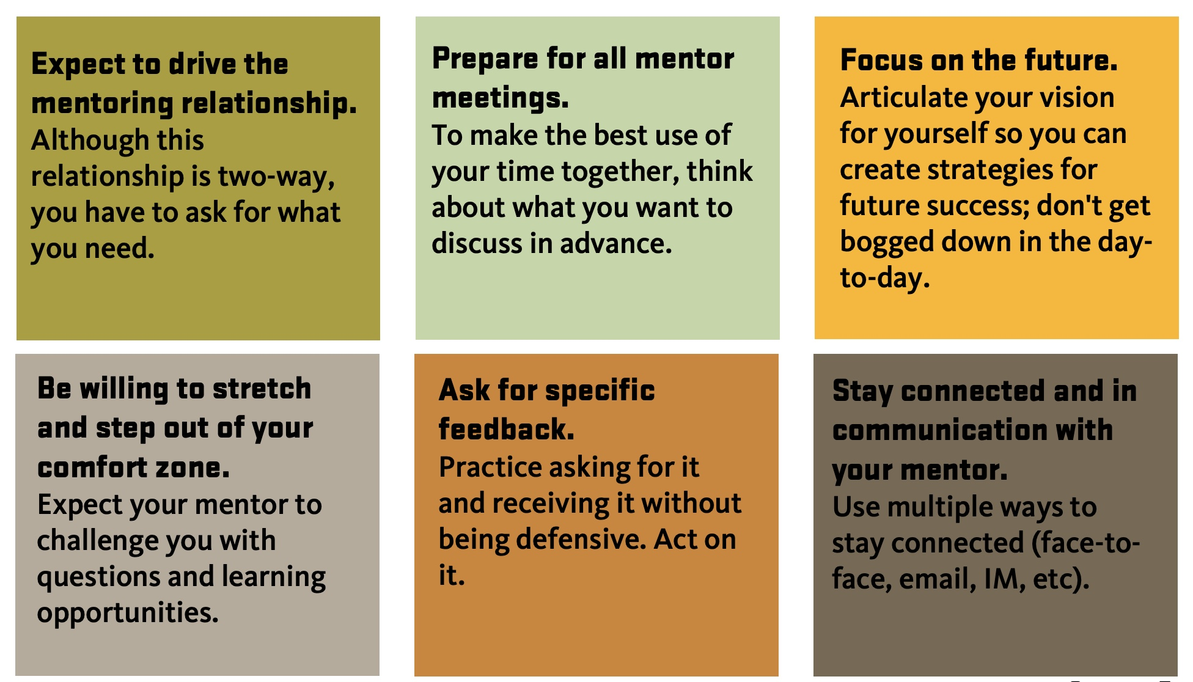
Mentee Tips:
Source: Gonzaga Organizational Development, 2022

