Slide 1
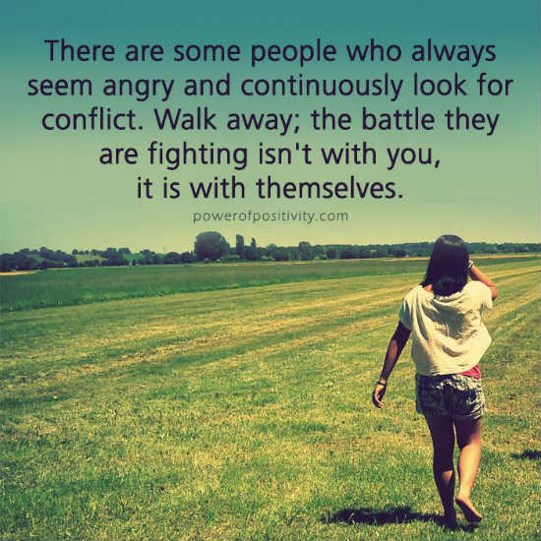
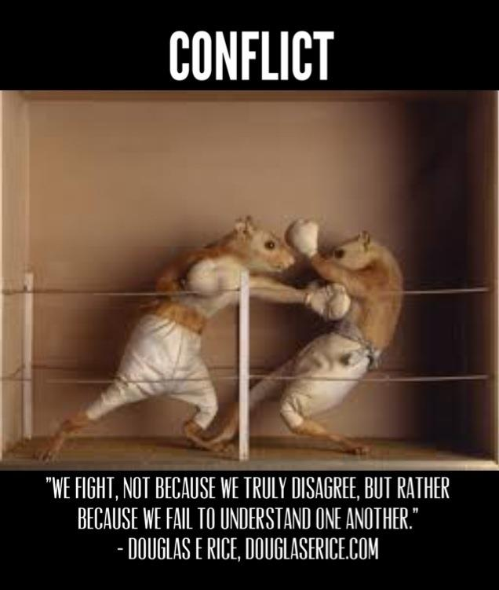
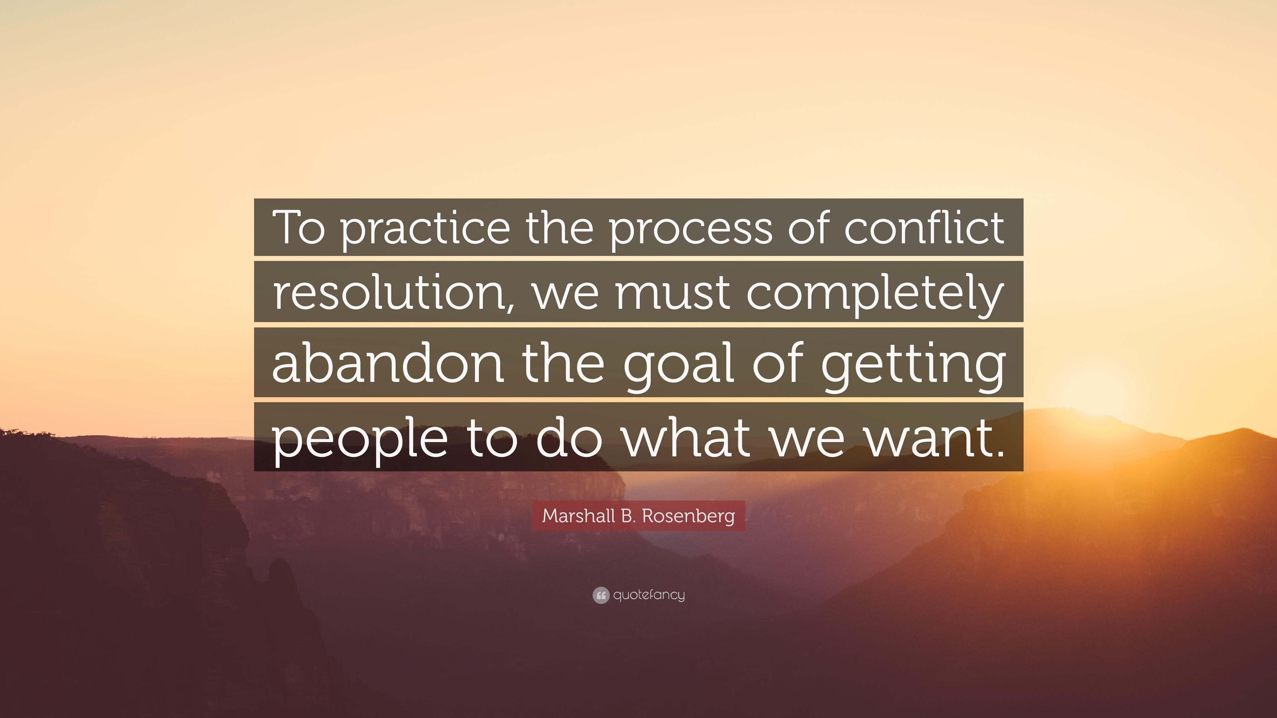
CONFLICT

Slide 2

TYPES OF WORKPLACE CONFLICT
Task based conflicts
Work-style conflicts
Conflicting priorities
Leadership conflicts
Personality-based conflicts
Strategy and business conflicts
Professional conflicts – example – two doctors having different approaches to treatment
Cultural conflicts
And?

Slide 3
Impact of Unresolved Conflict
Mayo Clinic article: conflict events between caregivers had potential negative impacts on pt. care.
UK – 38% of workers reported a work conflict
85% of employees experience some kind of conflict
• 29% of employees nearly constantly experience conflict
• 34% of workplace conflict happens among employees on the front line
• 12% of employees say they often see conflict within the senior team
49% of workplace conflict happens as a result of personality clashes and egos
• 34% of workplace conflict is a result of workplace stress
Conflict resolution works about 80% of the time
U.S. employees spend 2.1 hours per week in conflict, which amounts to 385 million working days.
57% of employees have witnessed confrontational workplace conflicts that have resulted in personal insult or injury.
3 out of 4 employees believe that their direct manager could manage workplace conflict more effectively.
Over 33% of conflicts are about resolving differences in style or strategy.
40% of employees find that their workplace conflicts were due to workload tensions.
42% of a manager’s time is spent managing conflicts.
Over 65% of performance problems result from strained relationships between employees, not from incompetence.
Conflicts in the workplace account for one-third of employee resignations.
88% of employees believe that unresolved conflicts lead to unhealthy work environments.
72% of employees in the workplace see a positive outcome from conflict.
Unresolved workplace conflict can negatively impact a company’s success rate by 20%-30%.
1. Mayo Clin Proc Innov Qual Outcomes. 2019 Mar; 3(1): 43–51.
Published online 2019 Feb 26. doi: 10.1016/j.mayocpiqo.2018.11.003
2. Pollack Peacebuilding Systems,”Workplace Conflict Statistics” https://pollackpeacebuilding.com/workplace-conflict-statistics/
3. https://zipdo.co/statistics/workplace-conflict/

Slide 4
What Kind of Conflict is It? Diagnostics…
What are the parties saying the conflict is? Is that the real issue?
Is the conflict impacting : others, the department(s), the organization’s values, productivity, the work climate, rules?
Is the conflict likely to get worse without intervention?
Is it causing others to get involved and take sides?
Is there egregious behavior that should addressed now?
If the parties aren’t capable of solving their conflict, what steps will you take to help them resolve this conflict?
Do you need to get a neutral facilitator to make conflict resolution easier?

Slide 5
Before Your Conflict Gets Worse…Some Thoughts
Seeking compromise
Taking the other person’s perspective
Being humble – letting your issue go if it’s not essential
Forgiveness
Accepting responsibility for your part
Is the ROI there to address the conflict? What are unintended consequences?
Will failure to resolve the conflict hurt the organization, team, and people?
Talk to your best and wisest friend (who is NOT in your workplace…)

Slide 6
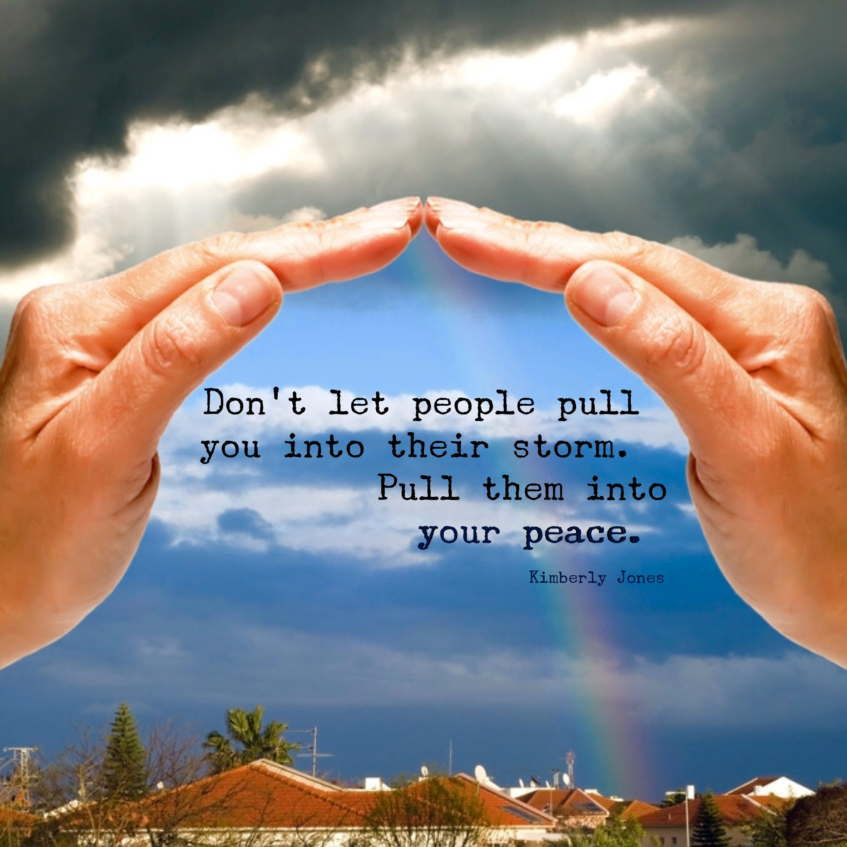
Five Approaches to Conflict Resolution
Avoiding
Compartmentalize the disagreement
Stay out of conversations that will restart the conflict
Listen more and remain calm
Live with minor consequences
When: the stakes are either not high, or are VERY HIGH

Slide 7

Five Approaches to Conflict Resolution
Accommodation
Giving in to other person as a conscious decision
When you need to demonstrate maturity and level-headedness
Use when long term effects of a real conflict are BIG
Must be authentic
Can create a better relationship
NOTE: Accommodation will not stop bullying

Slide 8

Five Approaches to Conflict Resolution
Competing
When outcomes are really at stake for the org.
Rules are known and fair
The parties agree that there will be winners and losers
Examples: Sales force incentives; bonuses, contests of talent or abilities in the organization; deadlines that really matter
When the outcome does not hurt the loser(s) except perhaps their pride
Must be a bit playful

Slide 9
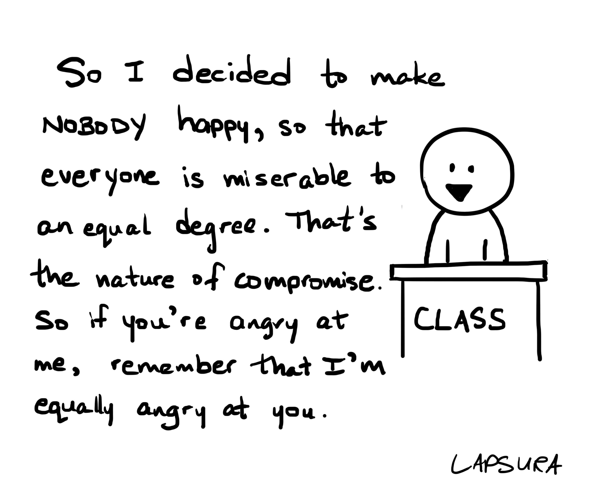
Five Approaches to Conflict Resolution
Compromising
Both parties gain and both give something up
Rules known and fair
Everyone wins something
Very useful in negotiations when life and death isn’t at stake

Slide 10

Five Approaches to Conflict Resolution
Collaboration
Most difficult
Great for new endeavors
Goal is aspirational
Must share goals and incentives
Equitable relationships exist
Trust is present
Mutual respect for one another

Slide 11

The Decision to Step Back and Focus on the Future
Is the bigger picture more important than I thought?
What is the impact for me/us in the long run of not resolving the conflict?
Imagine the “good of the other” and their perspective as equally valuable.
Research: “Participants who focused on the future had less blame, greater forgiveness, and greater insight. The more participants used these cognitive strategies, the more they reported feeling positive emotions. And were optimistic about the relationship getting better”.
HBR, “To Defuse and Argument, think About the Future”, Alex C. Huynh, January 23, 2017.

Slide 12
STEPS TO RESOLVING CONFLICTS USING FACILITATOR (YOU!) BEFORE THE MEETING
PREPARATION:
It is important to let the two people know that the conflict is impacting the work and other people, so it must be resolved.
Ask the parties, individually, to write out “what is the conflict” and “why is it a conflict?”. The parties share their written statement with the facilitator.
Facilitator talks with each party separately to fully understand the nature of the conflict and asks each person to be ready to solve the problem. Ask them to bring 1-2 solutions into the meeting to resolve the conflict.
A meeting of 3 hours is set for the conflict resolution
Find a comfortable and small, private setting to have the meeting.

Slide 13
STEPS TO RESOLVING CONFLICTS – THE MEETING
Set ground rules – respect, listening, seek to understand
Ask each person to describe the conflict with “I” statements – each party gets as long as needed to describe the conflict, with no interruptions.
Ask the other person what they heard (each). Allow the other party to ask questions once the first person has completed their story.
Leader: summarize what you have heard and obtain agreement on the top issue/issues. Ask for agreement or modification.
Leader: ask each person in turn what is at stake if the conflict continues?
Leader: ask each person – what becomes possible if resolution is found? To their career? Their enjoyment of their job? Their happiness?
          TAKE A BREAK

Slide 14
STEPS TO RESOLVING CONFLICTS – THE MEETING
5. Invite solutions one person at a time: discuss all options in a positive manner. Chart these.
6. Rule out options that participants agree are unworkable.
7. Summarize the remaining solutions. Ask- are these the solutions we should discuss? Are you open to them?
8. Ask each person in turn: what are you willing to do to end this conflict? What options can you fully support?
9. Facilitate agreement on best option (s) to resolve the conflict
10. Ask each person to apologize (if needed); summarize next steps.
11. Ask the two people to jointly write up their plan, that day, provide it to you, and agree to meet regularly to gauge progress and give feedback to each other.
12. Revisit the parties in one week, together. Revisit again in two weeks.

Slide 15

IF IT’S THE BULLY CAUSING ALL THE CONFLICT… COACHING IS NOT THE ANSWER
Special circumstances:
- psychopathic behavior (lies, stirs conflict, destroys reputations, hurts those with lesser power….) This is abuse and must be dealt with.
- Do not tolerate bullies, liars, or dominators – you MUST “act to closure”. Or you are part of the problem.
- May need support and partnership with your supervisor
- Special issue – what if it is a high ranking executive, way past your pay grade?

Slide 16
Some Parting Thoughts…On Your Role
If You Address Conflict…
- There’s a good change things will change for the better
- You will get more respect from your team
- The team will be free of the secondary impacts on morale and productivity
- Two people will have learned to work together with respect
- The culture will be improved – aiding retention
If You Avoid Conflict Resolution
- Morale will suffer
- The team will be fractured
- Productivity will be reduced
- There is organizational risk in some situations – such as violence
- There will be less respect for you
- People will migrate out of a toxic environment
- The culture will be harmed, lessening retention

Slide 17
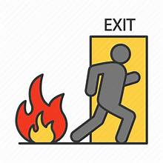

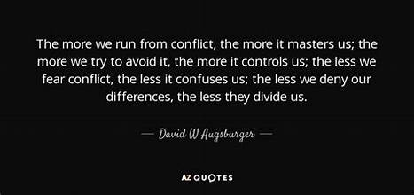
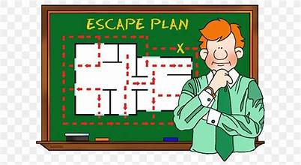
WHAT CONFLICT ARE YOU NOT ADDRESSING?

